Slide 1
Community Detection in stochastic block models via spectral methods
Laurent Massoulié (MSR-Inria Joint Centre, Inria)
based on joint work with:
Dan Tomozei (EPFL), Marc Lelarge (Inria), Jiaming Xu (UIUC)

Slide 2








Community Detection
→ Identification of groups of similar objects within overall population
→ Closely related objectives: clustering and embedding
Profile space

Slide 3
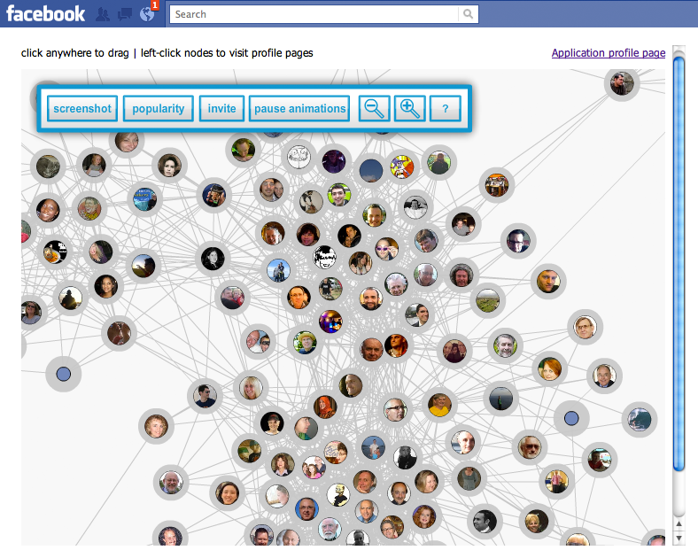
Application 1: contact recommendation in online social networks
Supporting data: e.g. OSN’s friendship graph
→recommend members of user’s implicit community

Slide 4
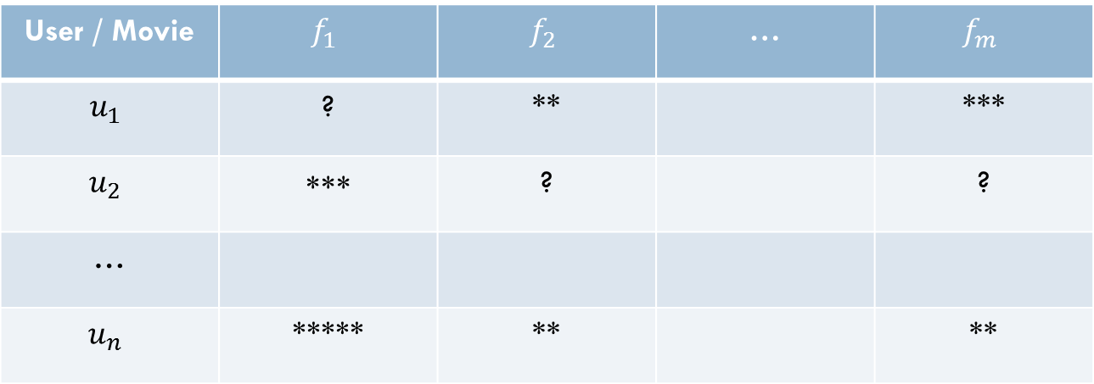
Application 2: content recommendation to users of Netflix-like system
Supporting data: user-content ratings matrix
Use content communities to support recommendation
“users who liked this also liked…”
User / Movie | $$f_{1}$$ | $$f_{2}$$ | … | $$f_{m}$$
$$u_{1}$$ | ? | ** |  | ***
$$u_{2}$$ | ∗∗∗ | ? |  | ?
…
$$u_{n}$$ | ***** | ** |  | **

Slide 5
Outline
  The Stochastic Block Model
    With labels
    With general types
  Performance of Spectral Methods
    “rich signal” case
  The weak signal case: sparse observations
    Phase transition on detectability
    A modified spectral method

Slide 6
Outline
  The Stochastic Block Model
    With labels
    With general types
  Performance of Spectral Methods
    “rich signal” case
  The weak signal case: sparse observations
    Phase transition on detectability
    A modified spectral method

Slide 7






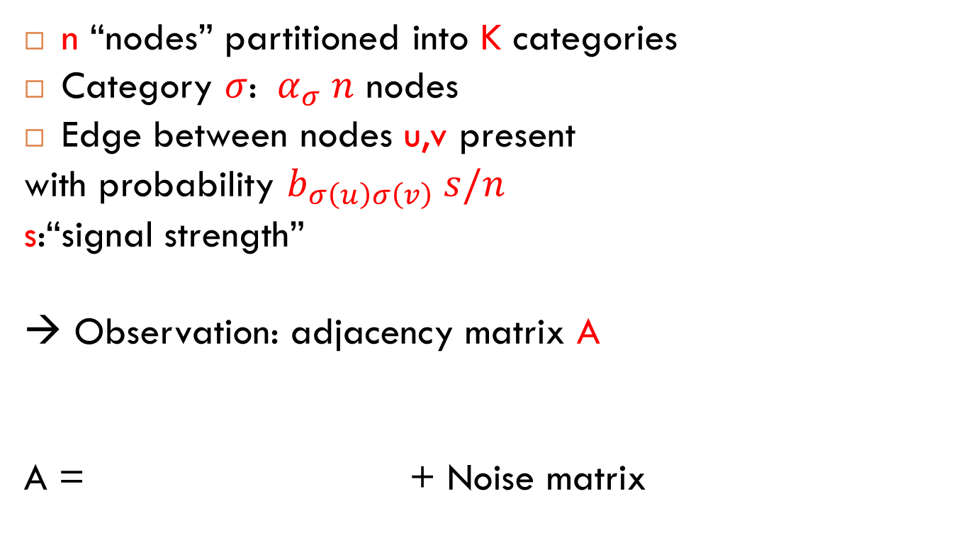
The Stochastic Block Model
[Holland-Laskey-Leinhardt’83]
n “nodes” partitioned into K categories
Category $σ$: ${ α}_{σ} n$ nodes
Edge between nodes u,v present
with probability $b_{σ\left(u\right)σ\left(v\right)} s/n$
s:“signal strength”
→ Observation: adjacency matrix A
A = + Noise matrix

Slide 8



The Labeled Stochastic Block Model
Edges (u-v) labeled by L_{uv} ∈ L (finite set)
Drawn from distribution $μ_{σ\left(u\right)σ(v)}$
Netflix case: labels 1-5 stars

Slide 9
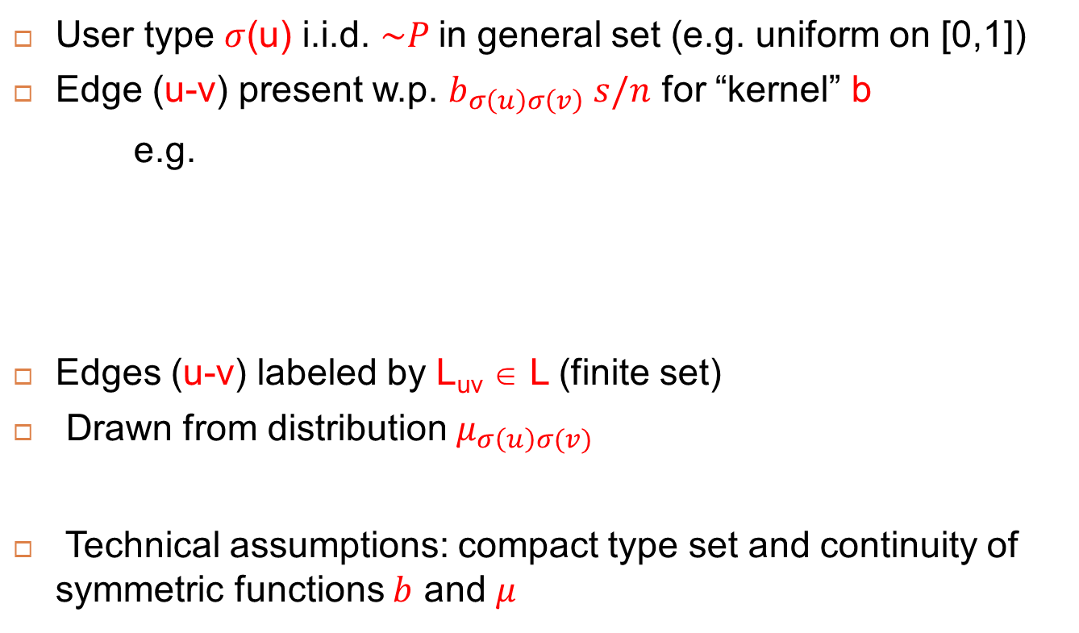
The SBM with general types
[Aldous’81; Lovász’12]
User type $σ$(u) i.i.d. $\sim P$in general set (e.g. uniform on [0,1])
Edge (u-v) present w.p. $b_{σ\left(u\right)σ\left(v\right)} s/n$ for “kernel” b
e.g.
Edges (u-v) labeled by L_{uv} ∈ L (finite set)
Drawn from distribution $μ_{σ\left(u\right)σ(v)}$
Technical assumptions: compact type set and continuity of symmetric functions $b$ and $μ$
F(x)
x
-1
+1

Slide 10
Outline
  The Stochastic Block Model
    With labels
    With general types
  Performance of Spectral Methods
    “rich signal” case
  The weak signal case: sparse observations
    Phase transition on detectability
    A modified spectral method

Slide 11
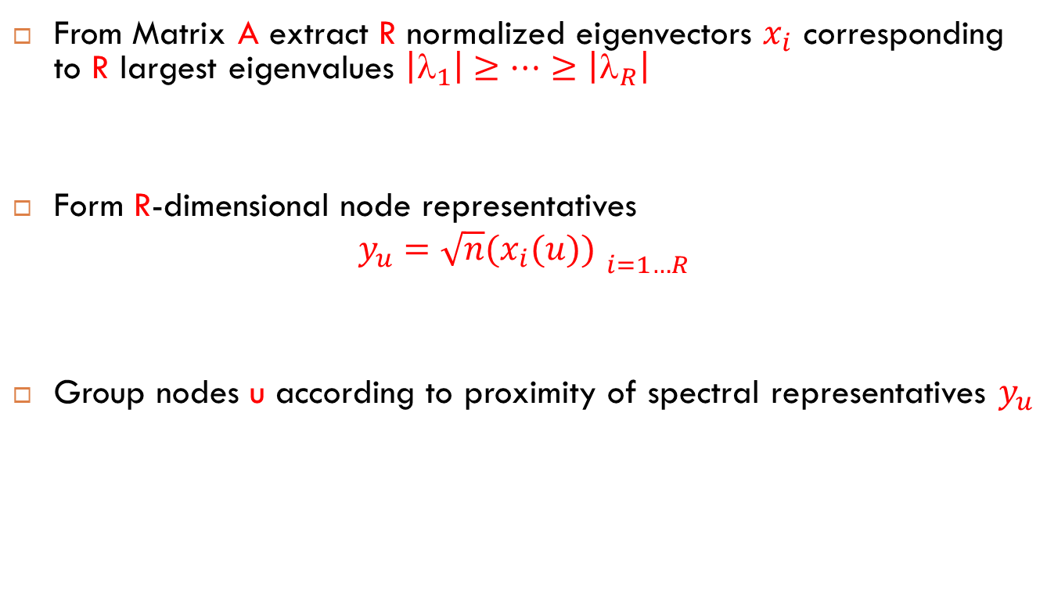
Spectral Clustering
From Matrix A extract R normalized eigenvectors $x_{i}$ corresponding to R largest eigenvalues $\left|_{1}\right|≥…≥$ $\left|_{R}\right|$
Form R-dimensional node representatives
$$y_{u}={\sqrt{n}(x_{i}(u)) }_{i=1…R}$$
Group nodes u according to proximity of spectral representatives $y_{u}$

Slide 12
Illustration for R=2
Netflix dataset
SBM with K=4

Slide 13
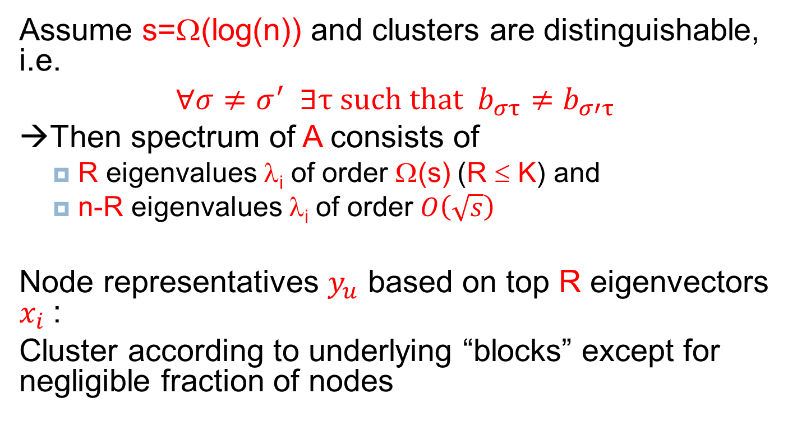
Result for “logarithmic” signal strength s
Assume s=Ω(log(n)) and clusters are distinguishable, i.e.
$∀σ≠$ $σ^{′} ∃τ \text{such} \text{that} b_{στ}≠b_{σ′τ}$
→Then spectrum of A consists of
  R eigenvalues λ_{i} of order Ω(s) (R ≤ K) and
  n-R eigenvalues λ_{i} of order $O\left(\sqrt{s}\right)$
Node representatives $y_{u}$ based on top R eigenvectors $x_{i}$:
Cluster according to underlying “blocks” except for negligible fraction of nodes
Notes:
Also assumes s=O(n^1/5)

Slide 14
Proof arguments
Control spectral radius of noise matrix
+ perturbation of matrix eigen-elements
A = + random “noise” matrix
Block matrix
non-zero eigenvalues: Θ(s)

Slide 15
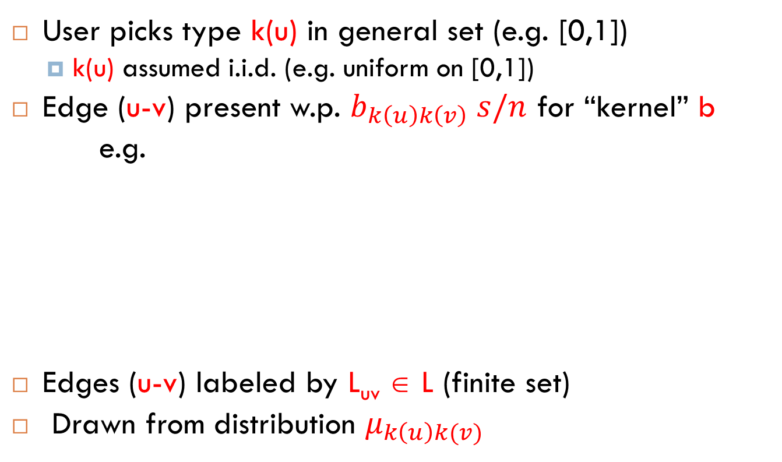
spectral separation properties
“à la Ramanujan”
s-regular graph Ramanujan if
$$\text{:=}\text{max}\left(\left|λ_{2}\right|,\left|λ_{n}\right|\right)≤2\sqrt{s−1}$$
[Lubotzky-Phillips-Sarnak’88]
[Friedman’08]: random s-regular graph verifies whp
$$\text{=}2\sqrt{s−1}+o(1)$$
[Feige-Ofek’05]: for Erdős-Rényi graph $G\left(n,s/n\right)$ and $s=\text{Ω}\left(\text{log} n\right)$, then whp $=O\left(\sqrt{s}\right)$
Also: $ρ\left(A−\overline{A}\right)=O\left(\sqrt{s}\right)$

Slide 16
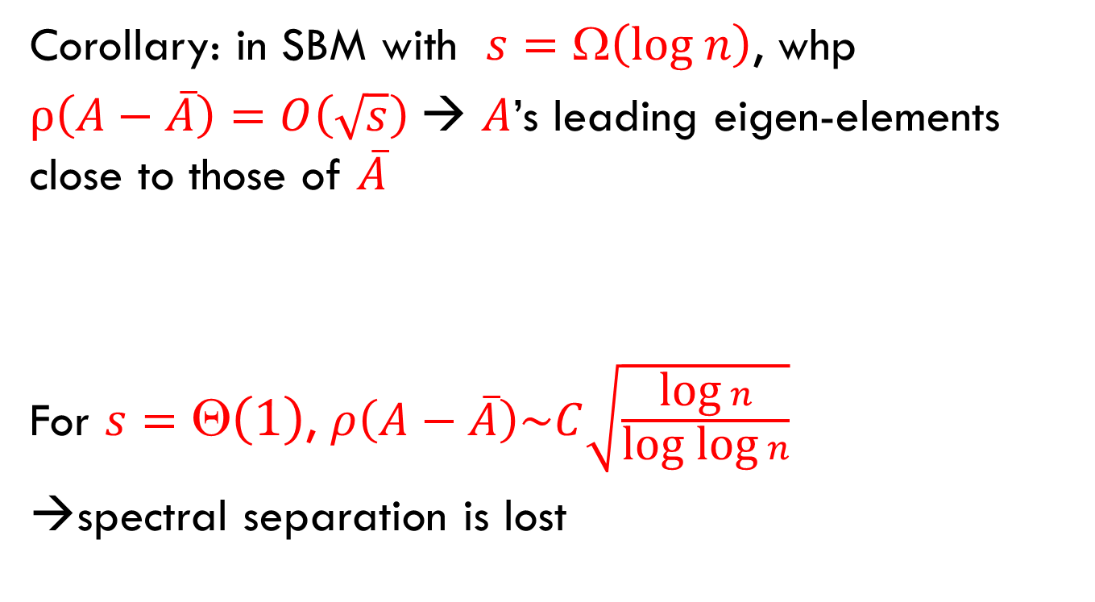
spectral separation properties
“à la Ramanujan”
Corollary: in SBM with $s=\text{Ω}\left(\text{log} n\right)$, whp
$ρ\left(A−\overline{A}\right)=O\left(\sqrt{s}\right)$→ $A$’s leading eigen-elements close to those of $\overline{A}$
For $s=\text{Θ}\left(1\right)$, $ρ\left(A−\overline{A}\right)\sim C\sqrt{\frac{\text{log} n}{\text{log} \text{log} n}}$
→spectral separation is lost

Slide 17
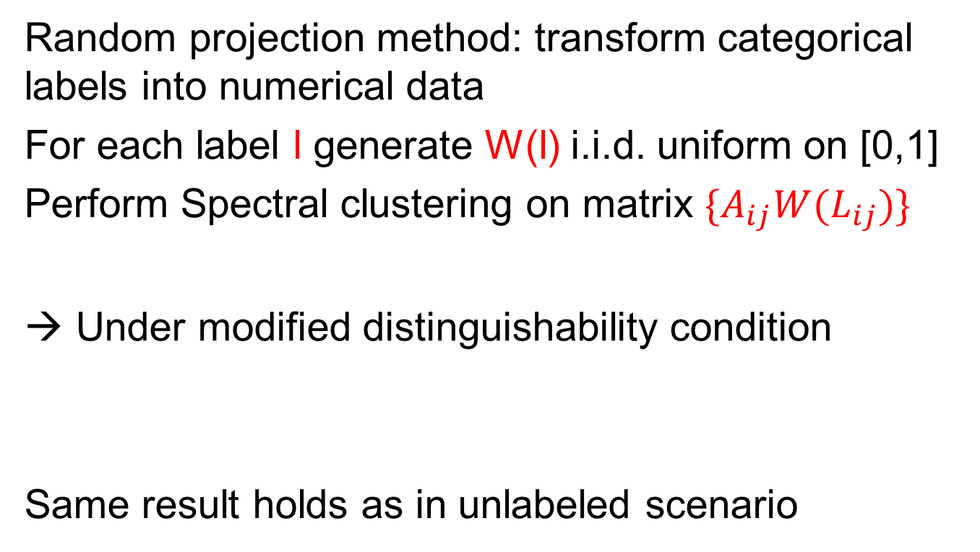
Result for “logarithmic” signal strength s – Labeled SBM
Random projection method: transform categorical labels into numerical data
For each label l generate W(l) i.i.d. uniform on [0,1]
Perform Spectral clustering on matrix $\{A_{ij}{W(L}_{ij})\}$
→ Under modified distinguishability condition
Same result holds as in unlabeled scenario

Slide 18
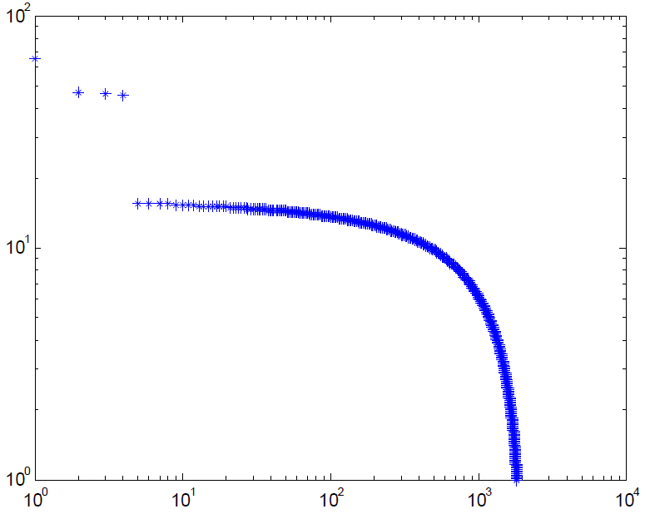
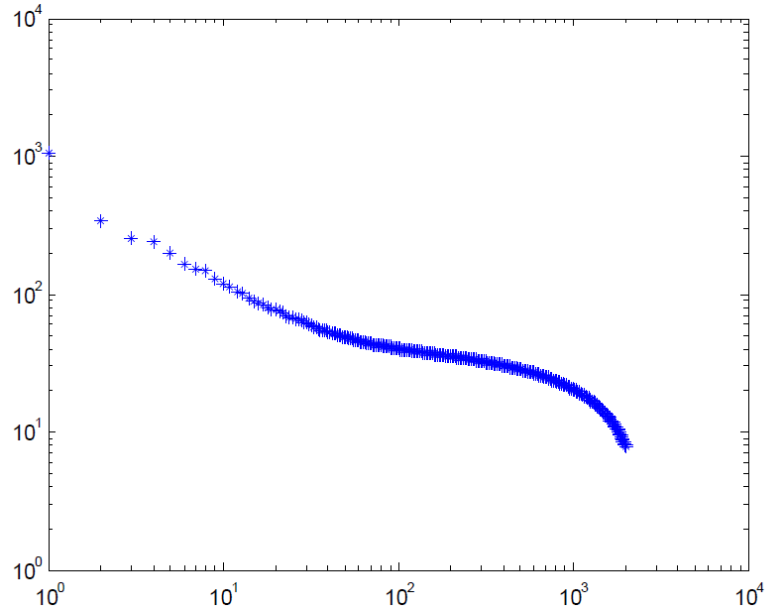
Discrepancy between SBM with small K and Netflix
Eigenvalue distributions
4 outstanding
eigenvalues
SBM with K=4
Netflix (subset)
→motivates consideration of SBM with general types

Slide 19
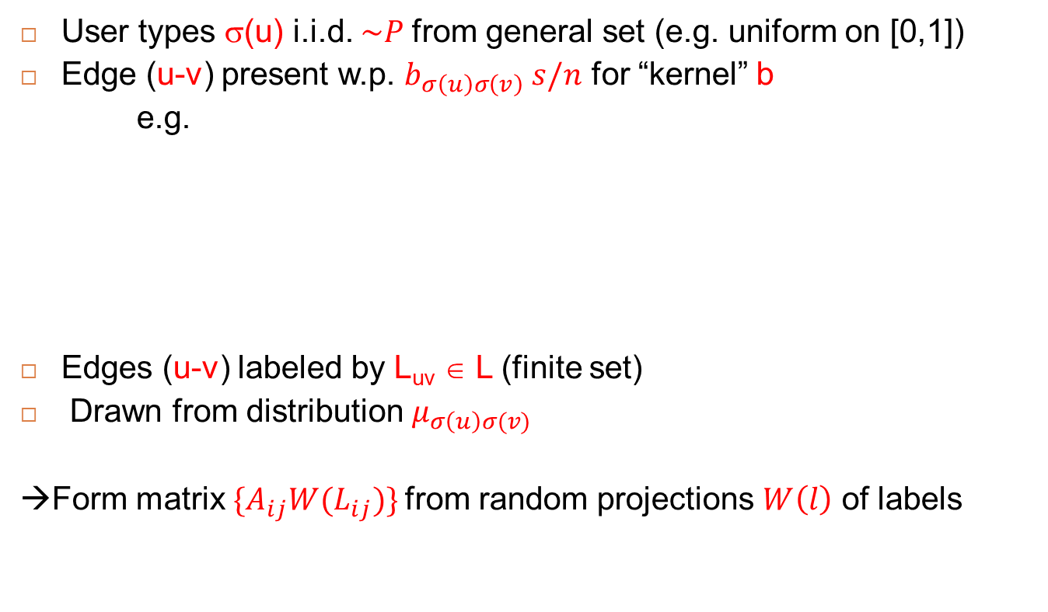
SBM with general types
User types σ(u) i.i.d. $\sim P$from general set (e.g. uniform on [0,1])
Edge (u-v) present w.p. $b_{σ\left(u\right)σ\left(v\right)} s/n$ for “kernel” b
e.g.
Edges (u-v) labeled by L_{uv} ∈ L (finite set)
Drawn from distribution $μ_{σ\left(u\right)σ(v)}$
→Form matrix $\{A_{ij}{W(L}_{ij})\}$from random projections $W\left(l\right)$ of labels
F(x)
x
-1
+1

Slide 20
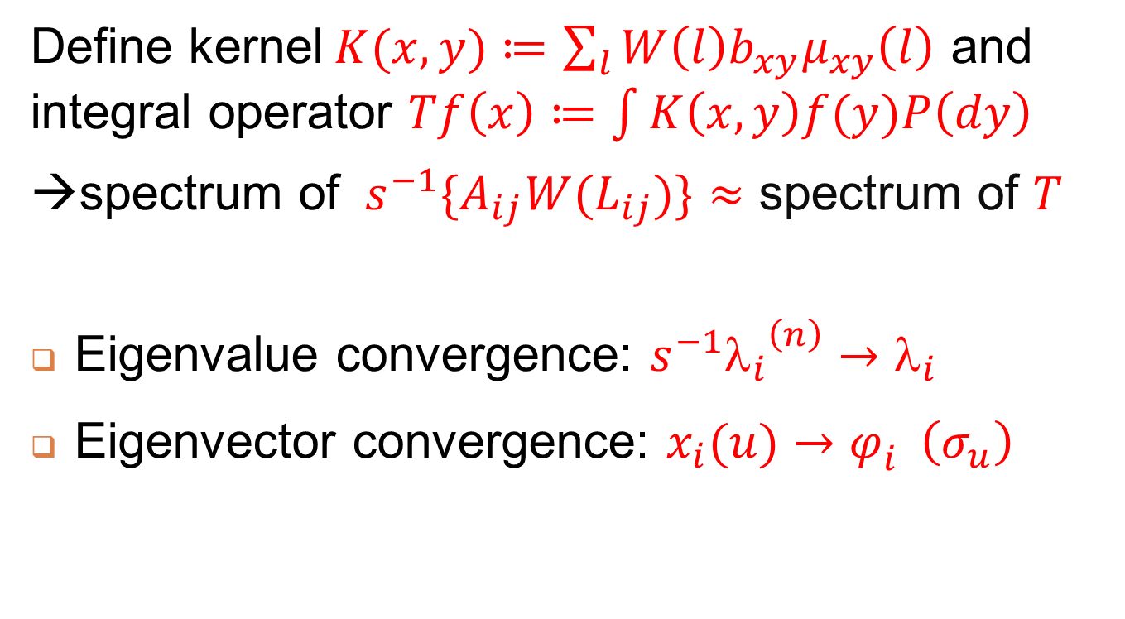
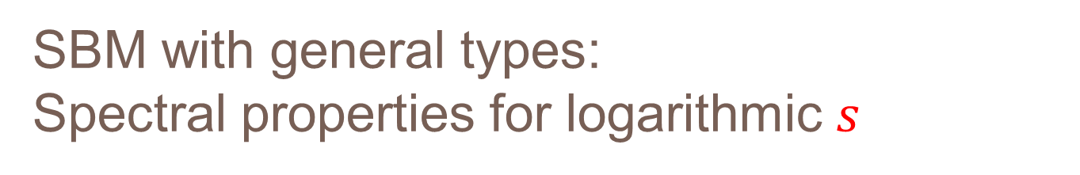
SBM with general types:
Spectral properties for logarithmic $s$
Define kernel$K(x,y)≔\sum_{l}{W\left(l\right){b_{xy}μ}_{xy}\left(l\right)}$ and integral operator $Tf\left(x\right)≔\int{K\left(x,y\right)f(y)P\left(dy\right)}$
→spectrum of $s^{−1}\{A_{ij}{W(L}_{ij})\}≈$ spectrum of $T$
Eigenvalue convergence: $s^{−1}{λ_{i}}_{}^{\left(n\right)}→λ_{i}$
Eigenvector convergence: $x_{i}(u)→φ_{i}^{}\left(σ_{u}\right)$
Associated eigen-functionn
Type of node u

Slide 21
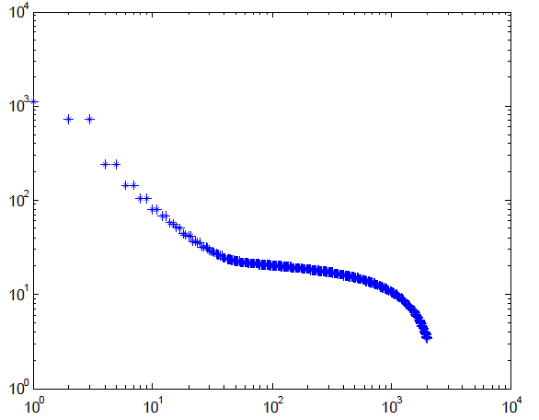
SBM with general types:
Spectral properties for logarithmic $s$
→Flexible model
-power-law spectra (convolution operator + Fourier analysis)
-better matches to
Netflix data
Notes:
A convolutional operator for special case previously mentioned

Slide 22
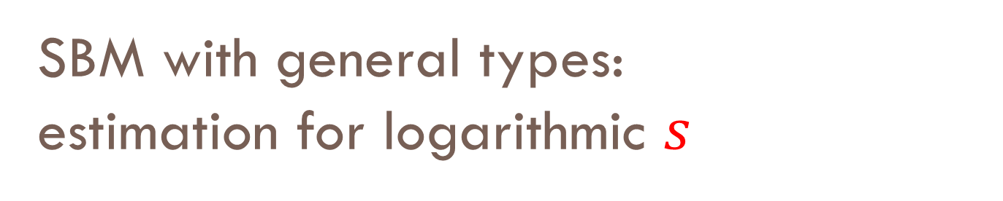
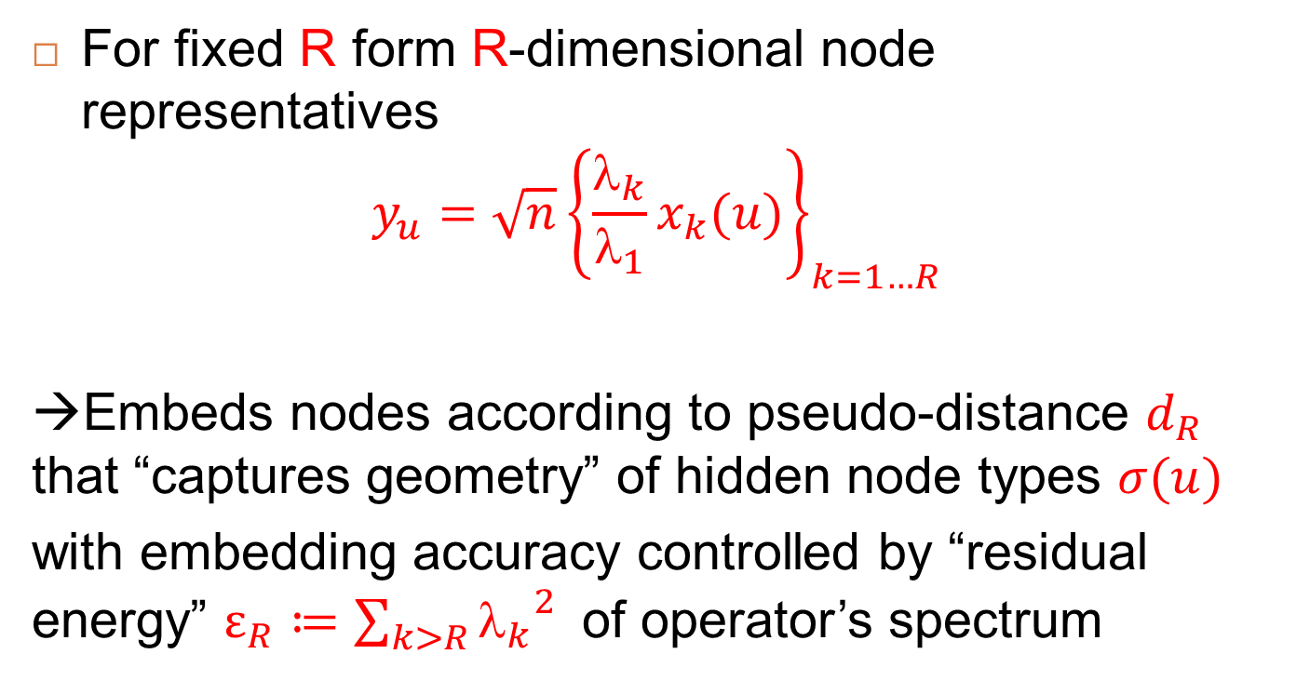
SBM with general types: estimation for logarithmic $s$
For fixed R form R-dimensional node representatives
$$y_{u}={\sqrt{n}\left\{\frac{λ_{k}}{λ_{1}}x_{k}(u)\right\}}_{k=1…R}$$
→Embeds nodes according to pseudo-distance $d_{R}$ that “captures geometry” of hidden node types $σ(u)$
with embedding accuracy controlled by “residual energy” $ε_{R}≔\sum_{k>R}{{λ_{k}}_{}^{2}}$of operator’s spectrum
Notes:
Integral operator is compact; beta_k is k-th eigenvalue

Slide 23
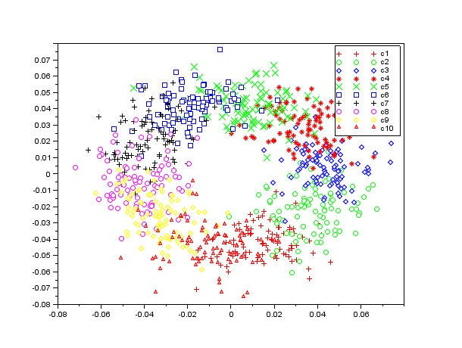
Illustration with [0,1] types
F(x)
x
Prob(label(i,j)=5)?
Node j
Node i
Use empirical distribution of labels L(i,k) for k in ε-neighborhood of j
Embedding allows consistent estimation of label distributions

Slide 24
Outline
  The Stochastic Block Model
    With labels
    With general types
  Performance of Spectral Methods
    “rich signal” case
  The weak signal case: sparse observations
    Phase transition on detectability
    A modified spectral method

Slide 25


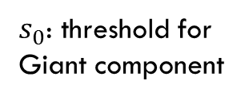

Weak signal strength: s = $\text{}$(1)
Correct classification of all but negligible fraction of nodes impossible (isolated nodes…)
→ Assess performance of clustering $\hat{σ}$ by overlap metric:
Overlap
Overlap
Signal
strength s
$s_{0}$: threshold for
Giant component
$$s_{0}$$
$$s_{c}$$
Signal strength s

Slide 26
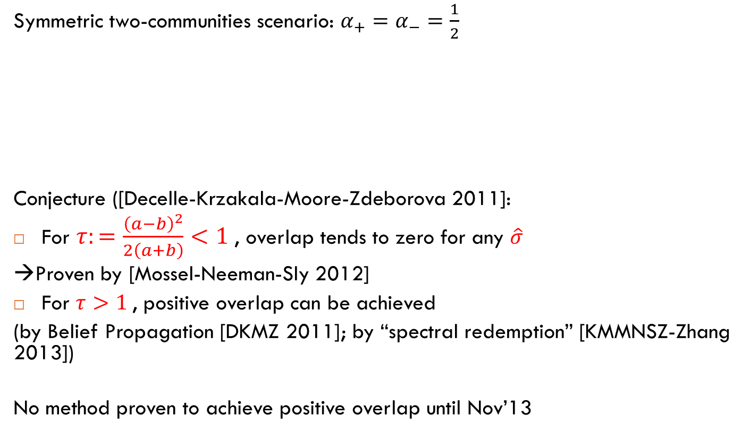
Weak signal strength : s=1
Symmetric two-communities scenario: $α_{+}=α_{−}=\frac{1}{2}$
Conjecture ([Decelle-Krzakala-Moore-Zdeborova 2011]:
For $τ:=\frac{{\left(a−b\right)}^{2}}{2\left(a+b\right)}<1$, overlap tends to zero for any $\hat{σ}$
→Proven by [Mossel-Neeman-Sly 2012]
For $τ>1$, positive overlap can be achieved
(by Belief Propagation [DKMZ 2011]; by “spectral redemption” [KMMNSZ-Zhang 2013])
No method proven to achieve positive overlap until Nov’13
Notes:
Interesting for two reasons: tells how much subsampling can be tolerated; methods achieving positive overlap up to transition are likely robust.

Slide 27

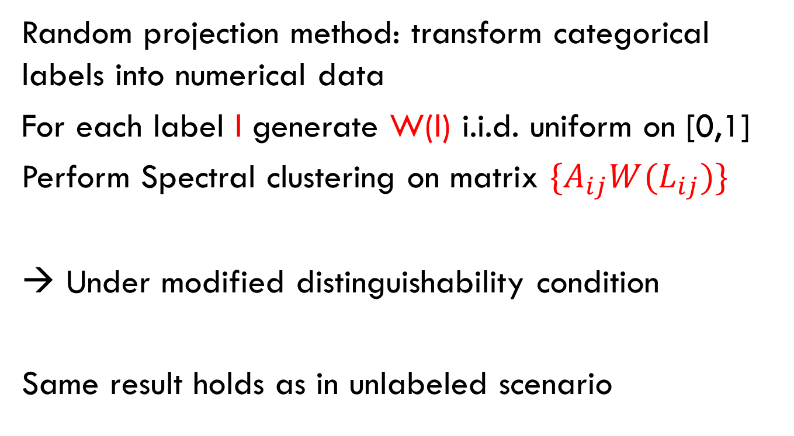
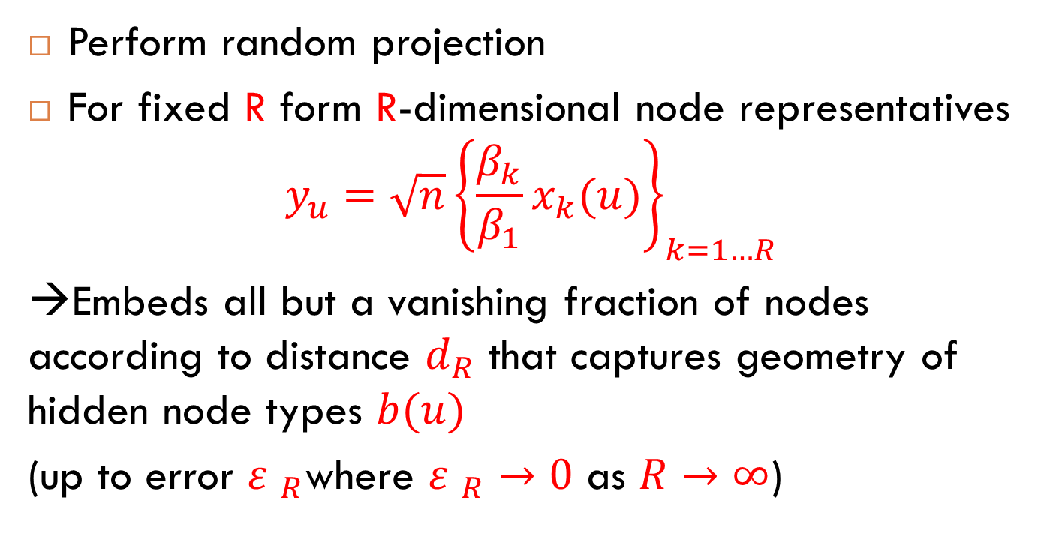

Detection by modified spectral method
Form matrix $B^{(l)}:{B^{(l)}}_{ij}=$nb of self-avoiding paths of length $l$
Ex: for l=4
j
i
j
i
$${B^{(l)}}_{ij}=1$$
$${B^{(l)}}_{ij}=2$$
Typical case: for tree-shaped l-neighborhood of i,
$${B^{(l)}}_{ij}=1_{\left\{d\left(i,j\right)=l\right\}}$$

Slide 28
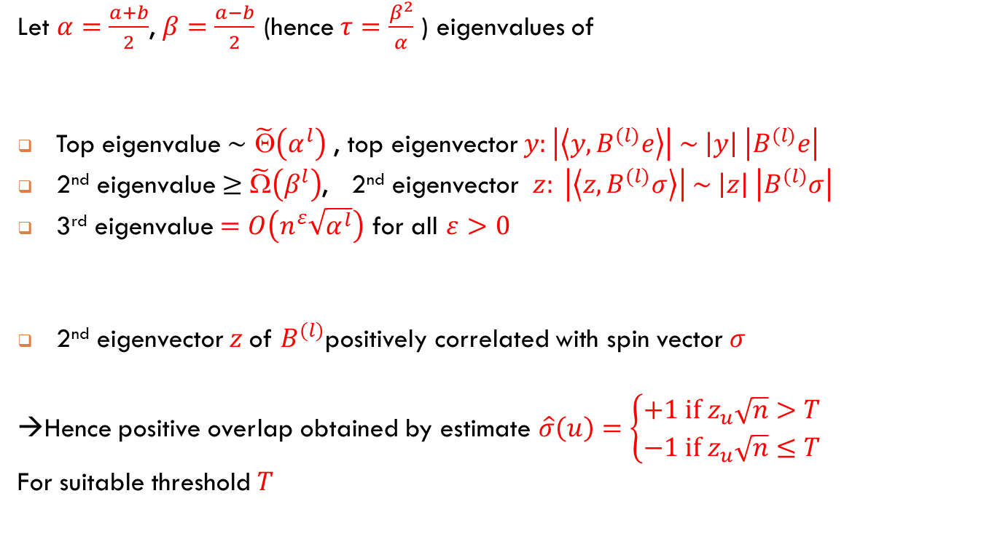
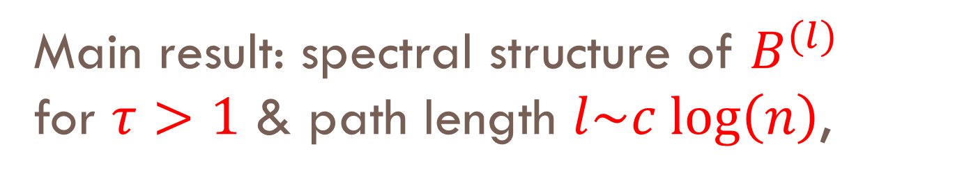
Main result: spectral structure of $B^{(l)}$ for $τ>1$ & path length $l\sim c \text{log}\left(n\right)$,
Let $α=\frac{a+b}{2}$, $β=\frac{a−b}{2}$ (hence $τ=\frac{β^{2}}{α}$ ) eigenvalues of
Top eigenvalue $\sim$ $\tilde{\text{Θ}}\left(α^{l}\right)$ , top eigenvector $y:\left|\left\langle y,B^{(l)}e\right\rangle \right| \sim \left|y\right| \left|B^{(l)}e\right|$
2nd eigenvalue $≥$ $\tilde{Ω}\left(β^{l}\right)$, 2nd eigenvector $z: \left|\left\langle z,B^{(l)}σ\right\rangle \right| \sim \left|z\right| \left|B^{(l)}σ\right|$
3rd eigenvalue $=O\left(n^{ε}\sqrt{α^{l}}\right)$ for all $ε>0$
2nd eigenvector $z$of $B^{(l)}$positively correlated with spin vector $σ$
→Hence positive overlap obtained by estimate $\hat{σ}\left(u\right)=\left\{\begin{aligned}+1 \text{if} z_{u}\sqrt{n}>T \\ −1 \text{if} z_{u}\sqrt{n}≤T\end{aligned}\right.$
For suitable threshold $T$
a/2
b/2
b/2
a/2
Spectral separation
“à la Ramanujan”

Slide 29

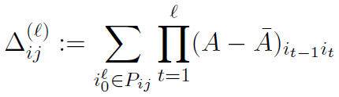
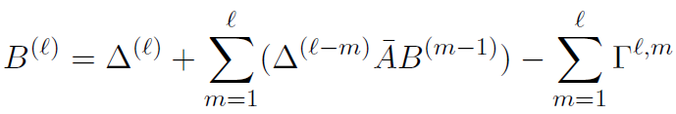
Proof elements 1) matrix expansion
Expected adjacency matrix
Centered simple path adjacency matrix
→Expansion:
“small” terms

Slide 30
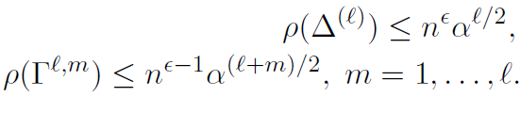
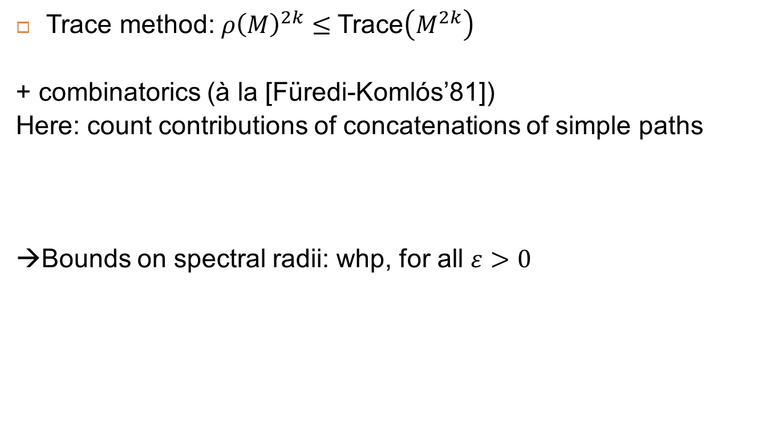
“Smallness” of matrix coefficients
Trace method: ${ρ\left(M\right)}^{2k}≤$Trace$\left(M^{2k}\right)$
+ combinatorics (à la [Füredi-Komlós’81])
Here: count contributions of concatenations of simple paths
→Bounds on spectral radii: whp, for all $ε>0$

Slide 31
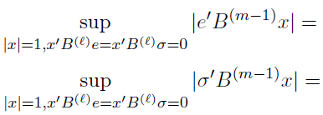




Proof elements 2) Quasi-deterministic growth of node neighborhoods
i
          Nb of distance t neighbors: $S_{t}\left(i\right)$
          Sum of spins of distance t neighbors: $D_{t}\left(i\right)$
  →then whp: $S_{t}\left(i\right)=α^{t−l}S_{l}\left(i\right)+\tilde{O}\left(α^{t/2}\right)$
  $D_{t}\left(i\right)=β^{t−l}D_{l}\left(i\right)+\tilde{O}\left(α^{t/2}\right)$
  Proof: Chernoff bounds on binomial random variables
  Corollary: For $m≤l$, whp
+
+
+
-
-
Close to vectors $\left\{S_{m−1}\left(i\right)\right\}$, $\left\{D_{m−1}\left(i\right)\right\}$
$$\tilde{O}\left(\sqrt{n}α^{(m−1)/2}\right)$$
$$\tilde{O}\left(\sqrt{n}α^{(m−1)/2}\right)$$

Slide 32

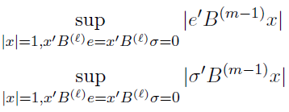

Weak Ramanujan property
Previous results combined give
Use spectral radius bounds
Express in terms of $e, σ$
Use bounds from quasi-deterministic growth

Slide 33
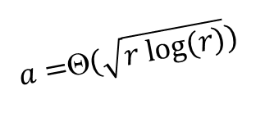
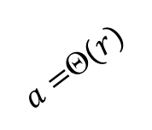
Remaining mysteries about SBM’s (1)
Conjectured “phase diagram” for more than 2 blocks
(assuming fixed inter-community parameter b)
Detection hard but feasible
(how? In polynomial time?)
Intra-community
parameter a
Detection easy
(spectral methods
or BP)
$a=$Θ$(r)$
$a=$Θ$(\sqrt{r log⁡(r)})$
Detection infeasible
Number of
communities r

Slide 34
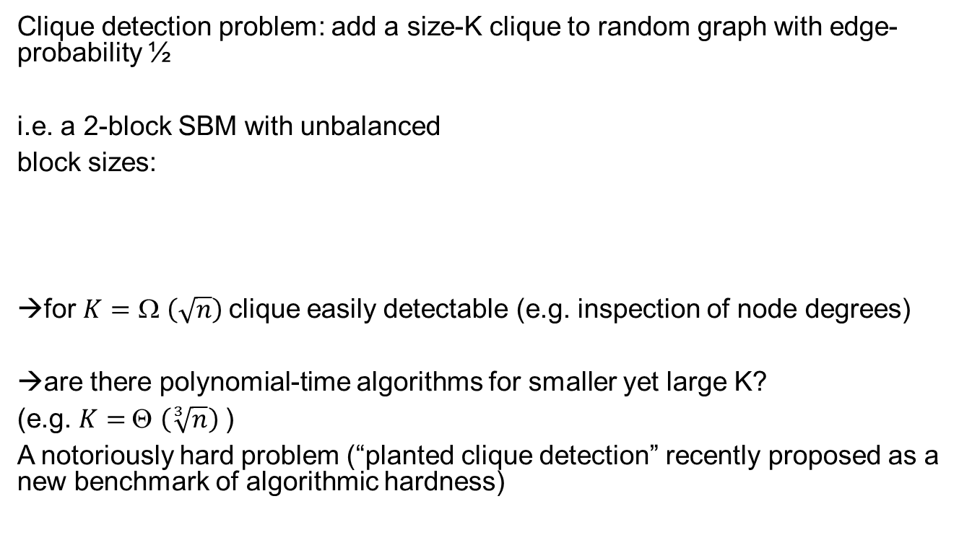
Remaining mysteries about SBM’s (2)
Clique detection problem: add a size-K clique to random graph with edge-probability ½
i.e. a 2-block SBM with unbalanced
block sizes:
→for $K=$ Ω $\left(\sqrt{n}\right)$clique easily detectable (e.g. inspection of node degrees)
→are there polynomial-time algorithms for smaller yet large K?
(e.g. $K=$Θ $\left(\sqrt[3]{n}\right)$)
A notoriously hard problem (“planted clique detection” recently proposed as a new benchmark of algorithmic hardness)
½
K
½
½
n-K

Slide 35
Conclusions and Outlook
“Vanilla” spectral methods efficient for strong (logarithmic) signal strength
Alternatives needed at low signal strength
  Belief propagation conjectured optimal
  Spectral approach on path-expanded matrix proven optimal down to “easy/hard” transition
Computationally efficient methods for “hard” cases?
  Detection in SBM = rich playground for analysis of computational complexity with methods of statistical physics
Does SBM model correctly real-life data?
Speed of convergence, better-than-random label projections, choice of embedding dimension…

Slide 36
References
  D. Tomozei, L.M., distributed user profiling via spectral methods, ACM Sigmetrics’10
  M. Lelarge, L.M., J. Xu, Reconstruction in the labelled stochastic block model, ITW’13
  J. Xu, L.M., M. Lelarge, Edge label inference in generalized SBM: from spectral theory to impossibility results, COLT’14
  L.M., Community detection thresholds and the weak Ramanujan property, ACM STOC’14

Slide 37

SBM with general types: estimation for logarithmic $s$
Define Distance $d^{2}\left(x,y\right)=\int{{\left[K\left(x,z\right)−K\left(y,z\right)\right]}^{2}P\left(dz\right) }$
captures model structure
Verifies $0≤d_{R}≤d$
And ${\iint{\left[d^{2}\left(x,y\right)−{d_{R}}^{2}\left(x,y\right)\right]P\left(dx\right)P\left(dy\right)=}ε}_{R}$
Notes:
Integral operator is compact; beta_k is k-th eigenvalue

Slide 38
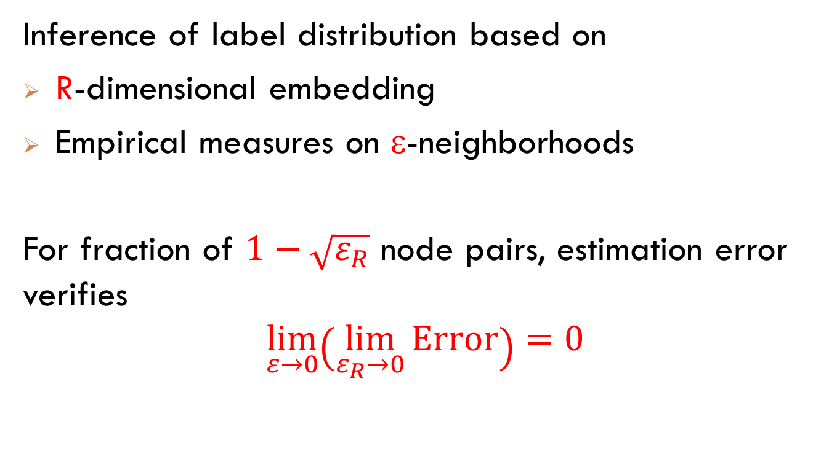

Consistency result for logarithmic $s$
Inference of label distribution based on
R-dimensional embedding
Empirical measures on ε-neighborhoods
For fraction of $1−\sqrt{ε_{R}}$ node pairs, estimation error verifies
$$\lim_{ε→0}\left(\lim_{ε_{R}→0}{\text{Error}}\right)=0$$

