Slide 1
Compositional Analysis of System Architectures (using Lustre)
Mike Whalen
Program Director
University of Minnesota Software Engineering Center
Sponsored by NSF Research Grant CNS-1035715
Notes:
1

Slide 2
Acknowledgements
Rockwell Collins (Darren Cofer, Andrew Gacek, Steven Miller, Lucas Wagner)
UPenn: (Insup Lee, Oleg Sokolsky)
UMN (Mats P. E. Heimdahl)
CMU SEI (Peter Feiler)

Slide 3
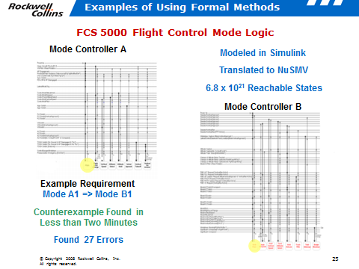
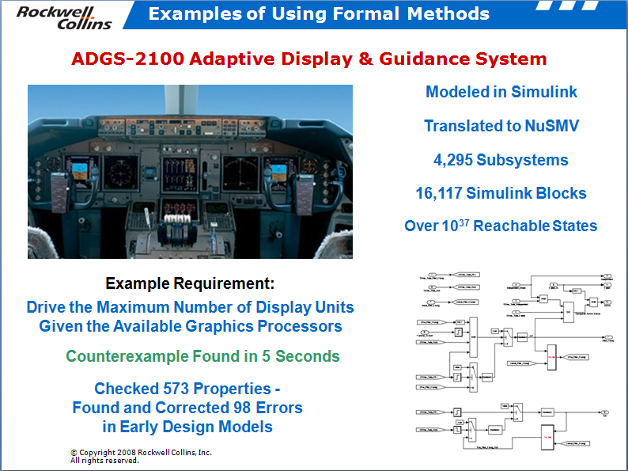
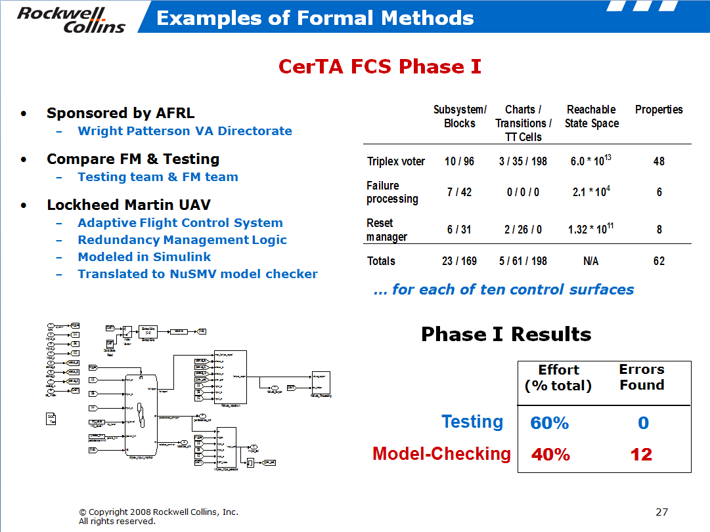
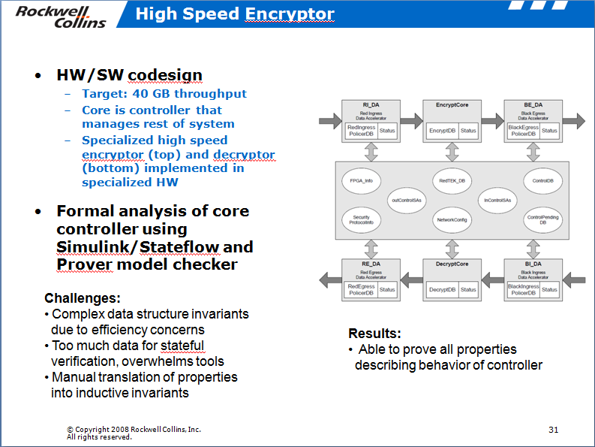
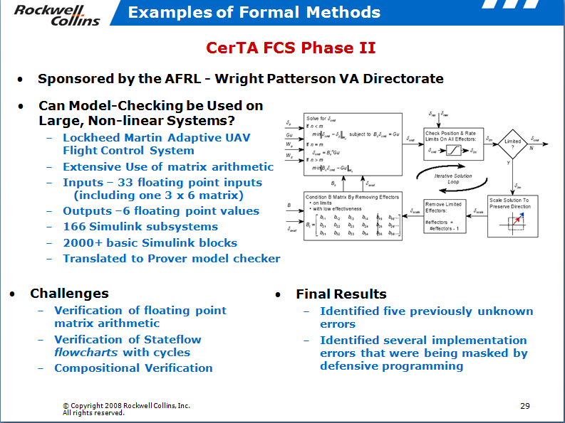
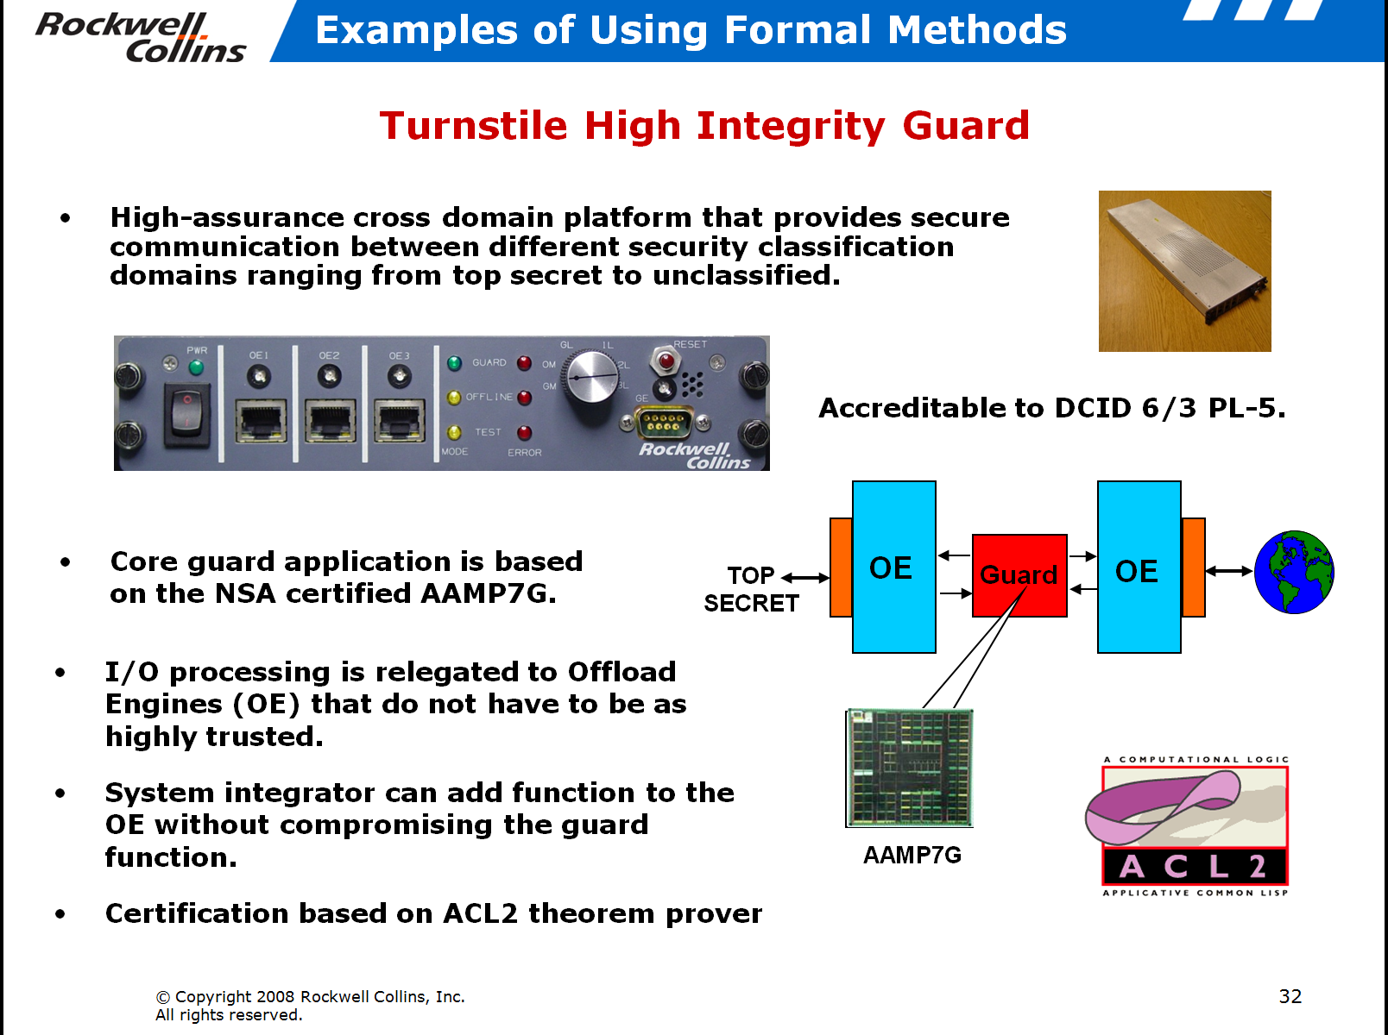
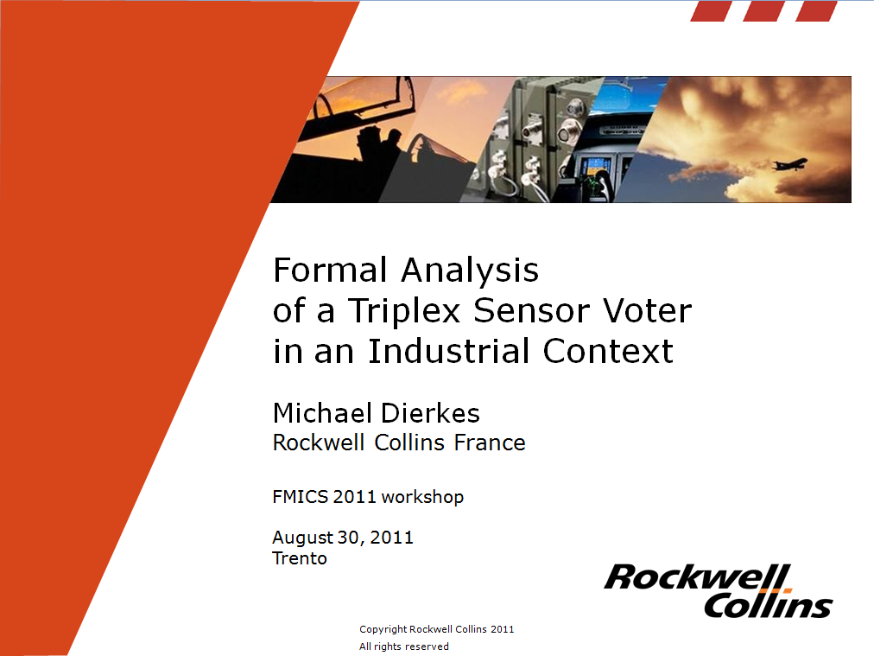
Component Level Formal Analysis Efforts
Notes:
Note: not a one man show! Collins continues to use this technology.

Slide 4
Vision
System design & verification through pattern application and compositional reasoning
LRU
SENSOR 1
VOTE MULTIPLE DATA
COMPUTING RESOURCE A
FAIL-SILENT NODE FROM REPLICAS
SENSOR
COMPUTING RESOURCE
ABSTRACTION
SENSOR 2
COMPUTING RESOURCE B
SENSOR 3
VERIFIED
AVAILABILITY
VERIFIED
INTEGRITY
VERIFICATION
REUSE
ARCHITECTURE
MODEL
COMPOSITIONAL PROOF OF CORRECTNESS
(ASSUME – GUARANTEE)
SAFETY, BEHAVIORAL, PERFORMANCE PROPERTIES
COMPOSITION
© Copyright 2011 Rockwell Collins, Inc.
All rights reserved.

Slide 5
System verification
SPECIFICATION
SYSTEM DEVELOPMENT
FOUNDRY
INSTANTIATE ARCHITECTURAL PATTERNS
ARCH PATTERN MODELS
ANNOTATE
& VERIFY MODELS
PATTERN & COMP SPEC
LIBRARY
SYSTEM MODELING ENVIRONMENT
SYSTEM MODEL
AUTO
GENERATE
SYSTEM IMPLEMENTATION
COMPONENT MODELS
COMPONENT
LIBRARY
COMPOSITIONAL REASONING & ANALYSIS
Reusable Verification:
Proof of component and pattern requirements (guarantees) and specification of context (assumptions)
Instantiation:
Check structural constraints, Embed assumptions & guarantees in system model
Compositional Verification:
System properties are verified by model checking using component & pattern contracts
© Copyright 2011 Rockwell Collins, Inc.
All rights reserved.

Slide 6
Hierarchical reasoning about systems
Avionics system req
requirement
Relies upon
  Accuracy of air data sensors
  Control commands from FCS
    Mode of FGS
    FGS control law behavior
    Failover behavior between FGS systems
    ….
  Response of Actuators
  Timing/Lag/Latency of Communications
Avionics
System
Under single-fault assumption,
GC output transient response is bounded in time and magnitude
ADS_L
ADS_R
FCS
…
FGS_L
FGS_R
Autopilot
…
System
Modes
Control
Laws
Co-ord

Slide 7
Compositional Reasoning for Active Standby
Want to prove a transient response property
  The autopilot will not cause a sharp change in pitch of aircraft.
  Even when one FGS fails and the other assumes control
Given assumptions about the environment
  The sensed aircraft pitch from the air data system is within some absolute bound and doesn’t change too quickly
  The discrepancy in sensed pitch between left and right side sensors is bounded.
and guarantees provided by components
  When a FGS is active, it will generate an acceptable pitch rate
As well as facts provided by pattern application
  Leader selection: at least one FGS will always be active (modulo one “failover” step)
transient_response_1 : assert true ->
abs(CSA.CSA_Pitch_Delta) < CSA_MAX_PITCH_DELTA ;
transient_response_2 : assert true ->
abs(CSA.CSA_Pitch_Delta - prev(CSA.CSA_Pitch_Delta, 0.0))
< CSA_MAX_PITCH_DELTA_STEP ;

Slide 8
Contracts between patterns and components
Avionics
System
Avionics system requirement
Relies upon
  Guarantees provided by patterns and components
  Structural properties of model
  Resource allocation feasibility
  Probabilistic system-level failure characteristics
Under single-fault assumption, GC output transient response is bounded in time and magnitude
Behavior
leader transition
bounded
LS
synchronous
communication
one node
operational
PALS
Rep
GUARANTEES
ASSUMPTIONS
Structure
timing
constraints
not
co-located
Platform
Principled mechanism for “passing the buck”
Resource
Probabilistic
RT sched
& latency
Error
model
© Copyright 2011 Rockwell Collins, Inc.
All rights reserved.

Slide 9
Contracts
Derived from Lustre and Property Specification Language (PSL) formalism
  IEEE standard
  In wide use for hardware verification
Assume / Guarantee style specification
  Assumptions: “Under these conditions”
  Promises (Guarantees): “…the system will do X”
Local definitions can be created to simplify properties
Contract:
fun abs(x: real) : real = if (x > 0) then x else -x ;
const ADS_MAX_PITCH_DELTA: real = 3.0 ;
const FCS_MAX_PITCH_SIDE_DELTA: real = 2.0 ;
…
property AD_L_Pitch_Step_Delta_Valid =
true ->
abs(AD_L.pitch.val - prev(AD_L.pitch.val, 0.0)) <
ADS_MAX_PITCH_DELTA ;
…
active_assumption: assume some_fgs_active ;
transient_assumption :
assume AD_L_Pitch_Step_Delta_Valid and
AD_R_Pitch_Step_Delta_Valid and Pitch_lr_ok ;
transient_response_1 :
assert true -> abs(CSA.CSA_Pitch_Delta) <
CSA_MAX_PITCH_DELTA ;
transient_response_2 :
assert true ->
abs(CSA.CSA_Pitch_Delta –
prev(CSA.CSA_Pitch_Delta, 0.0)) <
CSA_MAX_PITCH_DELTA_STEP ;
© Copyright 2011 Rockwell Collins, Inc.
All rights reserved.

Slide 10
Reasoning about contracts
Notionally: It is always the case that if the component assumption is true, then the component will ensure that the guarantee is true.
  G(A ⇒ P);
An assumption violation in the past may prevent component from satisfying current guarantee, so we need to assert that the assumptions are true up to the current step:
  G(H(A) ⇒ P) ;

Slide 11
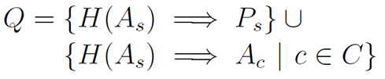
Reasoning about Contracts
Given the set of component contracts:
Γ = { G(H(A_{c}) ⇒ P_{c}) | c ∈ C }
Architecture adds a set of obligations that tie the system assumption to the component assumptions
This process can be repeated for any number of abstraction levels

Slide 12
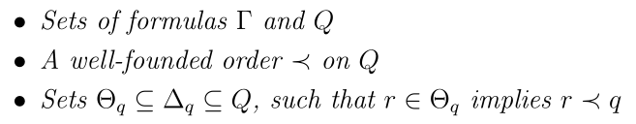
Composition Formulation
Suppose we have
Then if for all q ∈ Q
  Γ ⇒ G((Z(H(Θ_{q})) ^ Δ_{q}) ⇒ q)
Then:
G(q) for all q ∈ Q
[Adapted from McMillan]

Slide 13
A concrete example
Order of data flow through
system components is
computed by reasoning engine
  {System inputs} →
  {FGS_L, FGS_R}
  {FGS_L, FGS_R} → {AP}
  {AP} → {System outputs}
Based on flow, we establish
four proof obligations
  System assumptions →
  FGS_L assumptions
  System assumptions →
  FGS_R assumptions
  System assumptions +
  FGS_L guarantees +
  FGS_R guarantees →
  AP assumptions
  System assumptions + {FGS_L, FGS_R, AP} guarantees → System guarantees
System can handle circular flows, but user has to choose where to break cycle

Slide 14
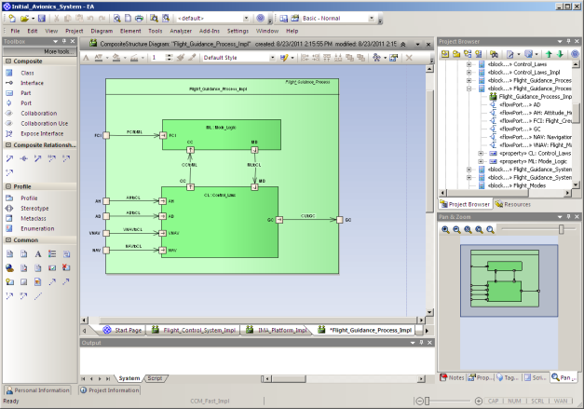
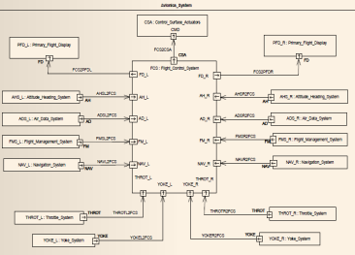
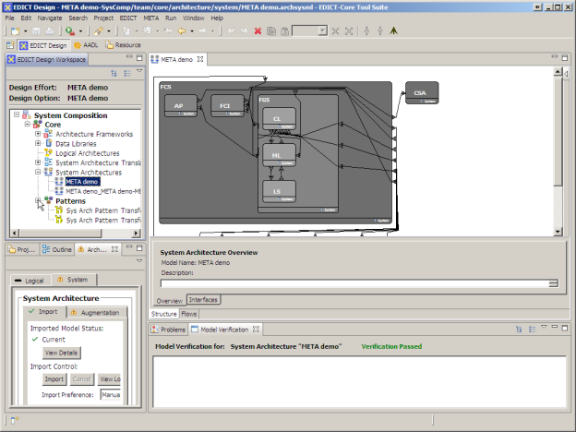
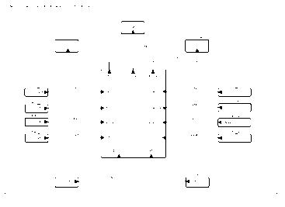
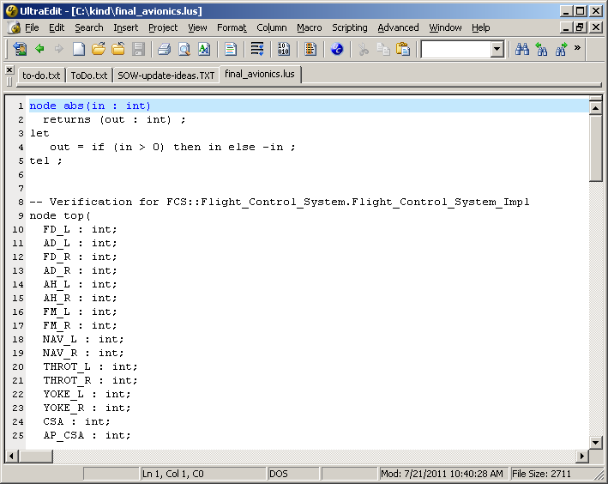
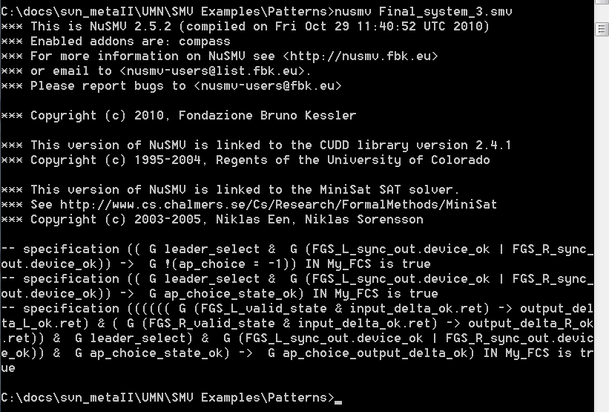
Tool Chain
SysML-AADL translation
Enterprise Architect
OSATE:
AADL modeling
SysML
EDICT:
Architectural
patterns
AADL
Lute:
Structural
verification
Eclipse
AGREE:
Compositional behavior verification
Lustre
KIND

Slide 15

Research Challenges

Slide 16
Proving
Current back-end analysis performed using SMT-based k-induction model checking technique [Hagen and Tinelli: FMCAD 2008]
Very scalable if properties can be inductively proven
Unfortunately, Inductive proofs often fail because properties are too weak
Lots of work on lemma/invariant discovery to strengthen properties
    Bjesse and Claessen: SAT-based verification without State Space Traversal
    Bradley: SAT-based Model Checking without Unrolling
    Tinelli: Instantiation-Based Invariant Discovery [NFM 2011]
These strengthening methods are not targeted towards our problem
Only supports analysis of linear models

Slide 17
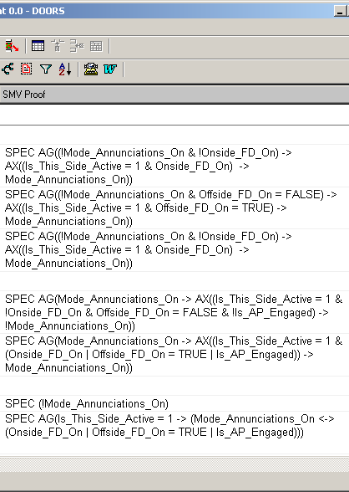
Scaling
What do you do when systems and subcomponents have hundreds of requirements?
  FGS mode logic: 280 requirements
  DWM: >600 requirements
Need to create automated slicing techniques for predicates rather than code.
  Perhaps this will be in the form of counterexample-guided refinement

Slide 18
Assigning blame
Counterexamples are often
hard to understand for big
models
It is much worse (in my
experience) for property-
based models
Given a counterexample,
can you automatically assign
blame to one or more
subcomponents?
Given a “blamed” component,
can you automatically open
the black box to strengthen
the component guarantee?
Signal | Step...
 | 0 | 1 | 2 | 3 | 4 | 5
AD_L.pitch.val | -0.91 | -1.83 | -2.74 | -3.65 | -4.35 | -4.39
AD_L.pitch.valid | FALSE | TRUE | FALSE | TRUE | TRUE | FALSE
AD_R.pitch.val | 0.83 | -0.09 | -1.00 | -1.91 | -2.83 | -3.74
AD_R.pitch.valid | TRUE | FALSE | TRUE | FALSE | FALSE | TRUE
AP.CSA.csa_pitch_delta | 0.00 | 0.13 | 0.09 | 0.26 | 0.74 | -4.26
AP.GC_L.cmds.pitch_delta | 0.00 | -4.91 | -4.65 | -4.57 | -4.74 | -4.35
AP.GC_L.mds.active | TRUE | FALSE | FALSE | FALSE | FALSE | TRUE
AP.GC_R.cmds.pitch_delta | 0.00 | 0.83 | -4.43 | -4.48 | 4.91 | 4.83
AP.GC_R.mds.active | TRUE | TRUE | FALSE | FALSE | FALSE | FALSE
Assumptions for AP | TRUE | TRUE | TRUE | TRUE | TRUE | TRUE
Assumptions for FCI | TRUE | TRUE | TRUE | TRUE | TRUE | TRUE
Assumptions for FGS_L | TRUE | TRUE | TRUE | TRUE | TRUE | TRUE
Assumptions for FGS_R | TRUE | TRUE | TRUE | TRUE | TRUE | TRUE
FGS_L.GC.cmds.pitch_delta | -4.91 | -4.65 | -4.57 | -4.74 | -4.35 | 0.09
FGS_L.GC.mds.active | FALSE | FALSE | FALSE | FALSE | TRUE | FALSE
FGS_L.LSO.leader | 2 | 2 | 3 | 2 | 1 | 3
FGS_L.LSO.valid | FALSE | TRUE | FALSE | TRUE | TRUE | FALSE
FGS_R.GC.cmds.pitch_delta | 0.83 | -4.43 | -4.48 | 4.91 | 4.83 | 3.91
FGS_R.GC.mds.active | TRUE | FALSE | FALSE | FALSE | FALSE | FALSE
FGS_R.LSO.leader | 0 | 0 | 1 | 0 | 1 | 1
FGS_R.LSO.valid | TRUE | FALSE | TRUE | FALSE | FALSE | TRUE
leader_pitch_delta | 0.00 | 0.83 | 0.83 | 0.83 | 0.83 | -4.35
System level guarantees | TRUE | TRUE | TRUE | TRUE | TRUE | FALSE
Notes:
Counterexamples can be hard to figure out when you have a functional system.
They are much harder to understand (in my experience) when doing these compositional proofs.

Slide 19
“Argument Engineering”
Disparate kinds of evidence throughout the system
  Probabilistic
  Resource
  Structural properties of model
  Behavioral properties of model
How do we tie these things together?
Evidence graph, similar to proof graph in PVS
  Shows evidential obligations that have not been discharged

Slide 20
Dealing with Time
Current analysis is synchronous
  It assumes all subcomponents run at the same rate
  It assumes single-step delay between subcomponents
This is not how the world works!
  …unless you use Time-Triggered Architectures or PALS
Adding more realistic support for time is crucial to accurate analyses
  Time intervals tend to diverge in hierarchical verification
  E.g. synchronization.

Slide 21
Provocations
We do not yet have a clear idea of how to effectively partition system analyses to perform effective compositional reasoning across domains
We need research to combine analyses to make overall system analysis more effective.
The Collins/UMN META tools are a first step towards this goal.

Slide 22
Conclusions
Still early work…
  Many AADL constructs left to be mapped
  Many timing issues need to be resolved
  Better support for proof engineering needs to be found
But
  Already can do some interesting analysis with tools
  Sits in a nice intersection between requirements engineering and formal methods
  Lots of work yet on how best to specify requirements

Slide 23
Thank you!

