Slide 1
Synchronous Control and State Machines in Modelica
Hilding Elmqvist
Dassault Systèmes
Sven Erik Mattsson, Fabien Gaucher, Francois Dupont
Dassault Systèmes
Martin Otter, Bernhard Thiele
DLR

Slide 2
Content
Introduction
Synchronous Features of Modelica
  Synchronous Operators
  Base-clock and Sub-clock Partitioning
Modelica_Synchronous library
State Machines
Conclusions

Slide 3
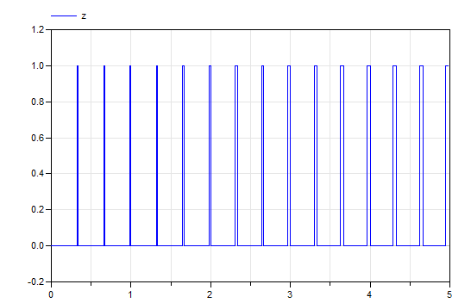
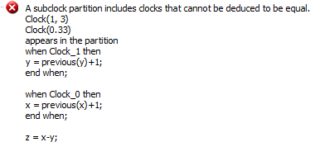
Introduction
Why synchronous features in Modelica 3.3?
model Asynchronous_Modelica32
Real x(start=0,fixed=true),
y(start=0,fixed=true), z;
equation
when sample(0,0.33) then
x = pre(x)+1;
end when;
when sample(0,1/3) then
y = pre(y)+1;
end when;
z = x-y;
end Asynchronous_Modelica32;
model Asynchronous_Modelica33
Real x(start=0,fixed=true),
y(start=0,fixed=true), z;
equation
when Clock(0.33) then
x = previous(x)+1;
end when;
when Clock(1,3) then
y = previous(y)+1;
end when;
z = x-y;
end Asynchronous_Modelica33;
Rational number 1/3
x and y must have
the same clock
Implicit hold
z = x-y
Error Diagnostics for safer systems!

Slide 4
Introduction
Scope of Modelica extended
Covers complete system descriptions including controllers
Clocked semantics
Clock associated with variable type and inferred
For increased correctness
Based on ideas from Lucid Synchrone and other synchronous languages
Extended with multi-rate periodic clocks, varying interval clocks and Boolean clocks

Slide 5
Synchronous Features of Modelica
Plant and Controller Partitioning
Boundaries between continuous-time and discrete-time equations
defined by operators.
sample(): samples a continuous-time variable and returns a clocked discrete-time expression
hold(): converts from clocked discrete-time to continuous-time by holding the value between clock ticks
sample operator may take a Clock argument to define when sampling should occur

Slide 6
Mass with Spring Damper
Consider a continuous-time model
partial model MassWithSpringDamper
parameter Modelica.SIunits.Mass m=1;
parameter Modelica.SIunits.TranslationalSpringConstant k=1;
parameter Modelica.SIunits.TranslationalDampingConstant d=0.1;
Modelica.SIunits.Position x(start=1,fixed=true) "Position";
Modelica.SIunits.Velocity v(start=0,fixed=true) "Velocity";
Modelica.SIunits.Force f "Force";
equation
der(x) = v;
m*der(v) = f - k*x - d*v;
end MassWithSpringDamper;

Slide 7
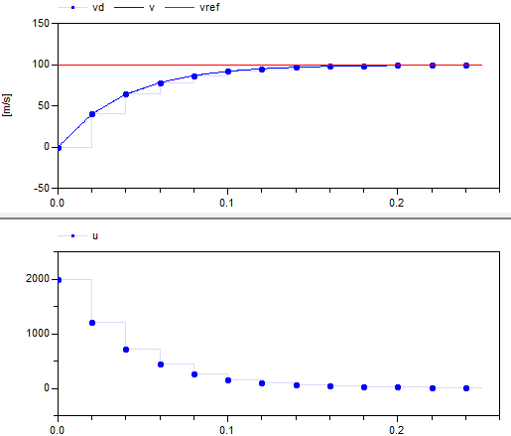
Synchronous Controller
Discrete-time controller
model SpeedControl
extends MassWithSpringDamper;
parameter Real K = 20 "Gain of speed P controller";
parameter Modelica.SIunits.Velocity vref = 100 "Speed ref.";
discrete Real vd;
discrete Real u(start=0);
equation
// speed sensor
vd = sample(v, Clock(0.01));
// P controller for speed
u = K*(vref-vd);
// force actuator
f = hold(u);
end SpeedControl;
Sample continuous velocity v
with periodic Clock with period=0.01
The clock of the equation
is inferred to be the same as for the variable vd which is the result of sample()
Hold discrete variable u
between clock ticks

Slide 8
Discrete-time State Variables
Operator previous() is used to access the value at the previous clock tick
(cf pre() in Modelica 3.2)
Introduces discrete state variable
Initial value needed
interval() is used to inquire the actual interval of a clock

Slide 9
Base-clocks and Sub-clocks
A Modelica model will typically have several controllers for different parts of the plant.
Such controllers might not need synchronization and can have different base clocks.
Equations belonging to different base clocks can be implemented by asynchronous tasks of the used operating system.
It is also possible to introduce sub-clocks that tick a certain factor slower than the base clock.
Such sub-clocks are perfectly synchronized with the base clock, i.e. the definitions and uses of a variable are sorted in such a way that when sub-clocks are activated at the same clock tick, then the definition is evaluated before all the uses.
New base type, Clock:
    Clock cControl = Clock(0.01);
    Clock cOuter = subSample(cControl, 5);

Slide 10
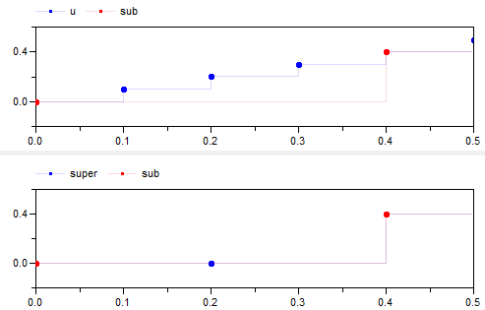
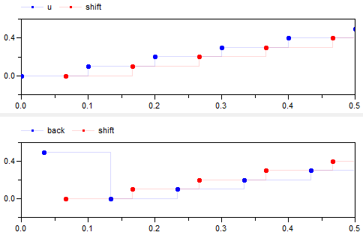
Sub and super sampling and phase
model SynchronousOperators
Real u;
Real sub;
Real super;
Real shift(start=0.5);
Real back;
equation
u = sample(time, Clock(0.1));
sub = subSample(u, 4);
super = superSample(sub, 2);
shift = shiftSample(u, 2, 3);
back = backSample(shift, 1, 3);
end SynchronousOperators;

Slide 11
Exact Periodic Clocks
Clocks defined by Real number period are not synchronized:
    Clock c1 = Clock(0.1);
    Clock c2 = superSample(c1,3);
    Clock c3 = Clock(0.1/3); // Not synchronized with c2
Clocks defined by rational number period are synchronized:
    Clock c1 = Clock(1,10); // period = 1/10
    Clock c2 = superSample(c1,3); // period = 1/30
    Clock c3 = Clock(1,30); // period = 1/30

Slide 12
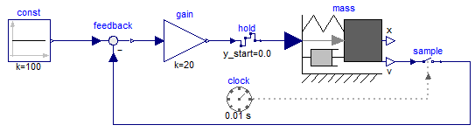
Modelica_Synchronous library
Synchronous language elements of Modelica 3.3
are “low level”:
Modelica_Synchronous library developed to access language elements in a convenient way graphically:
// speed sensor
vd = sample(v, Clock(0.01));
// P controller for speed
u = K*(vref-vd);
// force actuator
f = hold(u);

Slide 13
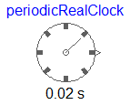
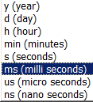
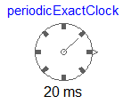

Blocks that generate clock signals
Generates a periodic clock with a Real period
parameter Modelica.SIunits.Time period;
ClockOutput y;
equation
y = Clock(period);
Generates a periodic clock as an integer multiple
of a resolution (defined by an enumeration).
Code for 20 ms period:
y = superSample(Clock(20), 1000);
Clock with period 20 s
super-sample clock with 1000
period = 20 / 1000 = 20 ms
Generates an event clock: The clock ticks whenever the continuous-time Boolean input changes from false to true.
y = Clock(u);

Slide 14
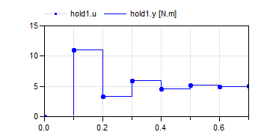
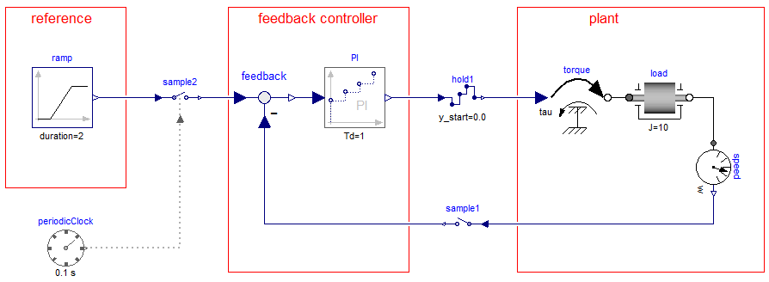
Sample and Hold
Holds a clocked signal and generates a continuous-time signal. Before the first clock tick, the continuous-time output y is set to parameter y_start
Discrete-time PI controller
y = hold(u);
Samples a continuous-time signal
and generates a clocked signal.
Purely algebraic block from
Modelica.Blocks.Math
y = sample(u, clock);
y = sample(u);

Slide 15
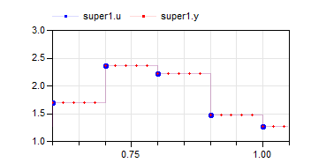
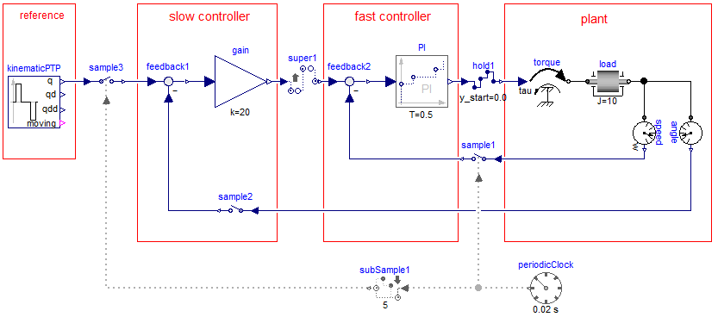
Sub- and Super-Sampling
Defines that the output signal is an integer factor faster as the input signal, using a “hold” semantics for the signal. By default, this factor is inferred. It can also be defined explicitly.
y = superSample(u);

Slide 16
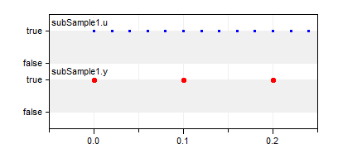
Defines that the output signal is an integer factor slower as the input signal, picking every n-th value of the input.
y = subSample(u,factor);

Slide 17
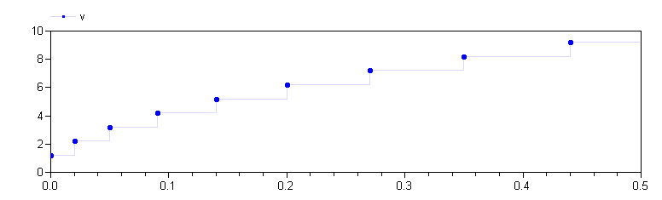
Varying Interval Clocks
The first argument of Clock(ticks, resolution) may be time dependent
Resolution must not be time dependent
Allowing varying interval clocks
Can be sub and super sampled and phased
model VaryingClock
Integer nextInterval(start=1);
Clock c = Clock(nextInterval, 100);
Real v(start=0.2);
equation
when c then
nextInterval = previous(nextInterval) + 1;
v = previous(v) + 1;
end when;
end VaryingClock;

Slide 18
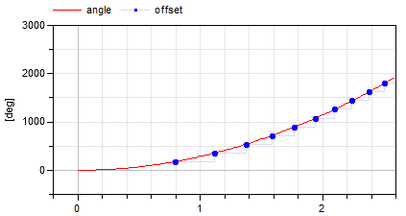
Boolean Clocks
Possible to define clocks that tick when a Boolean expression changes from false to true.
Assume that a clock shall tick whenever the shaft of a drive train passes 180º.
model BooleanClock
Modelica.SIunits.Angle angle(start=0,fixed=true);
Modelica.SIunits.AngularVelocity w(start=0,fixed=true);
Modelica.SIunits.Torque tau=10;
parameter Modelica.SIunits.Inertia J=1;
Modelica.SIunits.Angle offset;
equation
w = der(angle);
J*der(w) = tau;
when Clock(angle >= hold(offset)+Modelica.Constants.pi) then
offset = sample(angle);
end when;
end BooleanClock;

Slide 19
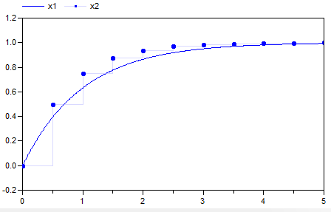
Discretized Continuous Time
Possible to convert continuous-time partitions to discrete-time
A powerful feature since in many cases it is no longer necessary to manually implement discrete-time components
Build-up a inverse plant model or controller with continuous-time components and then sample the input signals and hold the output signals.
And associate a solverMethod with the Clock.
model Discretized
Real x1(start=0,fixed=true);
Real x2(start=0,fixed=true);
equation
der(x1) = -x1 + 1;
der(x2) = -x2 + sample(1, Clock(Clock(0.5), solverMethod="ExplicitEuler"));
end Discretized;

Slide 20
State Machines
Modelica extended to allow modeling of control systems
Any block without continuous-time equations or algorithms can be a state of a state machine.
Transitions between such blocks are represented by a new kind of connections associated with transition conditions.
The complete semantics is described using only 13 Modelica equations.
A cluster of block instances at the same hierarchical level which are coupled by transition equations constitutes a state machine.
All parts of a state machine must have the same clock. (We will work on removing this restriction ,allowing mixing clocks and allowing continuous equations, in future Modelica versions.)
One and only one instance in each state machine must be marked as initial by appearing in an initialState equation.

Slide 21
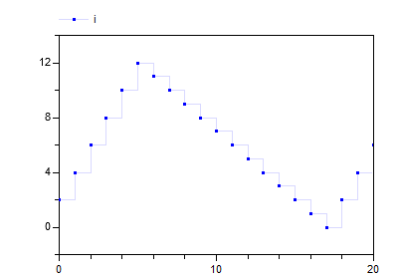
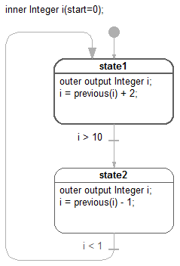
A Simple State Machine
inner i
outer output i
outer output i

Slide 22
A Simple State Machine – Modelica Text Representation
model StateMachine1
inner Integer i(start=0);
block State1
outer output Integer i;
equation
i = previous(i) + 2;
end State1;
State1 state1;
block State2
outer output Integer i;
equation
i = previous(i) - 1;
end State2;
State2 state2;
equation
initialState(state1);
transition(state1, state2, i > 10, immediate=false);
transition(state2, state1, i < 1, immediate=false);
end StateMachine1;

Slide 23
Merging Variable Definitions
An outer output declaration means that the equations have access to the corresponding variable declared inner.
Needed to maintain the single assignment rule.
Multiple definitions of such outer variables in different mutually exclusive states of one state machine need to be merged.
In each state, the outer output variables (v_{j}) are solved for (expr_{j}) and, for each such variable, a single definition is automatically formed:
v := if activeState(state₁) then expr₁
elseif activeState(state₂) then expr₂
elseif … else last(v)
last() is a special internal semantic operator returning its input. It is just used to mark for the sorting that the incidence of its argument should be ignored.
A start value must be given to the variable if not assigned in the initial state.
Such a newly created assignment equation might be merged on higher levels in nested state machines.

Slide 24
Defining a State machine
transition(from, to, condition, immediate, reset, synchronize, priority)
This operator defines a transition from instance “from” to instance “to”. The “from” and “to” instances become states of a state machine.
The transition fires when condition = true if immediate = true (this is called an “immediate transition”) or previous(condition) when immediate = false (this is called a “delayed transition”).
If reset = true, the states of the target state are reinitialized, i.e. state machines are restarted in initial state and state variables are reset to their start values.
If synchronize = true, the transition is disabled until all state machines within the from-state have reached the final states, i.e. states without outgoing transitions.
“from” and “to” are block instances and “condition” is a Boolean expression.
“immediate”, “reset”, and “synchronize” (optional) are of type Boolean, have parametric variability and a default of true, true, false respectively.
“priority” (optional) is of type Integer, has parametric variability and a default of 1 (highest priority). Defines the priority of firing when several transitions could fire.
initialState(state)
The argument “state” is the block instance that is defined to be the initial state of a state machine.

Slide 25
Conditional Data Flows
Alternative to using outer output variables is to use conditional data flows.
block Increment
extends Modelica.Blocks.Interfaces.PartialIntegerSISO;
parameter Integer increment;
equation
y = u + increment;
end Increment;
block Prev
extends Modelica.Blocks.Interfaces.PartialIntegerSISO;
equation
y = previous(u);
end Prev;
protected connector (node) i

Slide 26
Merge of Conditional Data Flows
It is possible to connect several outputs to inputs if all the outputs come from states of the same state machine.
u₁ = u₂ = … = y₁ = y₂ = …
with u_{i} inputs and y_{i} outputs.
Let variable v represent the signal flow and rewrite the equation above as a set of equations for u_{i} and a set of assignment equations for v:
v := if activeState(state₁) then y₁ else last(v);
v := if activeState(state₂) then y₂ else last(v);
…
u₁ = v
u₂ = v
…
The merge of the definitions of v is then made as described previously:
v = if activeState(state₁) then y₁
elseif activeState(state₂) then y₂
elseif … else last(v)
…

Slide 27
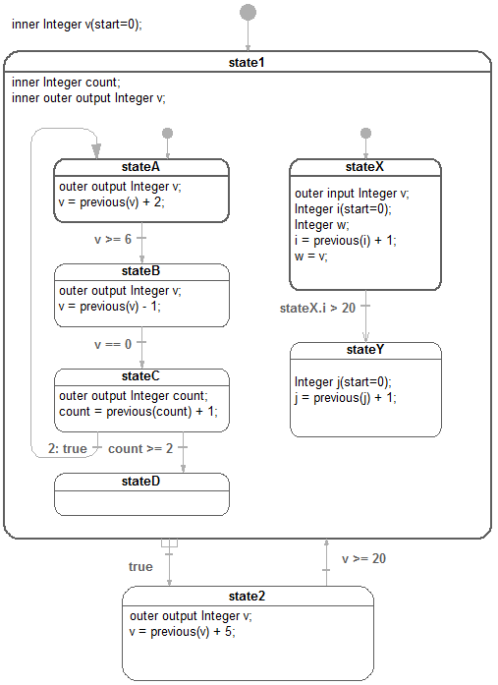
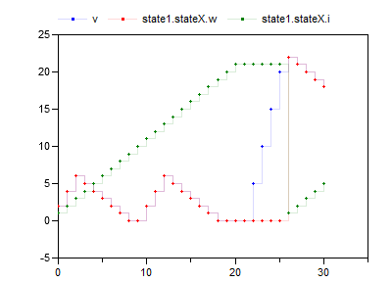
Hierarchical
State Machine Example
stateA declares v as ‘outer output’.
state1 is on an intermediate level and declares v as ‘inner outer output’, i.e. matches lower level outer v by being inner and also matches higher level inner v by being outer.
The top level declares v as inner and gives the start value.

Slide 28
Reset and Synchronize
count is defined with a start value in state1. It is reset when a reset transition (v>=20) is made to state1.
stateY declares a local counter j. It is reset at start and as a consequence of the reset transition (v>=20) from state2 to state1.
The reset of j is deferred until stateY is entered by transition (stateX.i>20) although this transition is not a reset transition.
Synchronizing the exit from the two parallel state machines of state1 is done by using a synchronized transition.

Slide 29
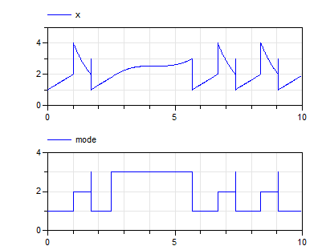
Hybrid Automata (Modelica 3.2-, 2006)

Slide 30
Hybrid Automata with Modelica 3.3+ (prototype)

Slide 31
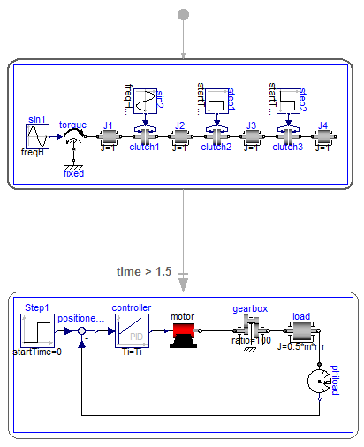
Acausal Models in States – Modelica 3.3+
The equations of each state is guarded by the activity condition
Should time variable be stopped when not active?
Should time be reset locally in state by a reset transition?
Special Boolean operator exception() to detect a problem in one model and transition to another model

Slide 32
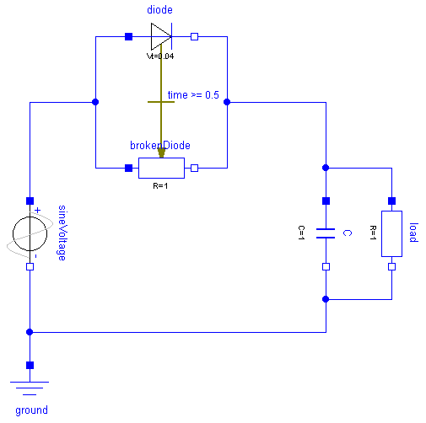
Multiple Acasual Connections
// C_p_i+brokenDiode_n_i+diode_n_i+load_p_i = 0.0;
Replaced by:
C_p_i +
(if activeState(brokenDiode) then brokenDiode_n_i else 0) +
(if activeState(diode) then diode_n_i else 0) +
load_p_i = 0.0;

Slide 33
Conclusions
We have introduced synchronous features in Modelica 3.3.
For a discrete-time variable, its clock is associated with the variable type and inferencing is supported.
Special operators have to be used to convert between clocks.
This gives an additional safety since correct synchronization is guaranteed by the compiler.
We have described how state machines can be modeled in Modelica 3.3.
Instances of blocks connected by transitions with one such block marked as an initial state constitute a state machine.
Hierarchical state machines can be defined with reset or resume semantics, when re-entering a previously executed state.
Parallel sub-state machines can be synchronized when they reached their final states.
Special merge semantics have been defined for multiple outer output definitions in mutually exclusive states as well as conditional data flows.

