Slide 1
Vertical Integration in Tool Chains for Modeling Simulation and Optimization of Large-Scale Systems
Johan Åkesson, Modelon AB/Lund University
Thanks to
Joel Andersson, Niklas Andersson, Magnus Gäfvert, Staffan Haugwitz,
Görel Hedin, Per-Ola Larsson, Alexandra Lind, Kilian Link,
Fredrik Magnusson, Elin Sällberg, Stephane Velut

Slide 2
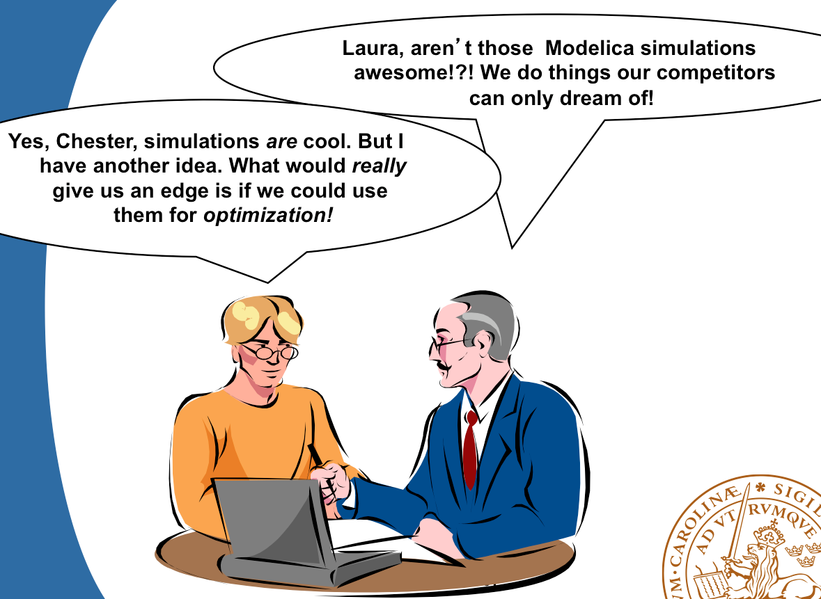
In 2006…

Slide 3
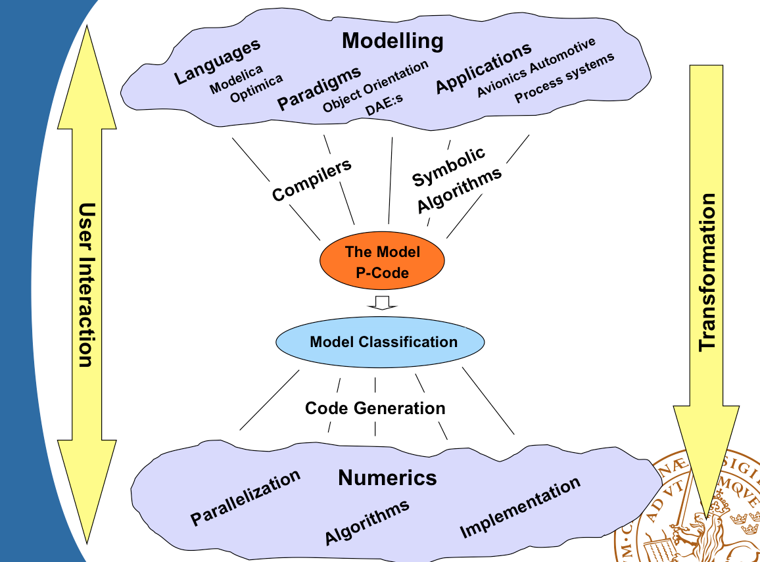
The Landscape

Slide 4
Outline
Modelica
Application examples
Extension example
Interface example
Towards a vertically integrated tool chain
Challenges

Slide 5
What is Modelica?
A language for modeling of complex heterogeneous physical systems
  Open language
    Modelica Association (www.modelica.org)‏
  Several tools supporting Modelica
    Dymola
    OpenModelica (free)
    MosiLab
    Scilab/Scicos (free)‏
  Extensive (free) standard library
    Mechanical, electrical, thermal etc.

Slide 6
Key Features of Modelica
Declarative equation-based modeling
  Text book style equations
Multi-domain modeling
  Heterogeneous modeling
Object oriented modeling
  Inheritance and generics
Software component model
  Instances and (acausal) connections
Graphical and textual modeling

Slide 7
A Simple Modelica model
Differential equation
x(t) = ax(t) + bu(t)
•
Class definition
model FirstOrder
input Real u;
parameter Real b = 1;
parameter Real a = -1;
Real x(start=1);
equation
der(x) = a*x + b*u;
end FirstOrder;
Parameter declaration
Variable declaration
Initialization
Derivative operator
Equation

Slide 8
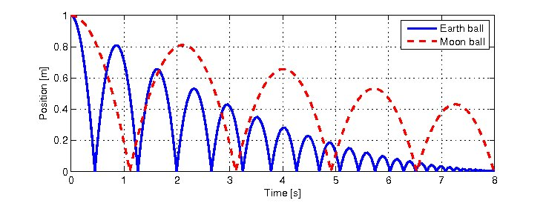
Hybrid modeling
class BouncingBall //A model of a bouncing ball
parameter Real g = 9.81; //Acceleration due to gravity
parameter Real e = 0.9; //Elasticity coefficient
Real pos(start=1); //Position of the ball
Real vel(start=0); //Velocity of the ball
equation
der(pos) = vel; // Newtons second law
der(vel) = -g;
when pos <=0 then
reinit(vel,-e*pre(vel));
end when;
end BouncingBall;
class BBex
BouncingBall eBall;
BouncingBall mBall(g=1.62);
end BBex;

Slide 9
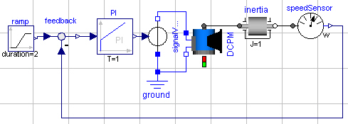
Graphical Modeling
model MotorControl
Modelica.Mechanics.Rotational.Inertia inertia;
Modelica.Mechanics.Rotational.Sensors.SpeedSensor speedSensor;
Modelica.Electrical.Machines.BasicMachines.DCMachines.DC_PermanentMagnet DCPM;
Modelica.Electrical.Analog.Basic.Ground ground;
Modelica.Electrical.Analog.Sources.SignalVoltage signalVoltage;
Modelica.Blocks.Math.Feedback feedback;
Modelica.Blocks.Sources.Ramp ramp(height=100, startTime=1);
Modelica.Blocks.Continuous.PI PI(k=-2);
equation
connect(inertia.flange_b, speedSensor.flange_a);
connect(DCPM.flange_a, inertia.flange_a);
connect(speedSensor.w, feedback.u2);
connect(ramp.y, feedback.u1);
connect(signalVoltage.n, DCPM.pin_ap);
connect(signalVoltage.p, ground.p);
connect(ground.p, DCPM.pin_an);
connect(feedback.y, PI.u);
connect(PI.y, signalVoltage.v);
end MotorControl;

Slide 10
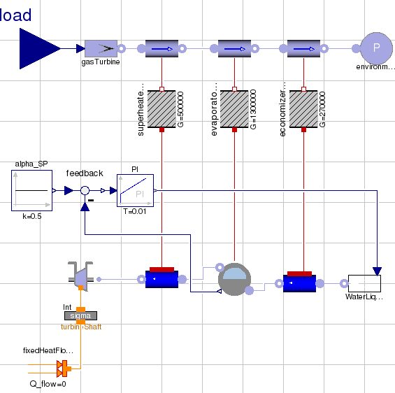
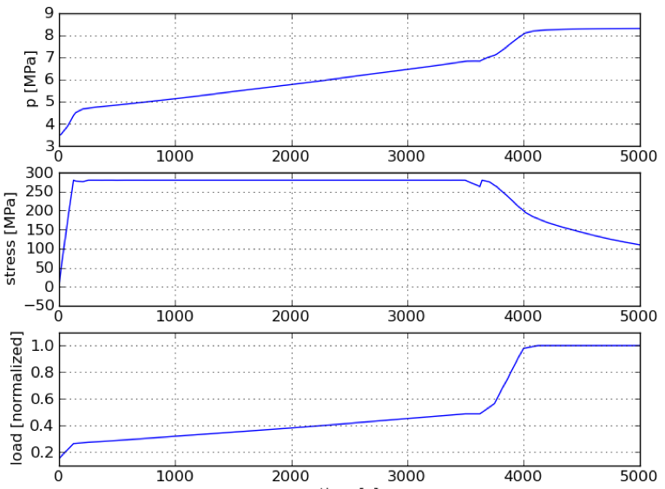
A Modelica-based
Tool Chain
Flattening of Modelica source code
Compiler front-end
Symbolic maniulation
Index reduction
Analytic solution of simple equations
Unstructured
Flat DAE
C code
Code generation
Residual equations
Analytic Jacobians
Transformed
flat DAE
Numerical solvers
NLP algorithms
Integrators
Result
Post processing
Visualization
Solution profiles

Slide 11
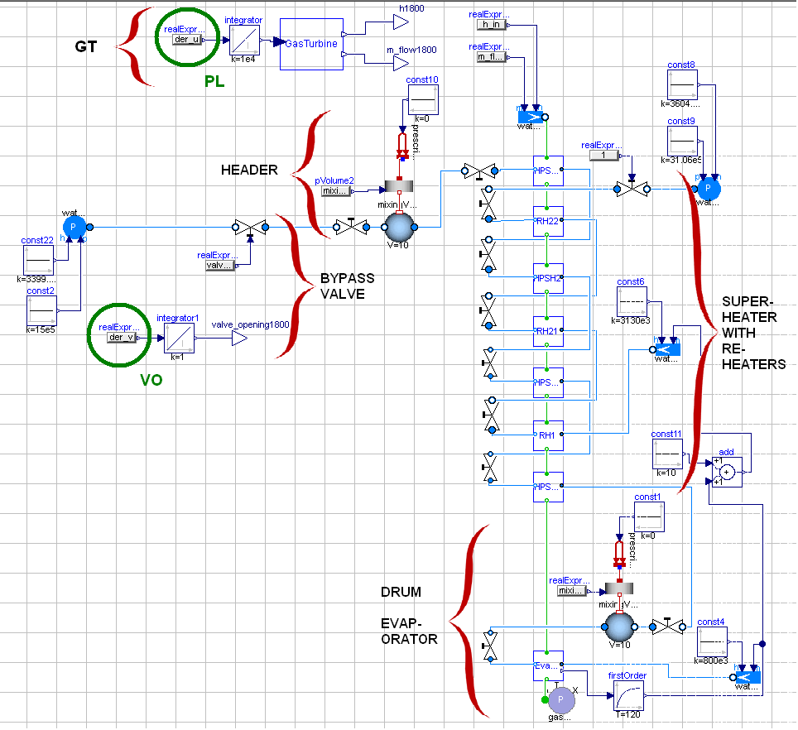
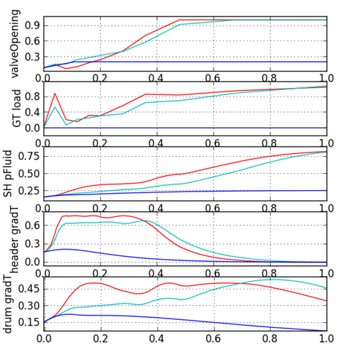
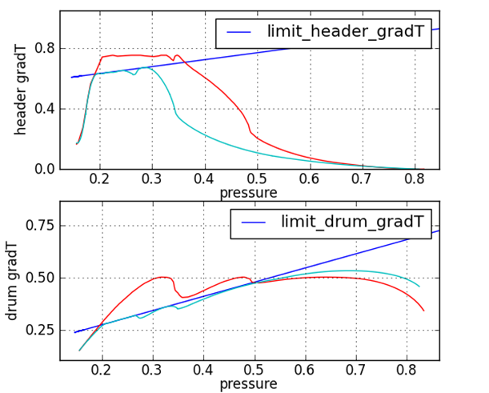
Industrial Application I
Power Plant Start-up Optimization
Start-up optimization of combined
cycle power plants
Reduce start-up time
Model-based optimization
Siemens AG, LU, Modelon
collaboration
Continuous time states: 39
Scalar equations: 569
Algebraic variables: 530
NLP equations: 26824

Slide 12
Industrial Application I
Power Plant Start-up Optimization
Design-patterns from Modelica media model libraries applied to optimization-friendly models
Intuitive high-level descriptions of dynamic optimization problem appreciated by users – a vehicle for communicating ideas
Large effort to develop models suitable for optimization
Scaling of problem significantly more challenging than in simulation
Convergence and robustness of numerical algorithms
Lessons learnt
Modeling for optimization is significantly different from modeling for simulation
Numerical optimization algortihm is significantly less robust than simulation algorithm
Scaling of problem and initial guesses have major impact

Slide 13
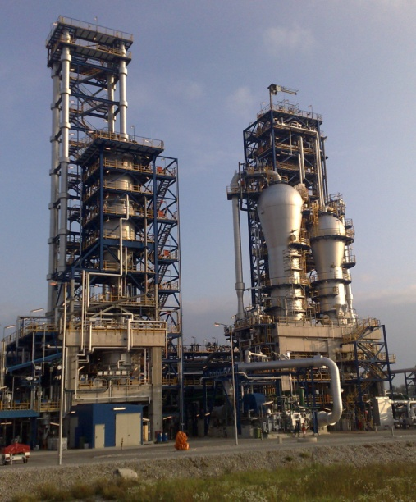
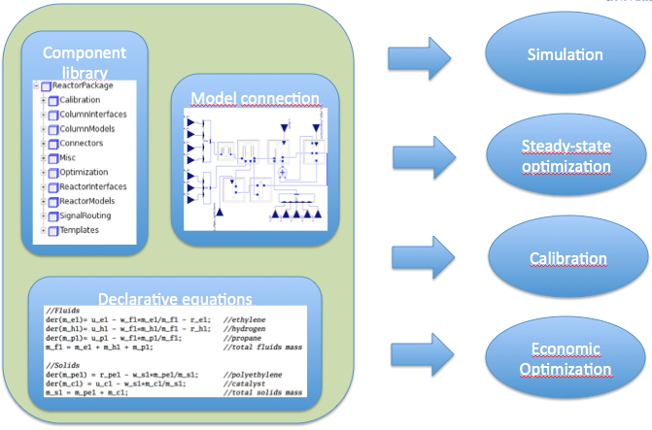
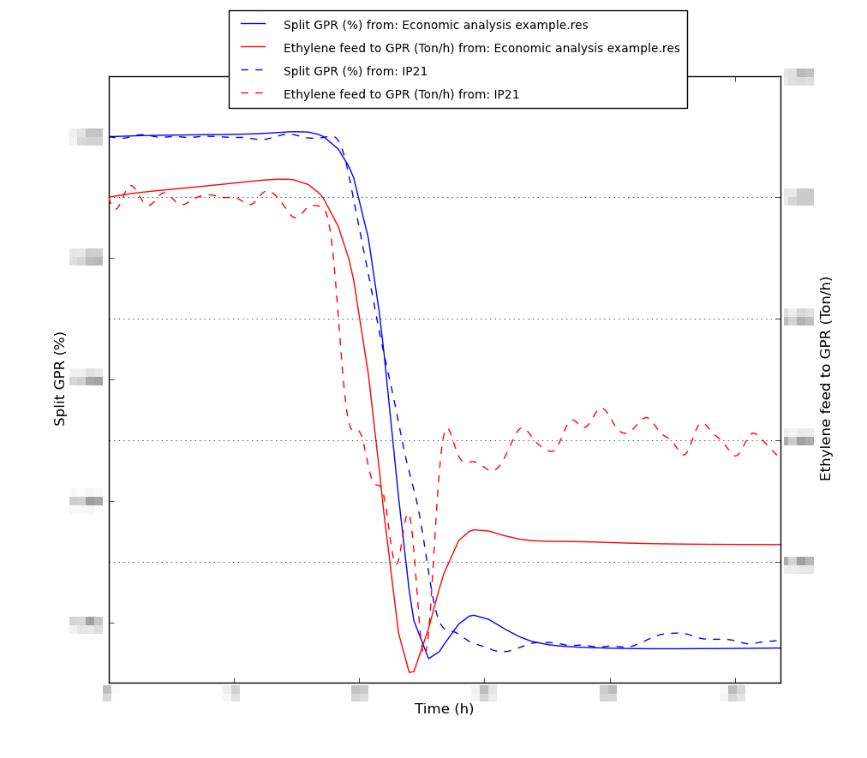
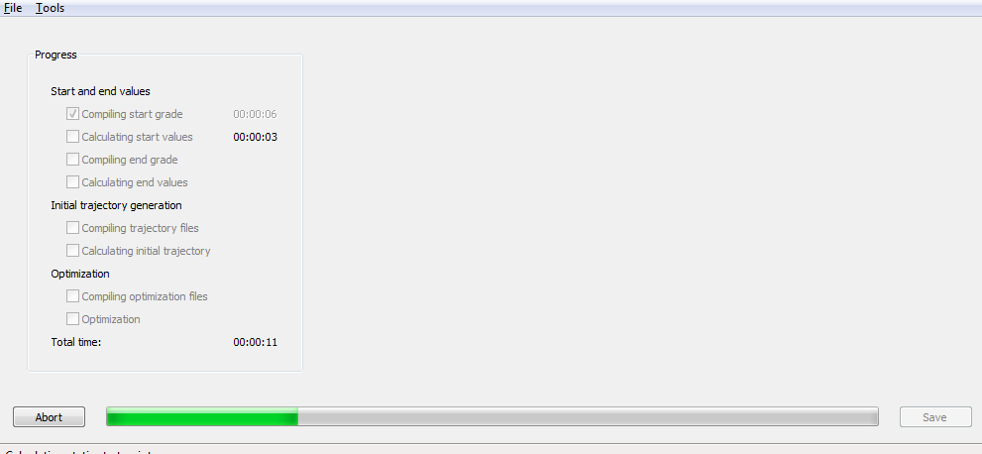
Industrial Application II
Grade Changes in Polyethylene Production
Optimization of economics of
polyethylene grade changes
Model calibration to data
Modeling with Modelica and Optimica
Development of end-user GUI
PIC-LU – Lund University and Borealis

Slide 14
Industrial Application II
Grade Changes in Polyethylene Production
Model reuse across different computations
High-level model and optimization problem formulation enabled promoted focus on problem formulation
Custom GUI in Python appreciated by end-users
Careful manual scaling of problem required for convergence
Difficult to tailor collocation optimization formulation to problem description
Non-standard economic cost difficult to handle
Lessons learnt
Significant advantages from Modelica technology – same model used for steady-state, dynamic simulation, calibration and optimization
Increased interaction with discretization sometimes important

Slide 15
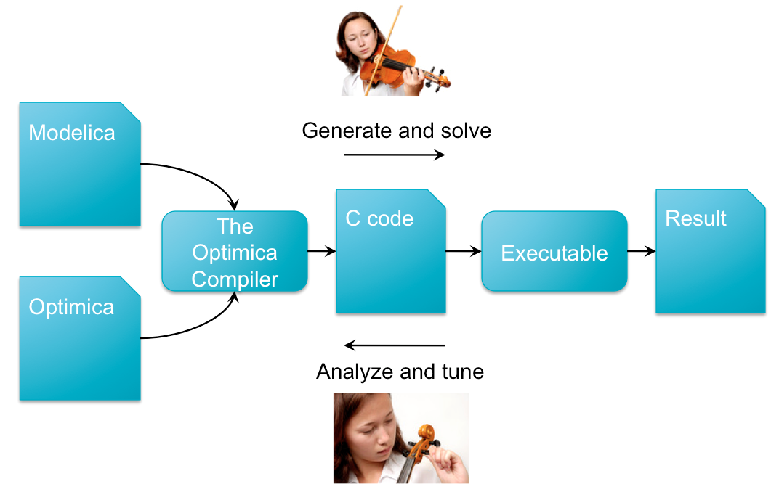
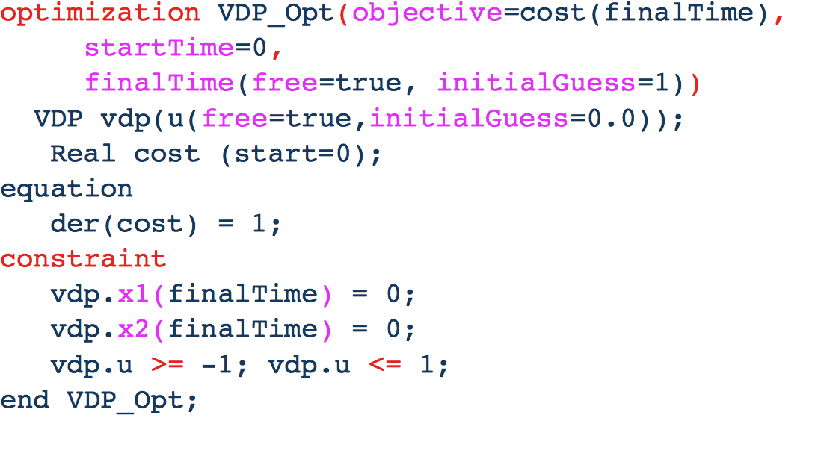
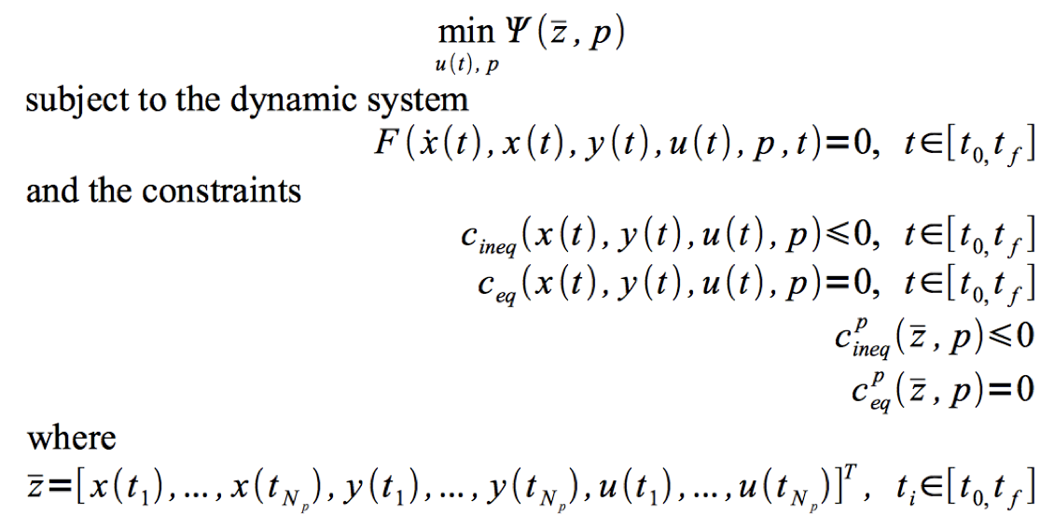
Extension Example – Optimica
High-level description of optimization problems
  Steady-state
  Dynamic
Extension to Modelica
  Optimization of physical models

Slide 16
Extension Example – Optimica
High-level problem descriptions promote focus on formulation rather than encoding
New users without optimization experience quickly gets up to speed
Model reuse for different usages
Automatic model transformation reduce user effort
Tailoring of problem discretization difficult, but sometimes needed
Power-users of dynamic optimization tools feel constrained
Lessons learnt
High-level descriptions make optimization technology available to non-experts
Automatic model transformation reduces design cycle times
Modern compiler construction technology is accessible to non-experts (e.g., JastAdd)

Slide 17
Towards a vertically integrated toolchain
Flattening of Modelica source code
Compiler front-end
Symbolic preprocessing
Code generation
Unstructured
Flat DAE
Interactive model evaluation and tranformation framework
Symbolic manipulation
Automatic differentiation
Model discretization
CasADi
XML code
Numerical solvers
NLP algorithms
Integrators
Solution profiles
Interactive user environment
Post processing
Visualization
Python

Slide 18
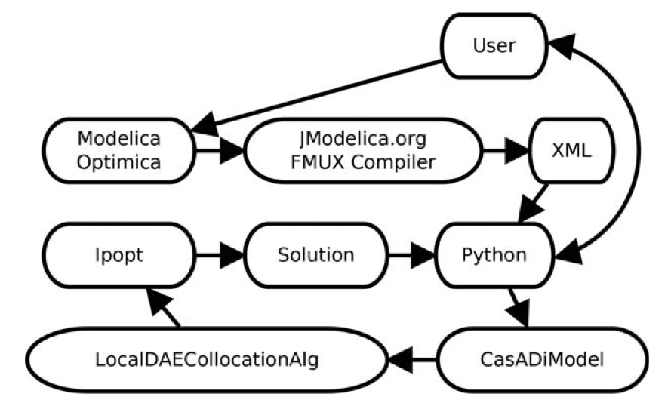
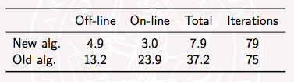
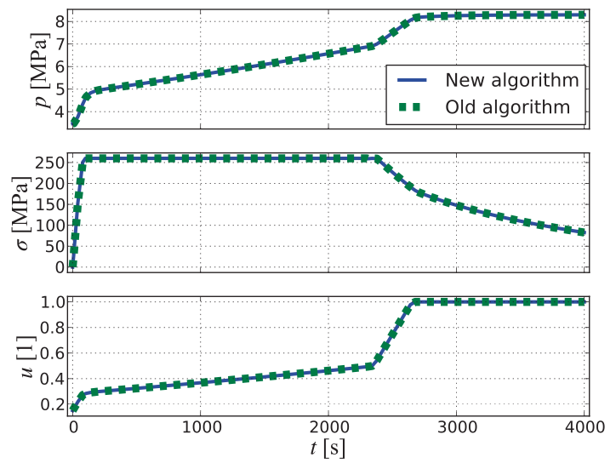
Interfacing Example –
Modelica, XML Models and CasADi
Replace C implementation of a collocation algorithm
Intermediate symbolic model format in XML
Decreased solution times by an order of magnitude
Decreased implementation time by an order of magnitude
Significantly increased flexibilty
Tailoring to specific problems

Slide 19
Interfacing Example –
Modelica, XML Models and CasADi
Rapid prototyping with interactive model evaluation and transformation frameworks
Flexibility to tailor model descretization to problem formulation
Inspiration for future versions of Optimica
Partial problem formulation in high-level format
Some of the overview lost when parts of the problem is formulated in Modelica/Optimica some part is in scripting language
Lessons learnt
Interactive model transformation powerful
Symbolic model exchange format needed (standardization on-going)
High performance and flexibility can be combined

Slide 20
Challenges
How do we make advanced algorithms in systems design in general and in optimization in particular PhD-free?
How do we combine declarative modeling languages with ideas from interactive model transformation/evaluation frameworks?
How do we propagate consistent error/diagnostics through the tool chain?
Open interfaces and interoperability, FMI and extensions
Classify models applicable to different solution algorithms

Slide 21
Conclusions
In users’ perception, current optimization algorithms for large-scale non-linear dynamic systems requires high level of expertise
Very different cultures and best practices in simulation and optimization communities – expectation management
Users sometimes need to/desire to to interact with both mathematical model and solution algorithm implementation
Challenges in usability and robustness of numerical algorithms
Challenges in vertically integrated tool chains – languages and open interfaces and tool decoupling

Slide 22
Thank you!
Questions, comments?

