Slide 1
On the Conditional Mutual Information in Gaussian-Markov Structured Grids
Hanie Sedghi &
Edmond Jonckheere

Slide 2
Agenda
“Smart” Grid
Phasor Measurement Units
False Data Injection Attacks
Gaussian Markov Random Field
DC power flow
Conditional Covariance Test
Stealthy Deception False Data Injection Attack
Attack Detection
Conclusion and Future Works
2

Slide 3
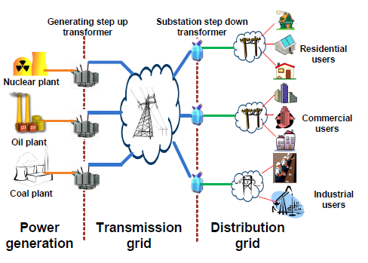
Traditional Grid
Traditional Grid
  electricity generation, electricity transmission, electricity distribution, and voltage/frequency stability control
  Colocation of generation and distribution
3

Slide 4
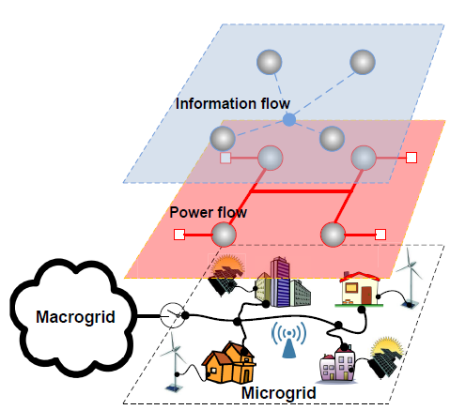
“Smart” Grid
New Grid
  a large-scale generation-transmission-distribution NETWORK
  Management and Control
  Large scale power flow across the grid to allow consumers to purchase electricity at cheaper prices
Overall architecture
4

Slide 5
Fault Detection
Today's power systems
  not adequately equipped with fault diagnosis mechanisms against various attacks
Fast and accurate uncovering of possibly malicious events
  preventing faults that may lead to blackouts
  routine monitoring and control tasks of the smart grid, including state estimation and optimal power flow
Fault localization in nation’s grid
  challenging
    due to the massive scale and inherent complexity
5

Slide 6
Phasor Measurement Units (PMU’s)
Synchronous PMU's with GPS time stamp
  being massively deployed across the grid
  considered the most reliable sensing information to monitor the state of “health" of the grid
Recently Suggested Applications:
  Voltage security to avoid voltage collapse by using synchronized PMU measurements and decision tree
  Fault detection through apparent changes in the bus susceptance parameters using PMU phase angles and generalized likelihood ratio
  Detecting line outages using PMU angle measurements and Lasso, to avoid cascading events
  And so many more!
6

Slide 7
False Data Injection Attack
False Data Injection attack refers to PMU data being manipulated before reaching the aggregator.
All of the suggested applications fail in case of False Data Injection attack.
PMU’s are being massively deployed for “Smart” Grid control and monitoring.
It is crucial to have a mechanism to guarantee reliability of PMU data.
We will consider the most recent false data injection attack that is capable of deluding the state estimator. Prior to us, no remedy was suggested for it.
7

Slide 8
False Data Injection Attack
False Data Injection attack refers to PMU data being manipulated before reaching the aggregator.
All of the suggested applications fail in case of False Data Injection attack.
PMU’s are being massively deployed for “Smart” Grid control and monitoring.
It is crucial to have a mechanism to guarantee reliability of PMU data.
We will consider the most recent false data injection attack that is capable of deluding the state estimator. Prior to us, no remedy was suggested for it.
7

Slide 9
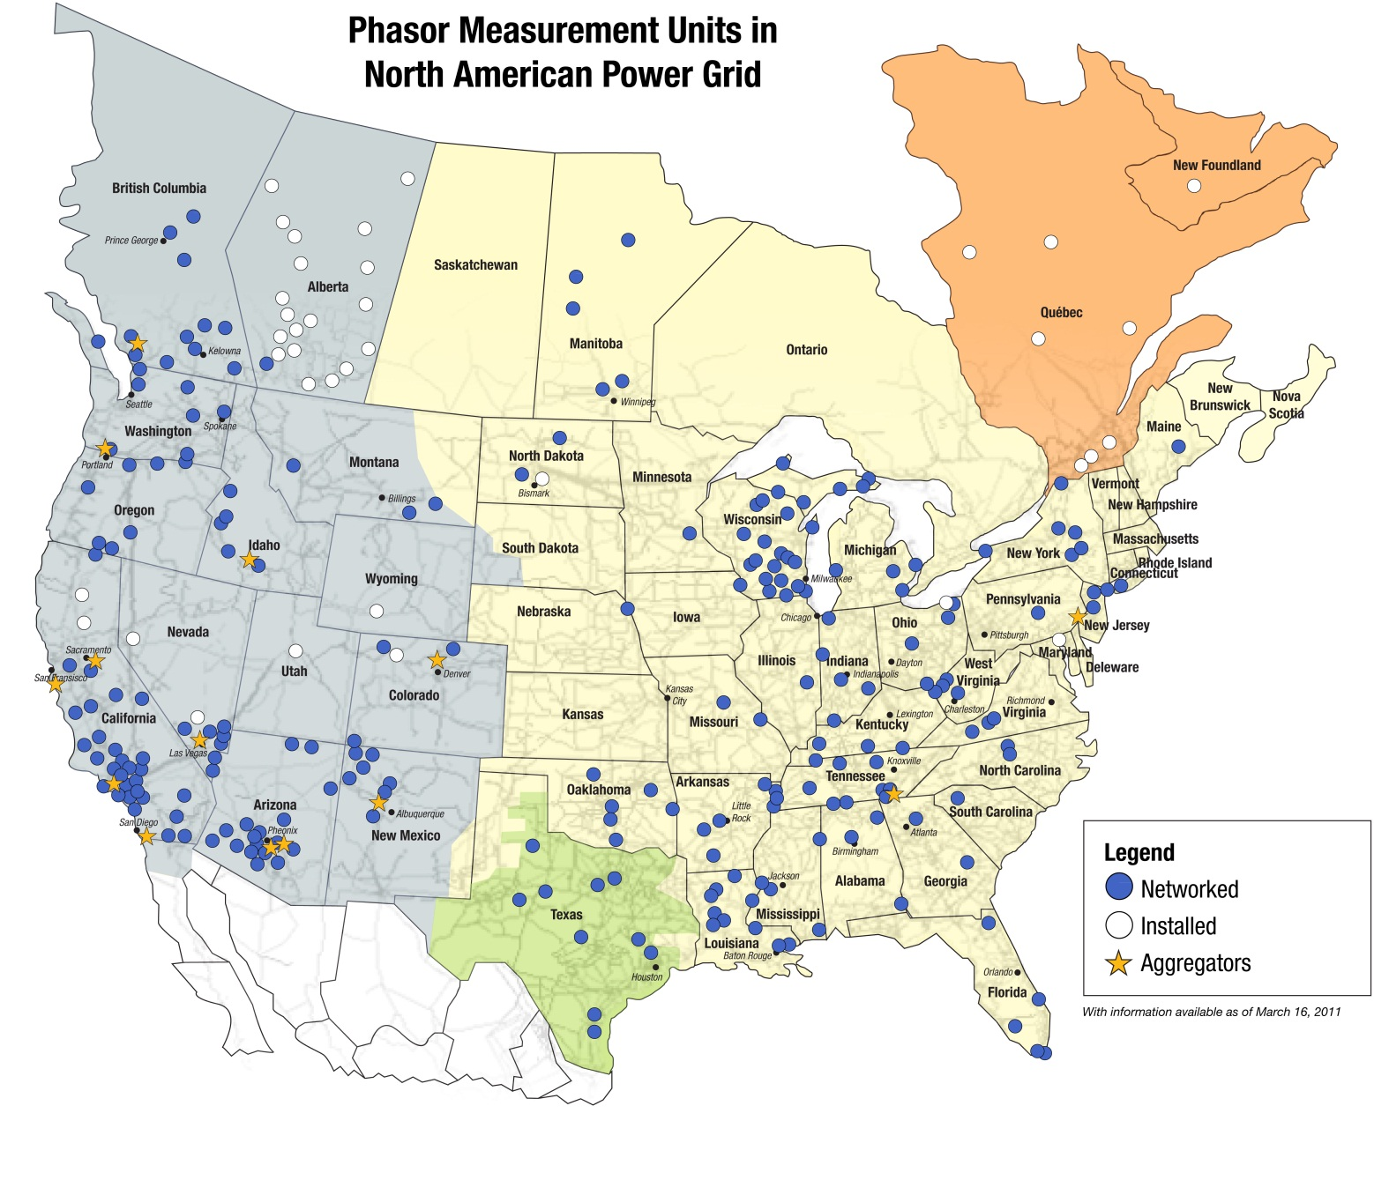
PMU Network
8

Slide 10



Gaussian Markov Random Field
A Gaussian Markov Random Field (GMRF) is a family of jointly Gaussian random variables with distribution that factors in accordance with a given graph.
Given a graph with
consider a vector of Gaussian random variables
where each node is associated with a scalar Gaussian random variable .
A GMRF on G has a probability density function
where is a positive-definite symmetric matrix whose sparsity pattern corresponds to that of the graph
The matrix is known as the potential or information matrix.
For a Gaussian Markov Random Field, local Markov property states that
9

Slide 11
Gaussian Markov Random Field: Separator
J
Separator S
I
N(i)
-i
i
10

Slide 12


DC Power Flow Equations
Often used for analysis of power systems in normal steady-state operations
Voltages are 1 p.u. and angle differences are small
The power flow on the transmission line connecting bus i to bus j is given by
and denote the phasor angles at bus i and j .
denotes the inverse of the line inductive reactance.
The probabilistic landscape is given by the power injected at the buses:
So,
where
11

Slide 13
PMU angle measurements as GMRF
Aggregated power (generation>0 & load<0) injection at buses are modeled as Gaussian random variables.
DC power flow is linear; hence
PMU angle measurements can be considered as Gaussian random variables.
DC power flow shows the GMRF property of PMU angle measurements:
  The first term shows that grid graph neighbors are probabilistic neighbors too.
  What about the second term?
  What is the correct set of neighbors?
12

Slide 14
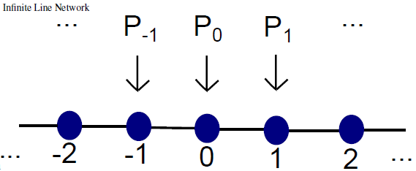
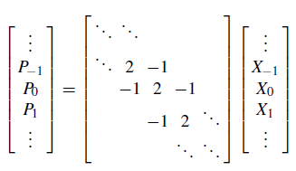


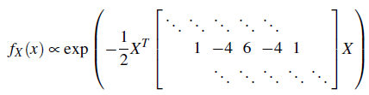

Infinite Chain-Structured Network
$\hat{P}\left(e^{jα}\right)=\hat{B}{(e}^{jα})\hat{X }$($e^{jα}$)
13

Slide 15





Euclidean Lattice structured network
is quadratic in the variables, but those variables that are multiplied have their indexes within at most a 2-neighbor relationship in the lattice structure.
14

Slide 16

Model Selection
We use Conditional Covariance Test (CCT)[1]:
  Two nodes are connected in the Markov graph iff the Conditional Mutual Information between those measurements is greater than a threshold.
  For Gaussian variables, testing Conditional Mutual Information is equivalent to Conditional Covariance Test.
In order to have structural consistency, the model should satisfy two important properties: walk-summability and local separation property.
walk-summability:
local separation property [1]:
[1] A. Anandkumar, V. Tan, F. Huang, and A.S. Willsky. High-dimensional Gaussian graphical model selection: walk summability and local separation criterion. Journal of Machine Learning, June 2012. accepted
15

Slide 17
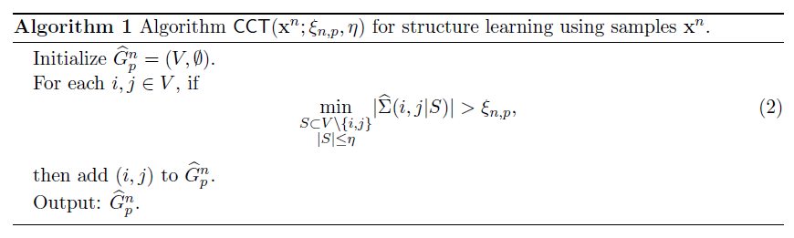
Conditional Covariance Test (CCT)
16

Slide 18
Neighboring Relationship
Grid structure is walk-summable. (⇐ It is of bounded degree.)
Under walk-summability the effect of faraway nodes on covariance decays with the distance and the error in approximating the covariance by local neighboring relationship decays exponentially with the distance [1].
By correct tuning of threshold and enough number of samples, we expect the output of CCT method to follow the grid structure.
17

Slide 19
Stealthy Deception False Data Injection Attack
The most recent and most realistically scary false data injection attack on the power grid is the stealthy deception attack [2]:
  z : measurement vector, x:state vector, h:measurement function,ᵋ measurement error
The goal of a stealthy deception attacker is to compromise the measurements available to the State Estimator (SE) as
  a is the attack vector and is designed in a way that the difference between real measurement z and attacked measurement is the desired value
  a is designed such that attack cannot be detected by Bad Data Detection in State Estimator
  Such an a is proven to be achievable via
[2] A. Teixeira, G. Dan, H. Sandberg, and K H. Johansson. A Cyber Security Study of a SCADA Energy Management System: Stealthy Deception Attacks on the State Estimator. In IFAC World Congress, September 2011.
18

Slide 20
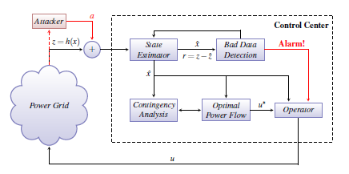
False Data Injection Attack
This attack is valid only if performed locally.
Attack is performed under DC power flow assumption.
The state estimator under a cyber attack [2]
19

Slide 21
Attack Detection
DC power flow assumption
  x=X
Numerical analysis on above equation shows that
the Markov graph of an attacked system lacks at least one link from the grid graph.
We use this to trigger the alarm.
It should be emphasized that the attack assumes the knowledge of the system's bus-branch model. So the attacker is equipped with a wealth of information. Yet, we can detect such an attack by a sophisticated player with our method.
20

Slide 22
Simulation
We considered a 9-node grid suggested by Zimmerman et al. [3]
[3] C. E. Murillo-Snchez R. D. Zimmerman and R. J. Thomas. MATPOWER steady-state operations, planning and analysis tools for power systems research and education. Power Systems, IEEE Transactions on,26(1):12–19, Feb. 2011
21

Slide 23
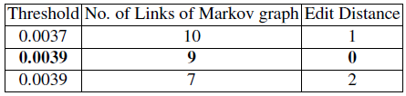
Simulation (cont.)
First, we fed the system with Gaussian demand and simulated the power grid. We used MATPOWER for solving the DC power flow equations for various demand and used the resulting angle measurements as the input to CCT algorithm.
We used YALMIP and SDPT3 to perform CCT.
With the right choice of parameters and threshold, and enough un-compromised measurements, the Markov graph follows the grid structure.
The edit distance between the Markov graph and the grid graph that is used to lead us to the correct threshold:
22

Slide 24
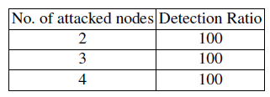
Attack Simulation
We introduced the stealthy deception attack to the system.
We investigated the cases where 2, 3 or 4 nodes were under attack.
For each case, we simulated all possible attack combinations.
In all attack scenarios, the Markov graph of tampered PMU measurements lacked at least one link that was present in grid graph, a discrepancy that triggered the alarm.
23

Slide 25
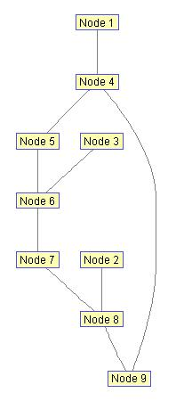
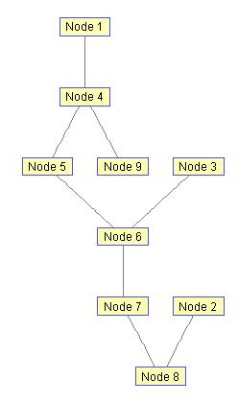
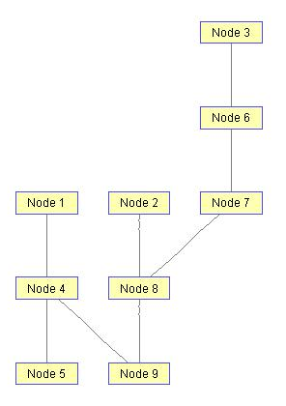
Attack Simulation
No attack
One case:
Nodes 3 and 9 under attack
One case:
Nodes 2 and 5 under attack
24

Slide 26
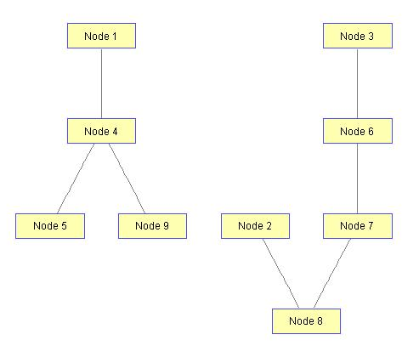
Attack Simulation
One case:
Nodes 6 and 9 under attack
25

Slide 27
Conclusion
It is crucial to assure PMU data reliability
Statistical structure learning of PMU angle measurements
Markov graph of bus angle measurements follows grid topology.
Discrepancy triggers the alarm that the system is under false data injection attack.
This is the first remedy for the strong false data injection attack mentioned.
We would like to extend this work to bigger grid networks.
26

Slide 28
References
A. Anandkumar, V. Tan, F. Huang, and A.S. Willsky. High-dimensional Gaussian graphical model selection: walk summability and local separation criterion. Journal of Machine Learning, June 2012. accepted.
A. Teixeira, G. Dan, H. Sandberg, and K H. Johansson. A Cyber Security Study of a SCADA Energy Management System: Stealthy Deception Attacks on the State Estimator. In IFAC World Congress, September 2011.
C. E. Murillo-Snchez R. D. Zimmerman and R. J. Thomas. MATPOWER steady-state operations, planning and analysis tools for power systems research and education. Power Systems, IEEE Transactions on,26(1):12–19, Feb. 2011
27

