Slide 1
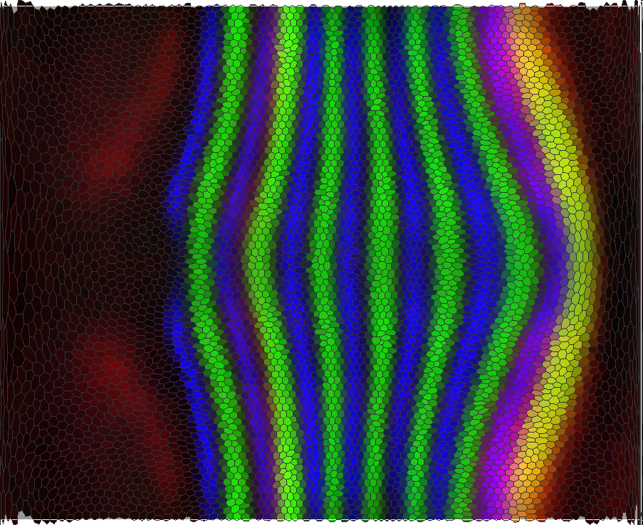
Regression on Manifolds: Nonparametric system identification with applications in control and systems biology
Anil Aswani
Peter Bickel
Claire Tomlin
Joint work with Mark Biggin, Charless Fowlkes, Soile Keränen, and Jitendra Malik
Electrical Engineering and Computer Sciences, UC Berkeley
ACCESS Linnaeus Center, School of Electrical Engineering, KTH
April 2010
TexPoint fonts used in EMF.
Read the TexPoint manual before you delete this box.: AAAAAAAAAA

Slide 2
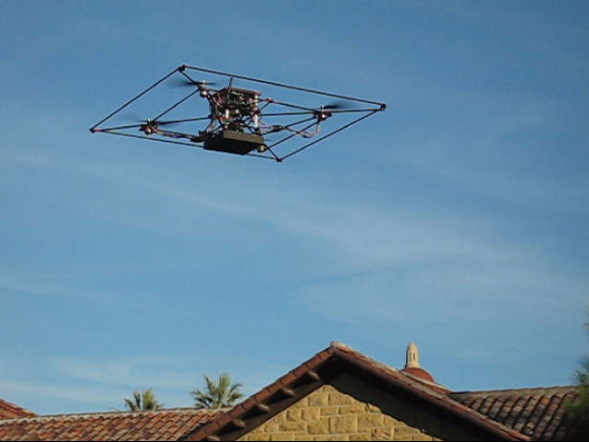
Experimental Platform: STARMAC
The Stanford Testbed of Autonomous Rotorcraft for Multi-Agent Control
[Hoffmann, Waslander, Vitus, Huang, Gillula, Mercer, Bouffard, Li]
Notes:
FIXME: get better video

Slide 3
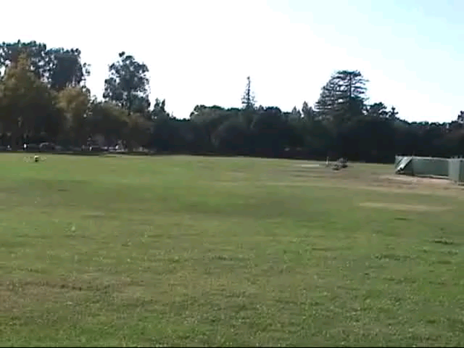
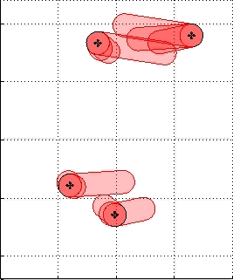
Case Study: Collision Avoidance
Pilots instructed to attempt to collide vehicles

Slide 4
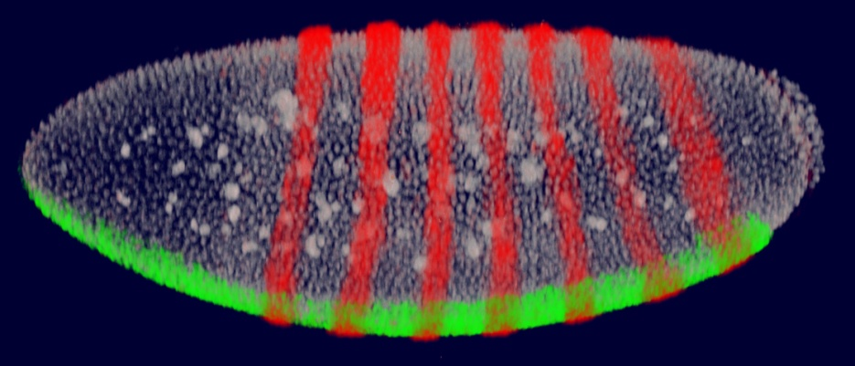
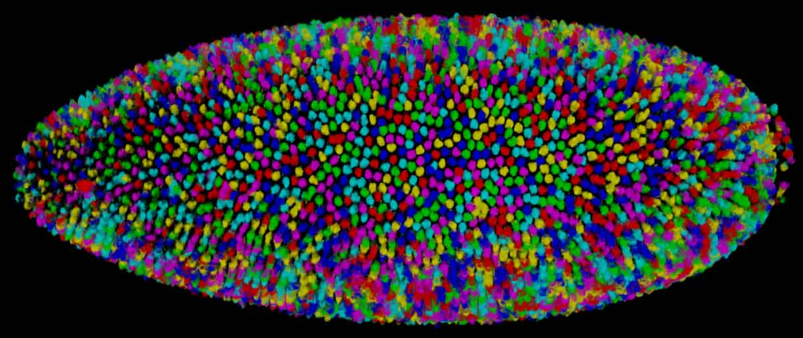
Image analysis can record 3D gene expression at cellular resolution
3D confocal images
3D segmentation mask
a “PointCloud” table
id, x, y, z, Nx, Ny, Nz, Vn, Vc, Sytox, Cy3_n, Cy3_a, Cy3_b, Cy3_g, Cou_n, Cou_a, Cou_b, Cou_g
1, 102.36, 142.14, 112.00,-0.396, 0.851, 0.344, 207.96, 605.36, 52.18, 23.55, 18.76, 22.55, 22.10, 11.95, 8.13, 28.01, 12.04
2, 264.63, 172.01, 79.36, 0.103, 0.972,-0.208, 281.73, 599.90, 82.12, 31.67, 34.97, 15.95, 31.93, 21.06, 12.56, 41.40, 19.12
3, 225.91, 174.99, 88.65,-0.030, 0.999,-0.015, 185.79, 418.35, 85.32, 35.63, 31.27, 14.77, 34.00, 19.59, 20.53, 38.80, 21.35
4, 318.42, 48.34, 138.91, 0.095,-0.744, 0.660, 182.46, 464.19, 37.61, 19.31, 15.15, 12.47, 17.55, 21.01, 13.78, 26.87, 17.53
5, 110.18, 34.40, 109.65,-0.186,-0.913, 0.362, 127.81, 432.01, 55.78, 24.12, 23.53, 12.19, 19.71, 13.81, 7.57, 28.16, 12.40
6, 340.48, 73.79, 37.548, 0.205,-0.299,-0.931, 208.26, 607.49, 80.23, 33.04, 26.75, 21.24, 28.91, 31.48, 20.69, 50.45, 26.96
. . .
Luengo et al, 2006
Notes:
4
we have used an image analysis based strategy to record expression patterns. 3D confocal stacks are taken of embryos stained to label nuclei and the expression pattern of two genes at atime, one of which is a reference gene. These then are converted to flat text files describing the x,y,z locations of each nucleus and expression in each cell.

Slide 5
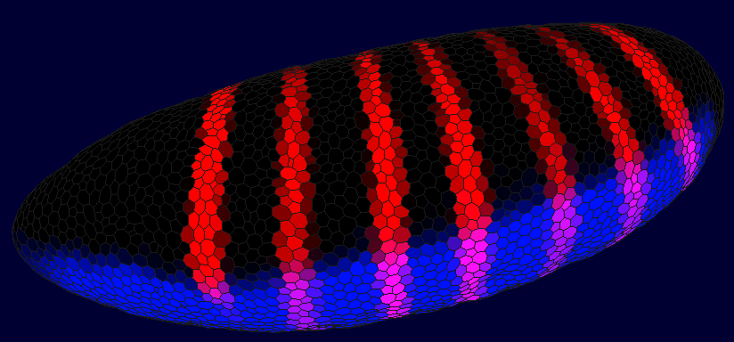
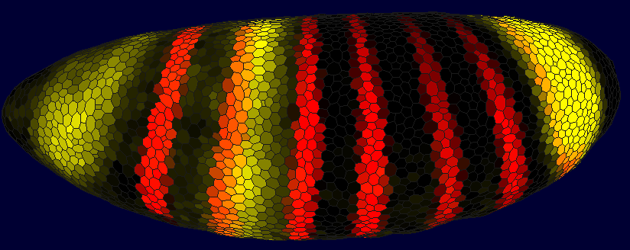
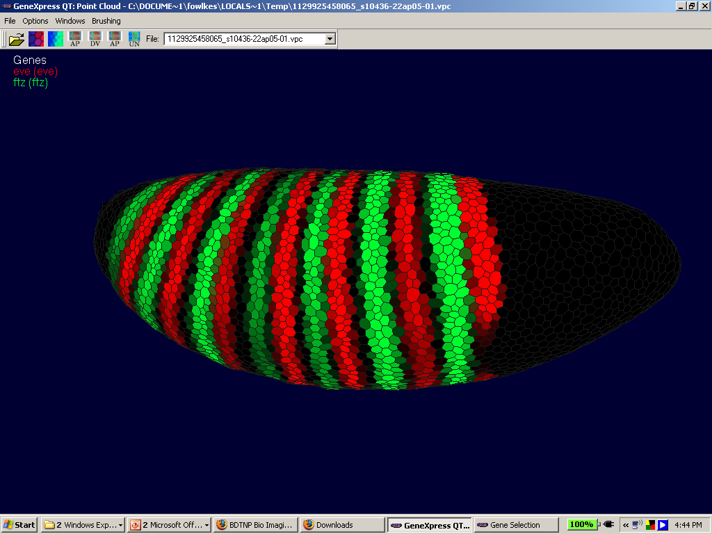
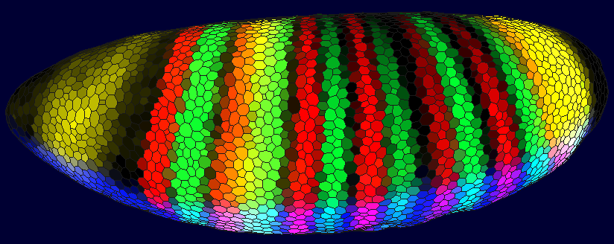
a 3D gene expression atlas
Fowlkes et al, 2008
Notes:
5
We have developed a way to accurately register such data from thousands of embryos and literally millions of cells into a single model blastoderm.

Slide 6
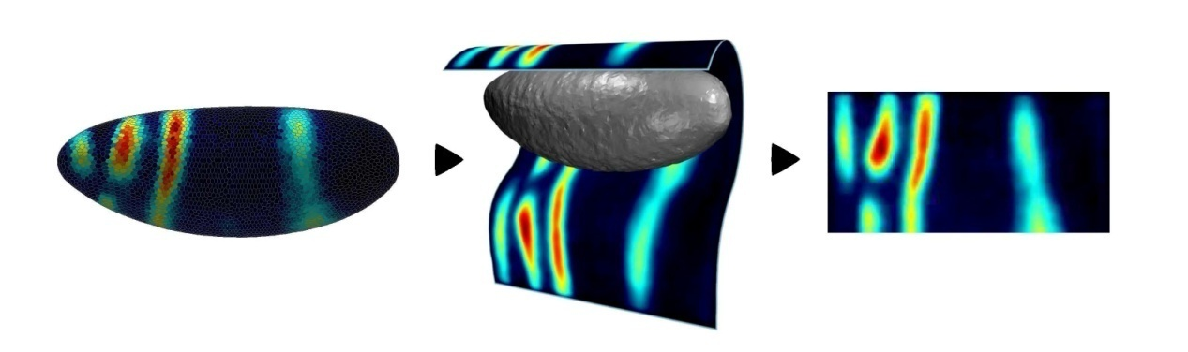
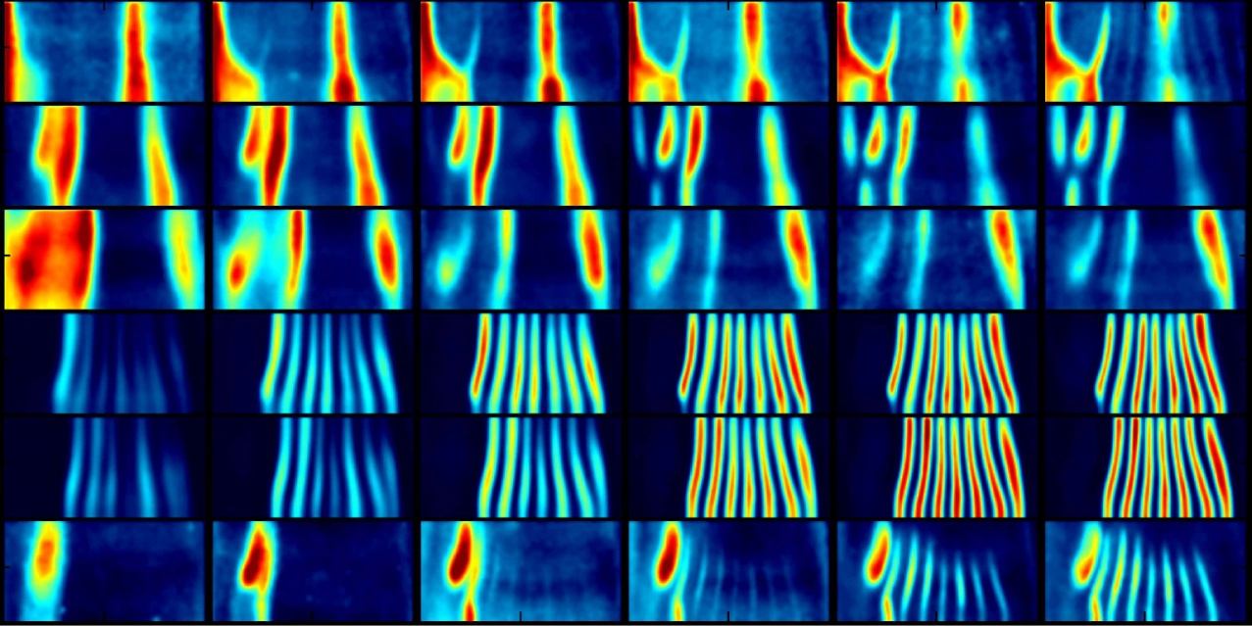
a 3D gene expression atlas
16 million cells
3,000 embryos
7 time points
protein 20 factors
1.0
KNI
GT
0.8
HB
0.6
EVE
0.4
FTZ
0.2
SLP1
0.0
time
Fowlkes et al, 2008
Notes:
6
Our current atlas records expression at 7 time points and has data for protein expression of 20 factors and mRNA expression of 100 target genes and 30 CRMs.

Slide 7
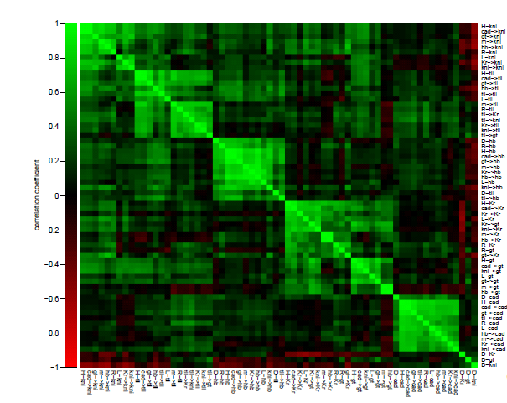
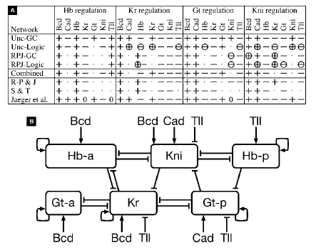
[Fomekong-Nanfack et al 2009,
Perkins et al 2006]

Slide 8
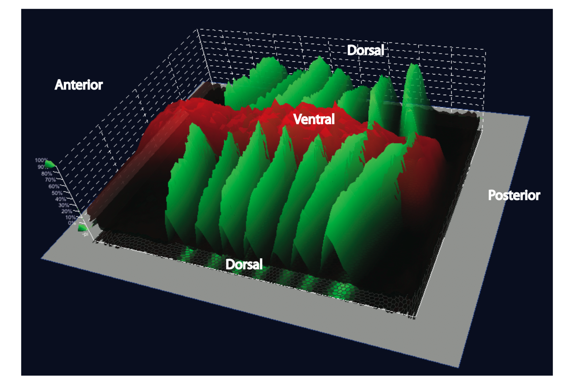
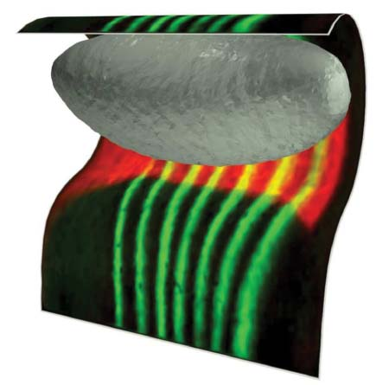
Quantitative changes in expression are
evident along both axes for almost all genes
visualizing expression along both axes
cylindrical projection
Notes:
This slide a cylindrical projection of eve and sna expression that allows the full 3D pattern to be appreciated at once.
8

Slide 9
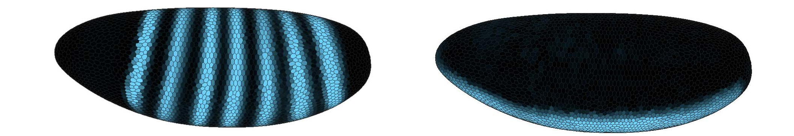
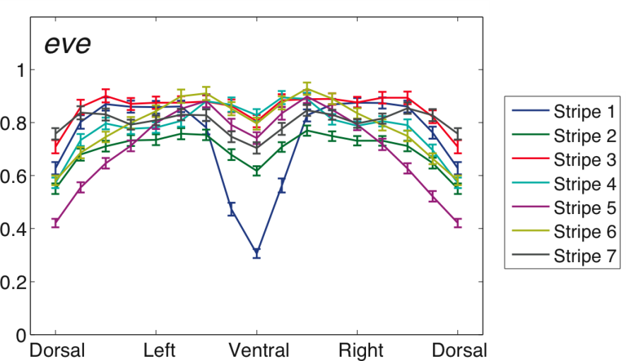
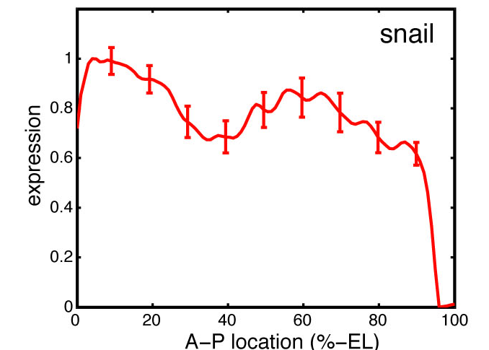
Quantitative changes in expression are
evident along both axes for almost all genes
eve
sna
eve expression along D/V axis
sna expression along A/P axis
Notes:
The power of having data in 3D was briefly shown by mark in last talk and I’ll remiind you of it here. At top you can see that the eve gene is principally patterned along the anterior posterior axis, left to right along the embryo on the left, and the sna gene is principally pattered along the D/V axis, top to bottom of the embryo image on the right. Below is show quantitation of each gene along the other axis where by eye it is hard to see any pattering. The 95% confidence limits indicate clear quantitative changes in expression.
9

Slide 10
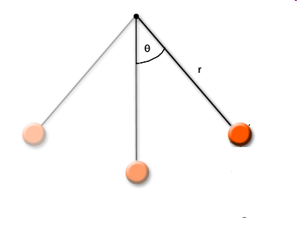
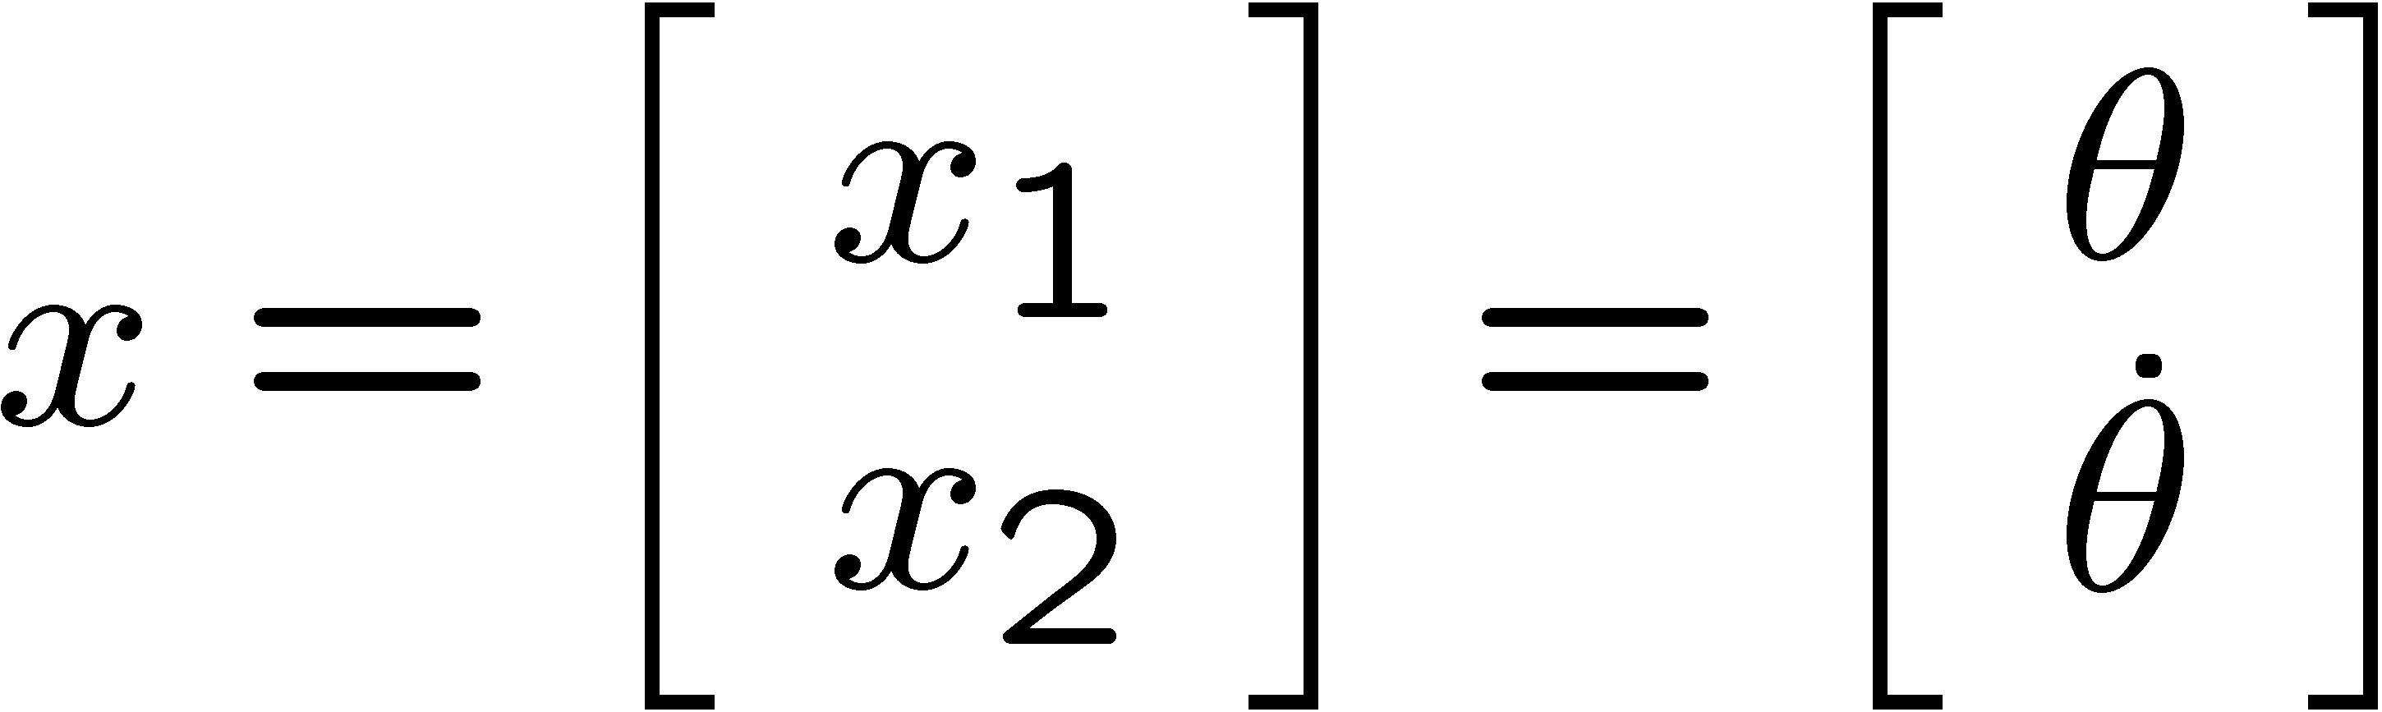
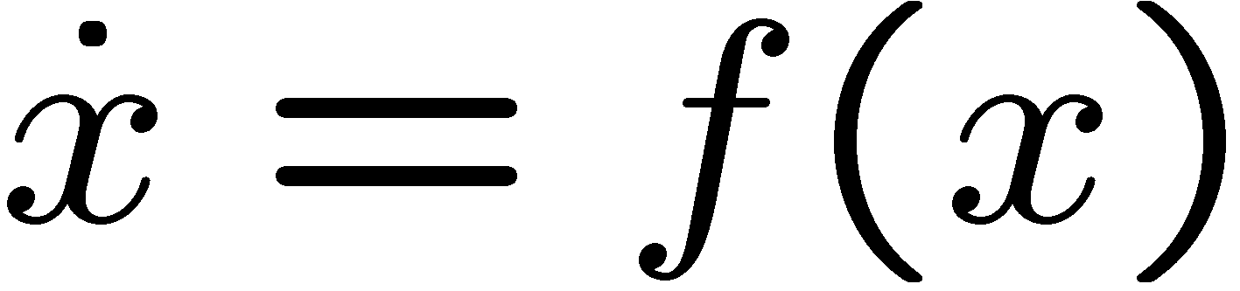
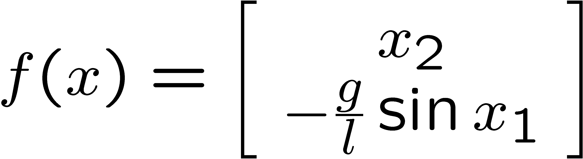

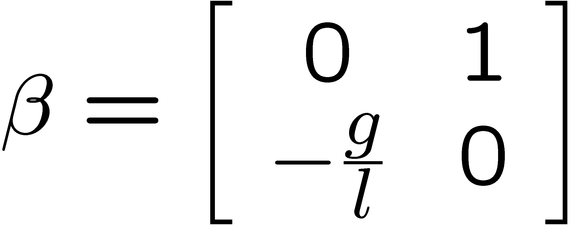
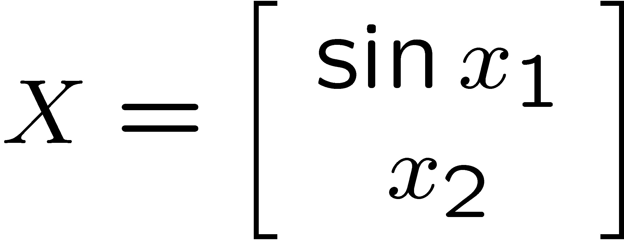
Toy Example: Pendulum
Dynamics:
Write this as:
[Jeremy Gillula]

Slide 11



Pendulum
Suppose:
model is unknown
noisy measurements are available of velocity
Identify a model
where
and is unknown
[Jeremy Gillula]

Slide 12
Pendulum
Learned Result:
  x1_dot = 0.23*x1 + 0.96*x2 + -0.27*sin(x1) +
  -0.02*cos(x1) + 0.15*sin(x2) + -0.01*cos(x2)
  x2_dot = 3.66*x1 + 0.00*x2 + -13.92*sin(x1) + 0.01*cos(x1) + -0.00*sin(x2) + 0.01*cos(x2)
Important to prevent overfitting
[Jeremy Gillula]

Slide 13


Online System Identification
[Kloetzer and Belta; Ma, Vidal, and Sastry; Soatto; Vijayakumar; Atkeson; Ting; Hunt…]
Notes:
And can calculate noisy estimates of the time derivative of the trajecotry. We are interested in the time derivative of the trajectory because we would like to learn the dynamics/ODE that describe the system motion.
13

Slide 14

Online System Identification
[Kloetzer and Belta; Ma, Vidal, and Sastry; Soatto; Vijayakumar; Atkeson; Ting; Hunt…]
Notes:
And can calculate noisy estimates of the time derivative of the trajecotry. We are interested in the time derivative of the trajectory because we would like to learn the dynamics/ODE that describe the system motion.
14

Slide 15

Online System Identification
[Kloetzer and Belta; Ma, Vidal, and Sastry; Soatto; Vijayakumar; Atkeson; Ting; Hunt…]
Notes:
And can calculate noisy estimates of the time derivative of the trajecotry. We are interested in the time derivative of the trajectory because we would like to learn the dynamics/ODE that describe the system motion.
15

Slide 16
Online System Identification
    Undersampling for high-dimensional systems
    Constrained dynamics
    Fast-slow dynamics
[Bickel and Li, 2007]
Notes:
And can calculate noisy estimates of the time derivative of the trajecotry. We are interested in the time derivative of the trajectory because we would like to learn the dynamics/ODE that describe the system motion.
16

Slide 17

Online System Identification
Notes:
And can calculate noisy estimates of the time derivative of the trajecotry. We are interested in the time derivative of the trajectory because we would like to learn the dynamics/ODE that describe the system motion.
17

Slide 18
Online System Identification
Notes:
And can calculate noisy estimates of the time derivative of the trajecotry. We are interested in the time derivative of the trajectory because we would like to learn the dynamics/ODE that describe the system motion.
18

Slide 19
Online System Identification
Notes:
And can calculate noisy estimates of the time derivative of the trajecotry. We are interested in the time derivative of the trajectory because we would like to learn the dynamics/ODE that describe the system motion.
19

Slide 20




Online System Identification
Look for a geometric structure for sparsity
Local linear models are easy to manipulate
Notes:
And can calculate noisy estimates of the time derivative of the trajecotry. We are interested in the time derivative of the trajectory because we would like to learn the dynamics/ODE that describe the system motion.
20

Slide 21
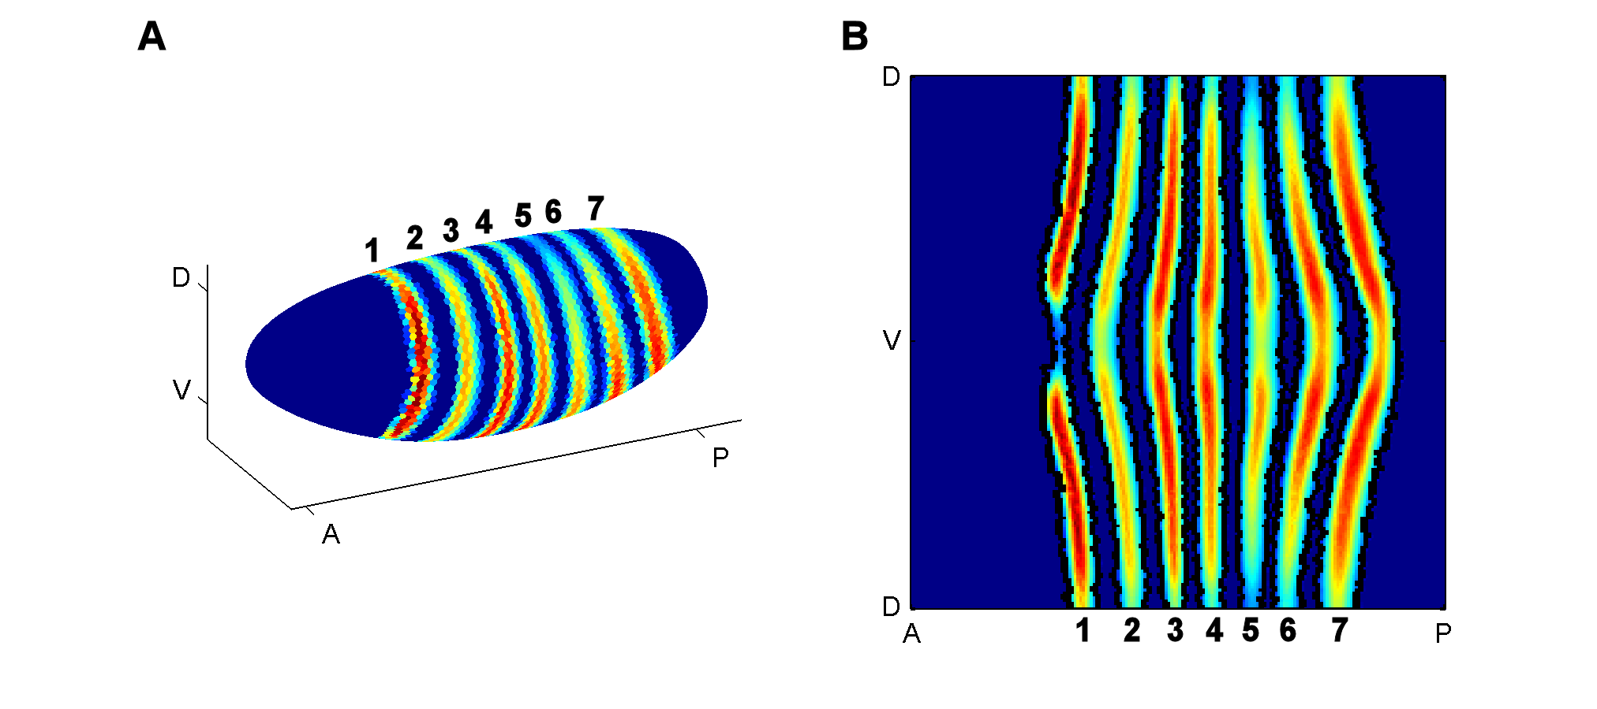
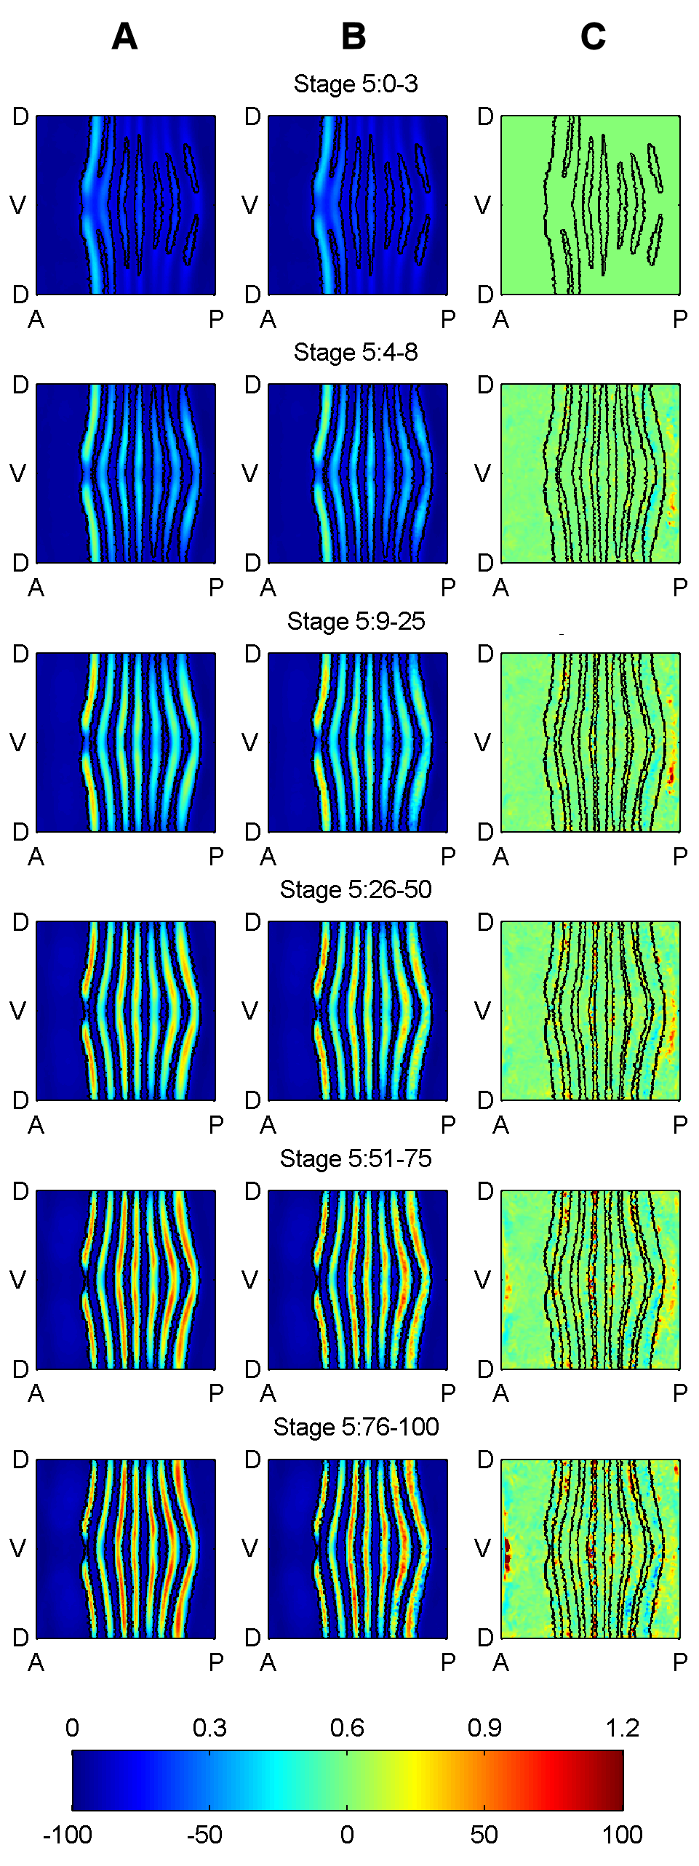
Stage 5:0-3
Stage 5:26-50
Stage 5:4-8
Stage 5:51-75
eve mRNA data shown in 3D and 2D projections
Stage 5:9-25
Stage 5:76-100

Slide 22
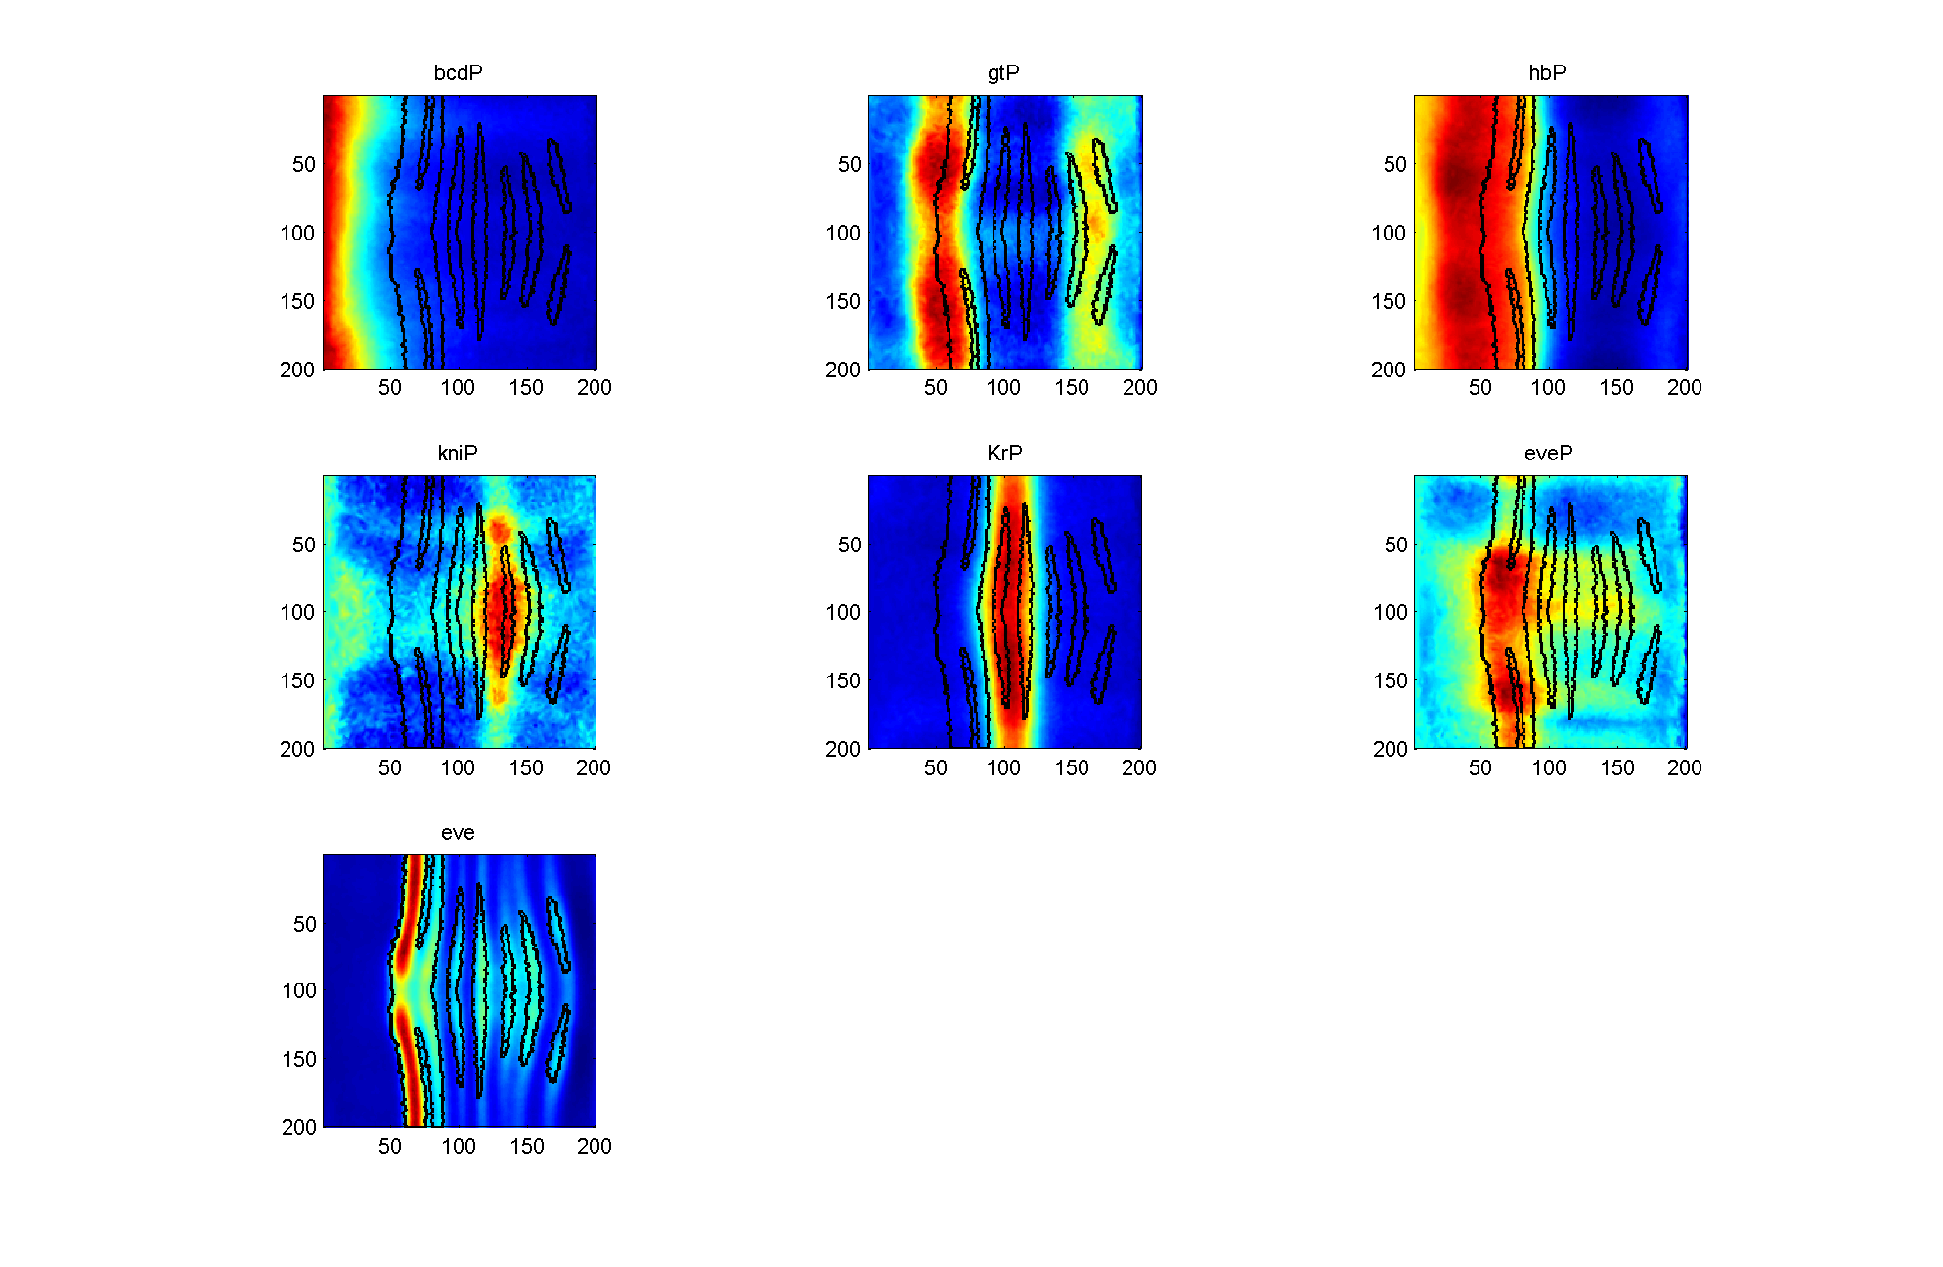
Data, Stage 5: 0-3

Slide 23
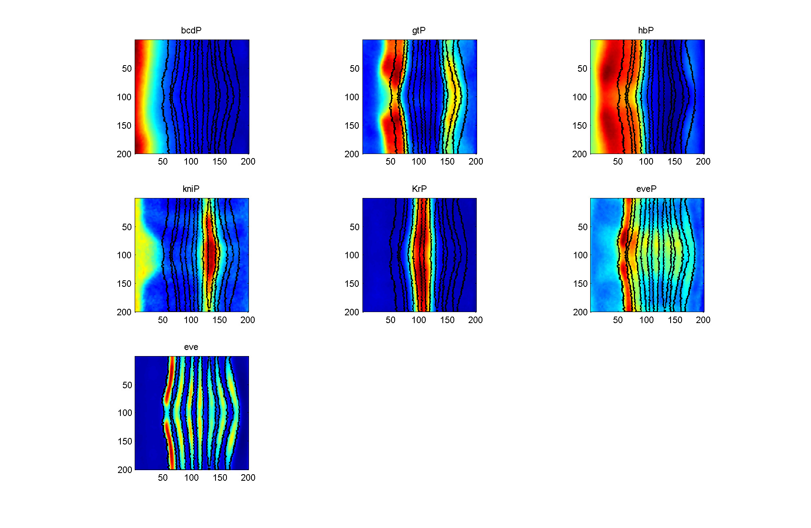
Data, Stage 5: 4-8

Slide 24
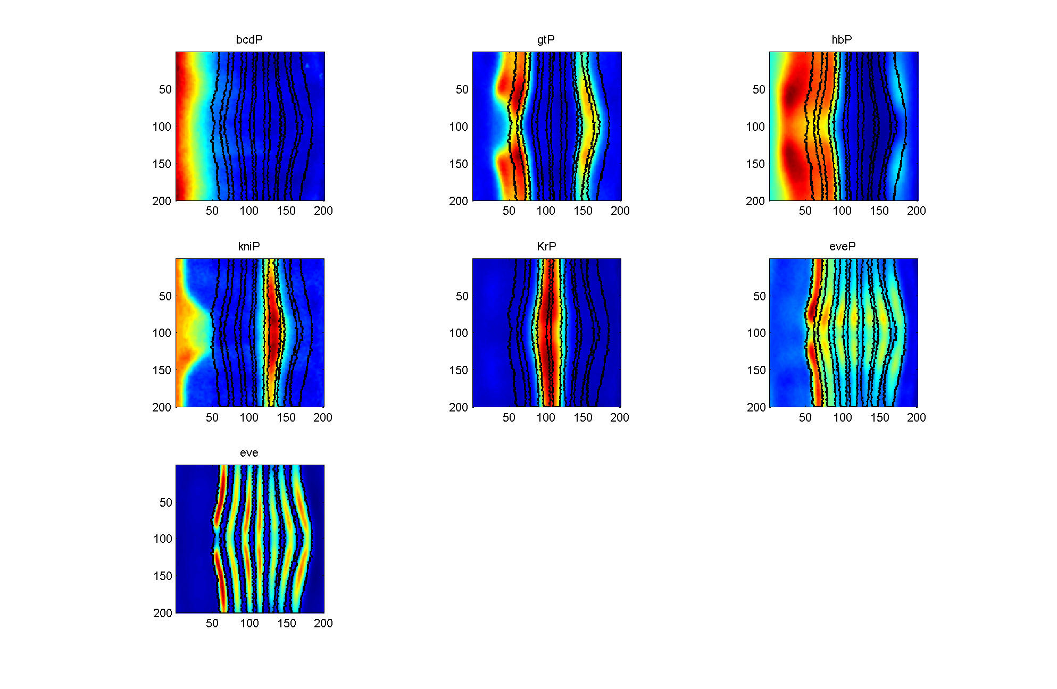
Data, Stage 4: 9-25

Slide 25



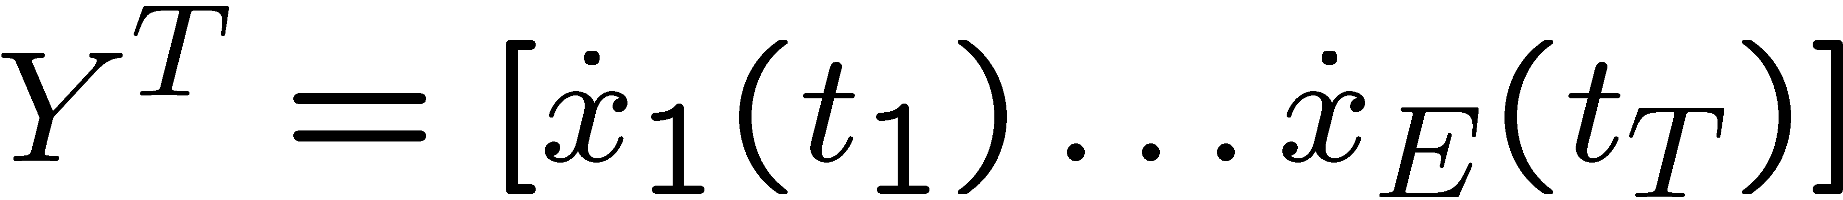
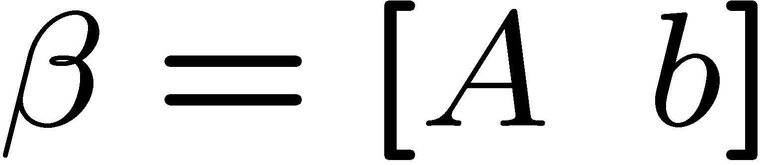
Local Linear Regression
Solve for in for all
Rewrite as:
where
Notes:
So we can surnarize the discussion in rnathernatical notation. To understand this online system identification procedure, we need to understand this linear regression problem in depth.

Slide 26
Existing Approaches
Estimator | Considers geometry | Sparsity | High-dimensionality
Moore-Penrose¹ | Yes
Ridge²
Principal Components Regression³ | Yes
Lasso^{4,5} |  | Yes | Yes
Elastic Net⁶ |  | Yes | Yes
Partial Least Squares⁷ | Yes
¹ (Knight and Fu, 2000); ²(Hoerl and Kannard, 1970); ³(Massy, 1965);
⁴(Tibshirani, 1996); ⁵(Zou, 2006); ⁶(Zou and Hastie, 2005); ⁷(Wold, 1975)
26
Notes:
26
Add references

Slide 27
Online System Identification
Difficulty in interpreting regression coefficients
Gradient of function does not exist
Notes:
And can calculate noisy estimates of the time derivative of the trajecotry. We are interested in the time derivative of the trajectory because we would like to learn the dynamics/ODE that describe the system motion.
27

Slide 28
Online System Identification
Exterior derivative of function does exist
  Extension of gradients to manifolds
  Best local linear approximation of function on manifold
Notes:
And can calculate noisy estimates of the time derivative of the trajecotry. We are interested in the time derivative of the trajectory because we would like to learn the dynamics/ODE that describe the system motion.
28

Slide 29

New Estimation Approach
Locally learn manifold
Constrain regression vector to lie on the manifold by penalizing for deviations from manifold
Where is chosen to penalize for lying off of the manifold
29
(Aswani , Bickel, Tomlin, 2010); (Bickel and Levina, 2008)
29
Notes:
29
As I mentioned earlier, the exterior derivative lies on the cotangent space which is the space of all directions of the manifold.

Slide 30
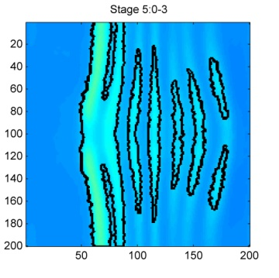
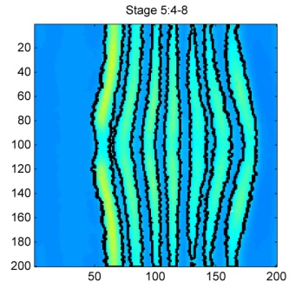
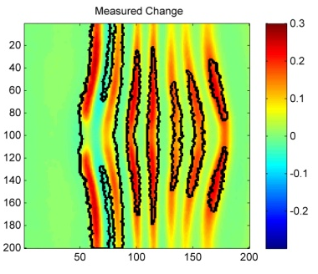
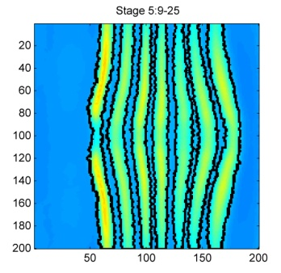
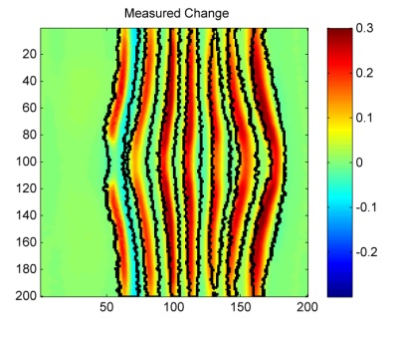
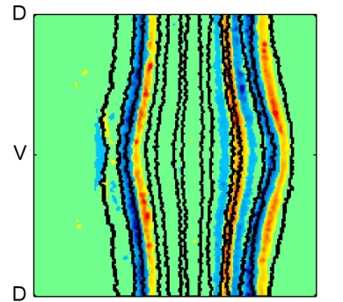
Correlation over space and time
eve mRNA expression
temporal change
in mRNA expression
correlation of gt protein
with change in eve mRNA
t=0
t=1
t=2
Notes:
30
As a result we are now exploring more sophisticated analyses. Instead of as before looking for correlations at one time point, we are now correlating protein expression at one time point with the change in target gene expression between that time and the next time point. The center shows the temporal change in eve mRNA expression, red is incresed expression blue is decreased amounts of RNA. The right column now shows the spatial correlation of of GT protein with these changes. Blue is a negative correlation, red is postitve correlation. In addition to the expected anticorrelates with the anterior boundary of eve stripe 2, in a region where GT concentrations are lower, there is a positive correlation, which could either imply that GT can also activate at low concenttations or quite possibly this correlation is miss leading and other factors play a more dominant role in controlling eve in these cells. .

Slide 31
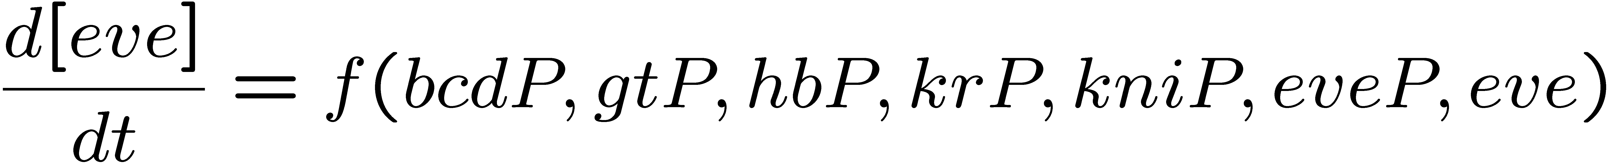
Drosophila Embryo, Stage 5
factor activity

Slide 32
Results: eve, Stage 5: 0-25
data
model
error

Slide 33
Results: eve, Stage 5: 26-100
data
model
error

Slide 34
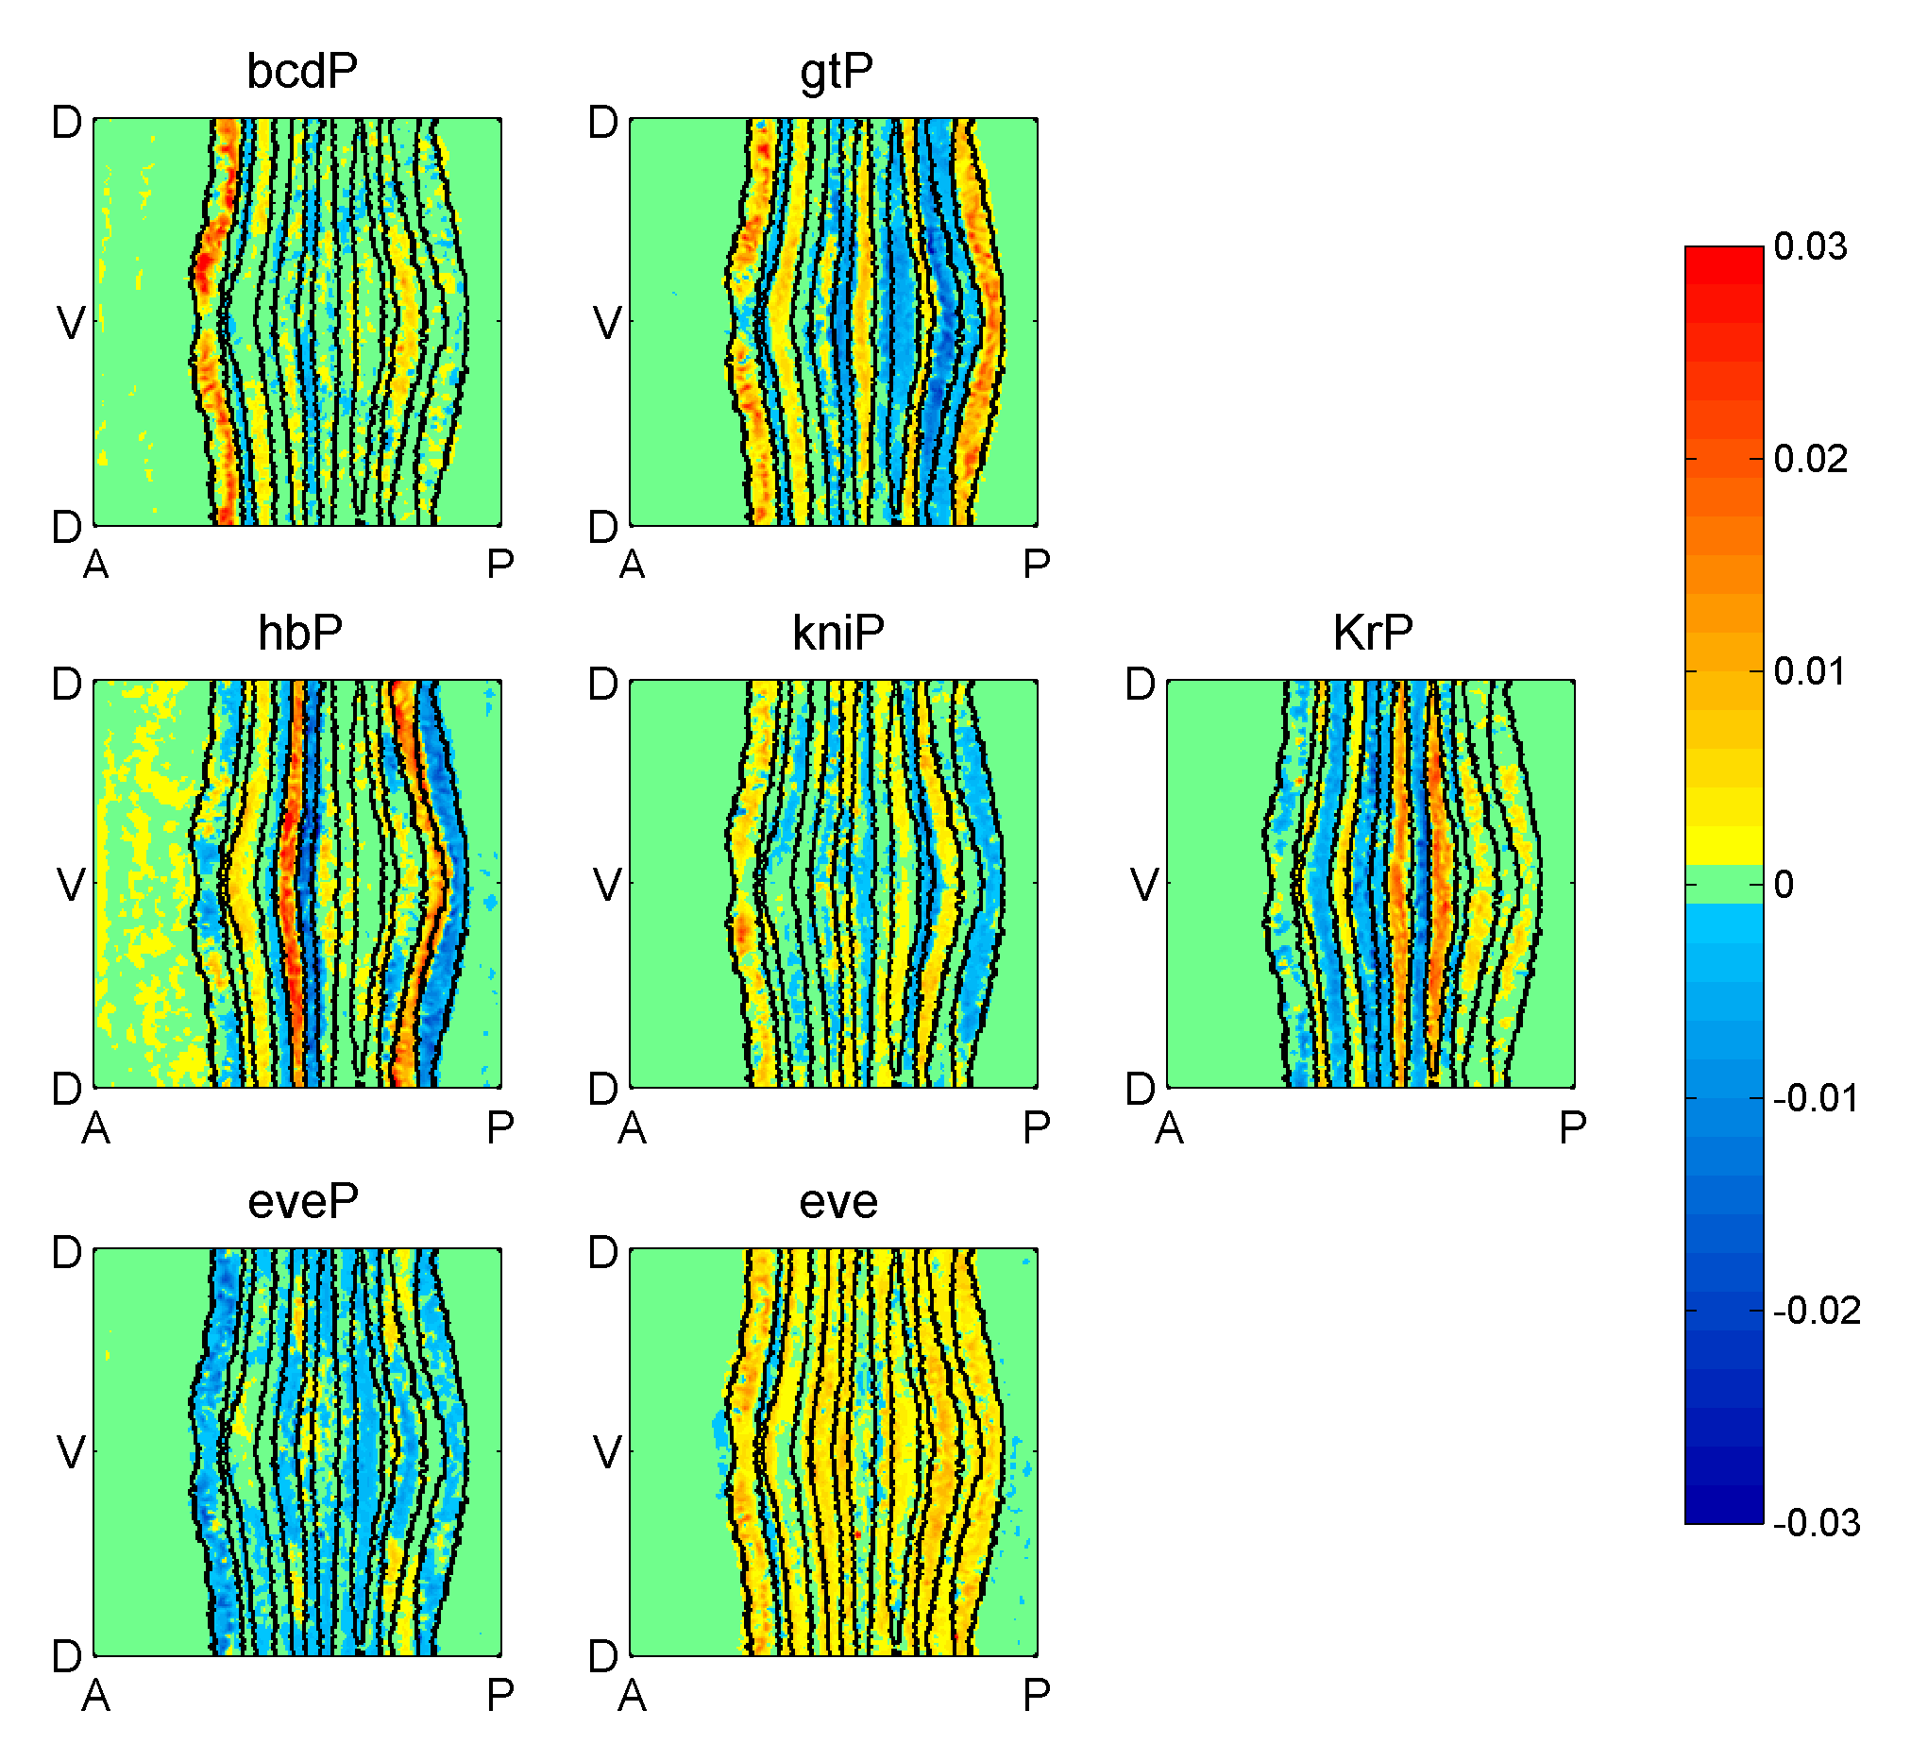
Factor activity, Stage 5: 4-8

Slide 35
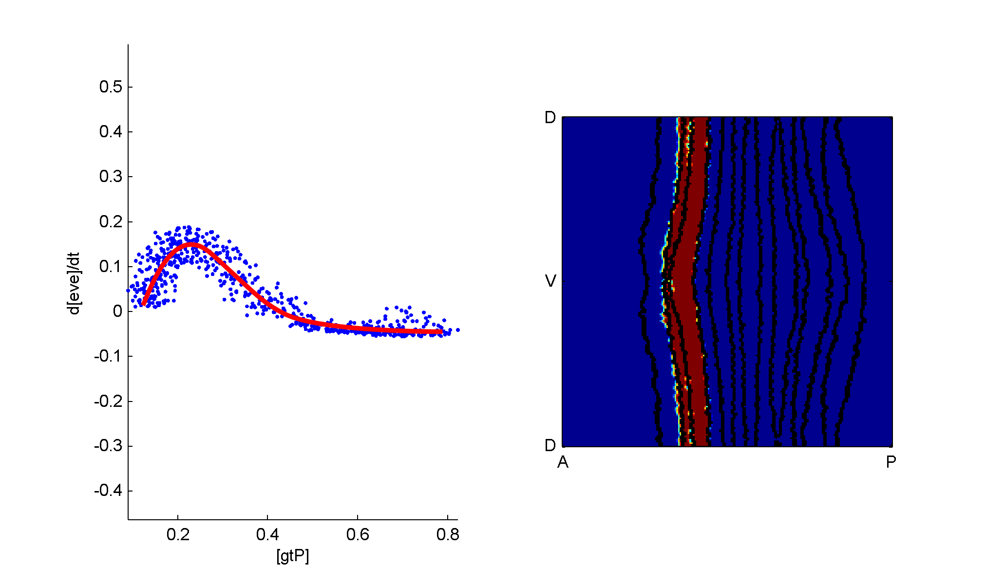
Rate of eve production vs gtP, Stage 5: 4-8

Slide 36
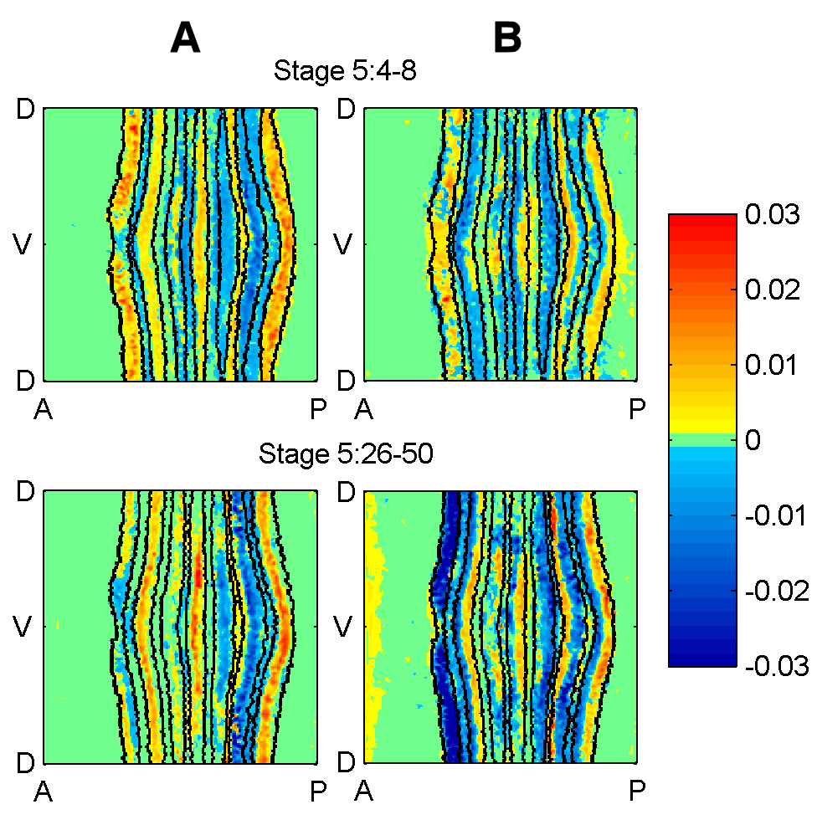
predicted gt activity
simulated
predicted gt activity
“correlation model”

Slide 37
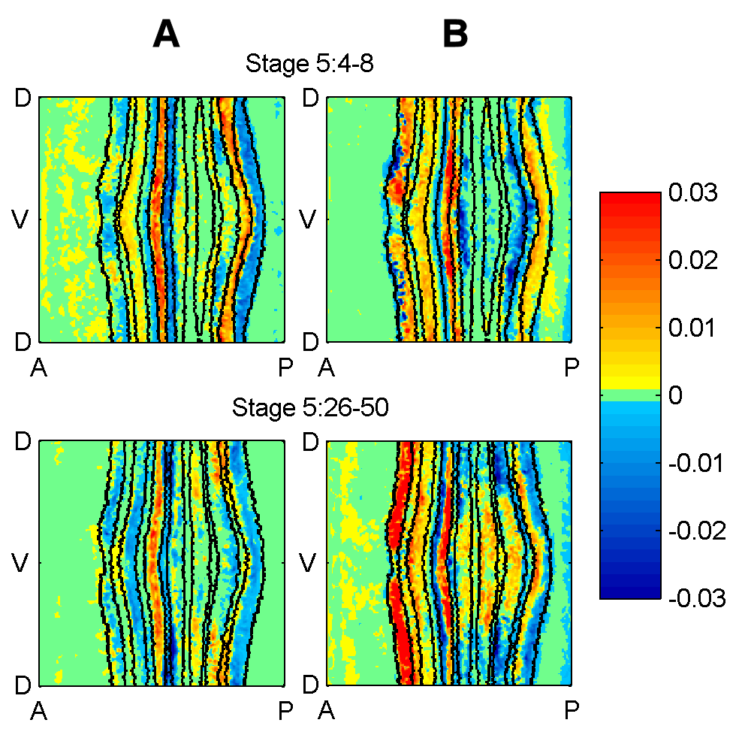
predicted hb activity
simulated
predicted hb activity
“correlation model”

Slide 38
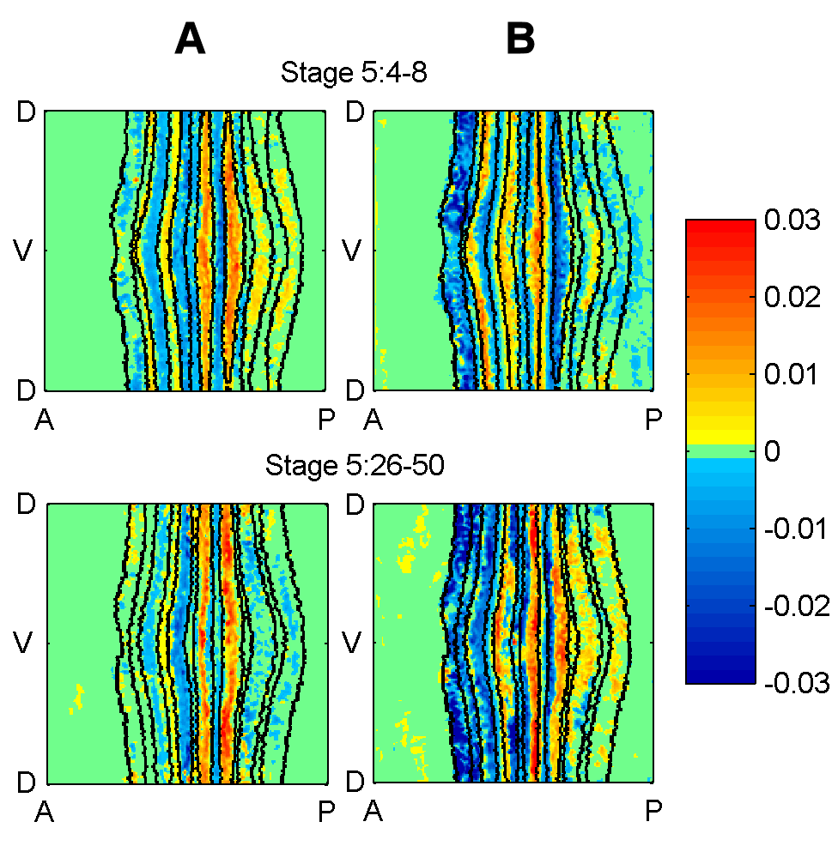
predicted kr activity
simulated
predicted kr activity
“correlation model”

Slide 39
Potential insights
factors appear to have concentration dependent effects
  repressing at one concentration, activating at another
  spurious correlations or real effects?
    starting to analyze the other data sets (binding data)
  if true, could add a new layer to the complexity of the signaling network
model overlaps, but also gives some different results from the spatial correlation model
  can distinguish between weakening of repression, and repression, for example

Slide 40
Summary …
Method for local linear regression, designed for systems evolving on a manifold of lower dimension than overall space
  Designed to prevent overfitting
  Can be used as a tool to help identify network structure
Another new project: network and parameter identification of HER2/3 network in cancer (with Joe Gray, Young-Hwan Chang, Steven Xie, and Soulaiman Itani)
A
C
Known in the same cell type.
Force.
Doesn’t exist.
Forbid.
D
B
Discovered in vitro.
Encourage.
Unknown.
Allow.
E
[S. Itani]

Slide 41
Nonparametric Identification of Regulatory Interactions from Spatial and Temporal Gene Expression Data
Anil Aswani
Peter Bickel
Claire Tomlin
Joint work with Mark Biggin, Charless Fowlkes, Soile Keränen, and Jitendra Malik
Electrical Engineering and Computer Sciences, UC Berkeley
ACCESS Linnaeus Center, School of Electrical Engineering, KTH
Thanks: NSF, NIH NCI
TexPoint fonts used in EMF.
Read the TexPoint manual before you delete this box.: AAAAAAAAAA

Slide 42
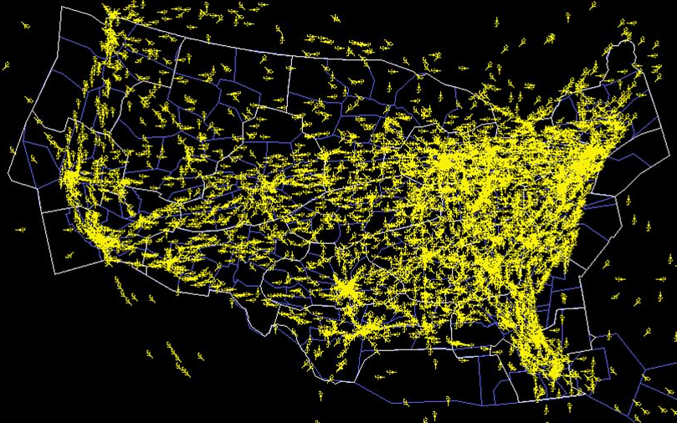
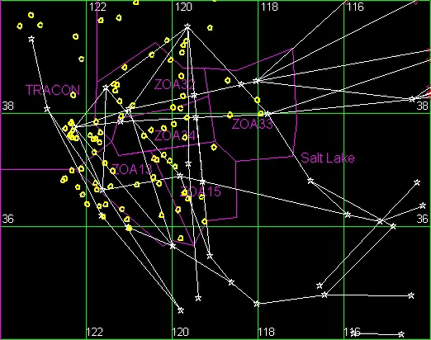
Air Traffic Control: Separation Assurance
FACET, NASA Ames
Safety: 5 mile lateral, 1000 ft vertical
separation
TexPoint fonts used in EMF.
Read the TexPoint manual before you delete this box.: AAAAAA
Notes:
Now, this is movie showing the high altitude traffic in the Oakland Center. You can see 5 sectors, enclosed by pink lines. As I said in the previous slide, each of these sectors is controlled by a single human ATC. This movie shows clearly the complexity of the traffic around an ATC. This complexity is the cause of FAA-fixed standards, which determine how much aircraft can legally be controlled by a single human air traffic controller.

Slide 43
Case Study 2: Back-Flip
Recovery
Drift
Impulse
Divide flip into three modes
Hit desired target sets while avoiding unsafe sets

Slide 44
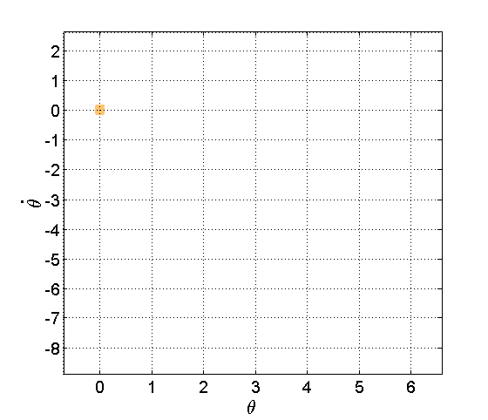
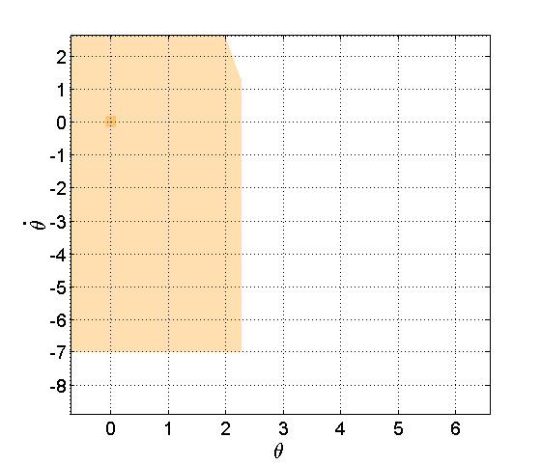
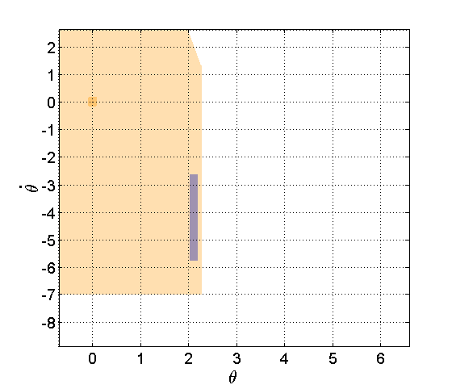
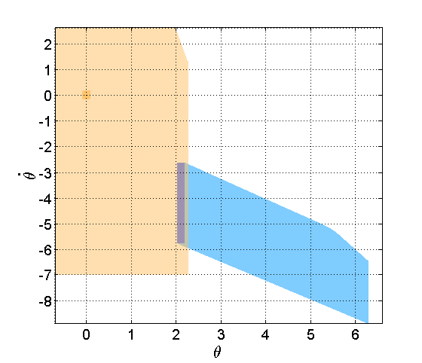


Back-flip: Method
Identify target region in rotational state space for each mode
Use reachable sets to calculate capture basin for each target
  Dynamic game formulation accounts for worst-case disturbances
Verify that target of each mode is contained by capture basin of next mode
Recovery
Drift
Impulse

Slide 45

Back-Flip: Results

Slide 47

Toy Example: Mass-Spring System
L = Length of uncompressed spring

Slide 48
Mass-Spring System
X = matrix of low noise measurements of positions
Y = vector of noisy measurements of acceleration
K = vector of estimated coefficients for the first ODE

Slide 49
Degenerate Mass-Spring System
L = Length of uncompressed spring
k₂ is a very stiff spring

Slide 50
Degenerate Mass-Spring System
X = matrix of low noise measurements of positions
Y = vector of noisy measurements of acceleration
K = vector of estimated coefficients for the first ODE
PROBLEM: Covariance matrix is (nearly) singular
CAUSE: States have geometric constraints
Important to design methods robust to this

Slide 51

Mass-Spring Example

Slide 52

Error Bars

Slide 53

FIT: [0, 3]

Slide 54

FIT: [4, 8]

Slide 55

FIT: [9, 25]

Slide 56
RESULTS:
Heatmap of Coefficients Times Factor Concentrations on Eve Stripes at Stage 5:4-8 with Changing Window Size
In general need to explain the weakening of repression etc.

Slide 57


Slide 58
Heatmap of Coefficients Times Factor Concentrations on Eve Stripes at Stage 5:4-8 with Fixed Window Size of Circle with Width of 6 Cells

Slide 59


Slide 60
Heatmap of Correlation Between Factor Concentration and Eve Stripes at Stage 5:4-8

Slide 61


Slide 62

Experimental eve mRNA Patterns

Slide 63

Simulated eve mRNA Patterns

Slide 64

Percent Error

Slide 65


Regulation is often associated with correlations in expression
Notes:
65
It has often been noted that target gene expression patterns show local correlations with the expression of their transcriptional regulators. shown here with the anti correlation between eve stripe 2 in green and the transcriptional repressors giant and Kr. By searching computationally for such postiive or negative correlations, it may be possible to determine which factors regulate which genes.

Slide 66

Regression analysis detects known
regulatory interactions
Activator
M(x,t) = F{ P_{i}(x,t) }
Repressor
eve 1
eve 2
eve 3
eve 4
eve 5
eve 6
eve 7
1
7
Transcription factors
Fowlkes et al, 2008
Notes:
66
To test this we have used a regression analysis. in the case of eve stripe 2 this approach correctly predicts that gt, kr, and tll are repressors. And that hb is an activator. however, it fails to class bcd as an activator because the bcd gradient is too shallow and thus the correlation between it and eve stripe 2 boundaries are small.

Slide 67



The method can be rapidly applied
to any large quantitative dataset
100s of expression stripes from 95 genes
Notes:
67
We applied this method to the entire dataset.

Slide 68

The measured expression correlates well
with that predicted by the regression
Frequency
Correlation coefficient
Most expression stripes r > 0.6
Notes:
68
Overall, most stripes’ expression has a correlation coefficient > 0.6 with the pattern that would be predicted by linear regression. So the method is reasonably useful. However, I don’t want to over sell it. I am sure it gets a great deal wrong.

Slide 69
Talk outline
One slide on PCP – use as motivation (here, we assumed a structure – given to us from Jeff, before modeling). What if we didn’t have, or weren’t confident with, the structure?
Simple pendulum example
Mark’s system
Local linear regression – justify, as a basis for identifying a potentially nonlinear system
  Method gives the regions of best fit, so there is a higher density of models in “very nonlinear” regions
  Key: protect against overfitting. If the system dynamic lies on a lower dimensional manifold, find it. (you can use the hb kr example here if you want)
  Sparsity, high dimensionality(?), non-parametric
Results

Slide 70
Questions
Anil – what is the diagram on slide 74 of quals pres?
Mark – hb, kr well known interaction?
Anil: NEDE is equivalent to an optimization formulation of principal components regression; Elastic net is equivalent to NALEDE in which the data is pure noise (no manifold) – explain clearly what is different

Slide 71
Comparison to Previous Work
71
NEDE is equivalent to an optimization formulation of principal components regression
Elastic net is equivalent to NALEDE in which the data is pure noise (no manifold)
Combines positive aspects of different estimators
Computational effort comparable to that of existing estimators

Slide 72
Simulation Results – Normalized Mean Squared Error
72
72

Slide 73
Simulation Results – Classification Rate
73
73

Slide 74
In previous models of the HER2/3 signaling pathway, the structure was fixed a priori (from biological knowledge.)
  Structure from different cell types, animals, and in vitro experiments was used. These do not necessarily hold.
  Some parts of the structure might not have been discovered to date.
We therefore need to search for the correct structure, and not only the parameters given a certain structure.
A
C
Known in the same cell type.
Established in many other types of cells.
D
B
Discovered in vitro.
Unknown.
E

Slide 75
A
C
Known in the same cell type.
Force.
Doesn’t exist.
Forbid.
D
B
Discovered in vitro.
Encourage.
Unknown.
Allow.
E
To include structure modifications in the optimization, we introduce a module that creates possible networks, in a controlled fashion, and a module that creates different experiments.
  Connections in a network can be forced, prohibited, encouraged, or discouraged.
  The data we have might be from different types of experiments (i.e. different perturbations, stimulations,…), and thus the ability to introduce different experiments dynamically is important.
These modules can be inserted in an optimization.

Slide 76


Compare results to data.
Decide on the next step depending on the optimization algorithm.
A
C
Create new network.
D
B
E
Specify experiment(s).
Choose parameters.

