Slide 1
OPC Unified Architecture
A Platform for Automation
The Power of Context
LCCC Process Control Workshop
Lund University
Dave Emerson
Director, U.S. Technology Center
Yokogawa

Slide 2


Context
Context
  The circumstances that form the setting for an event, statement, or idea, and in terms of which it can be fully understood..
    (oxforddictionaries.com)
Where is context hiding?
Notes:
For example a temperature profile over time requires contextual information about the equipment and process it was collected from to be truly useful.
In the past this contextual information was kept in people’s minds.
Look at your historian’s temperature data, it may have a tag, temperature values at different times and maybe some data quality information.
To make full use of the temperature profile requires an operator or engineer familiar with the process unit, this is because the contextual data was in the person’s mind. In essence the loss of this contextual information cripples data that was collected and stored.

Slide 3
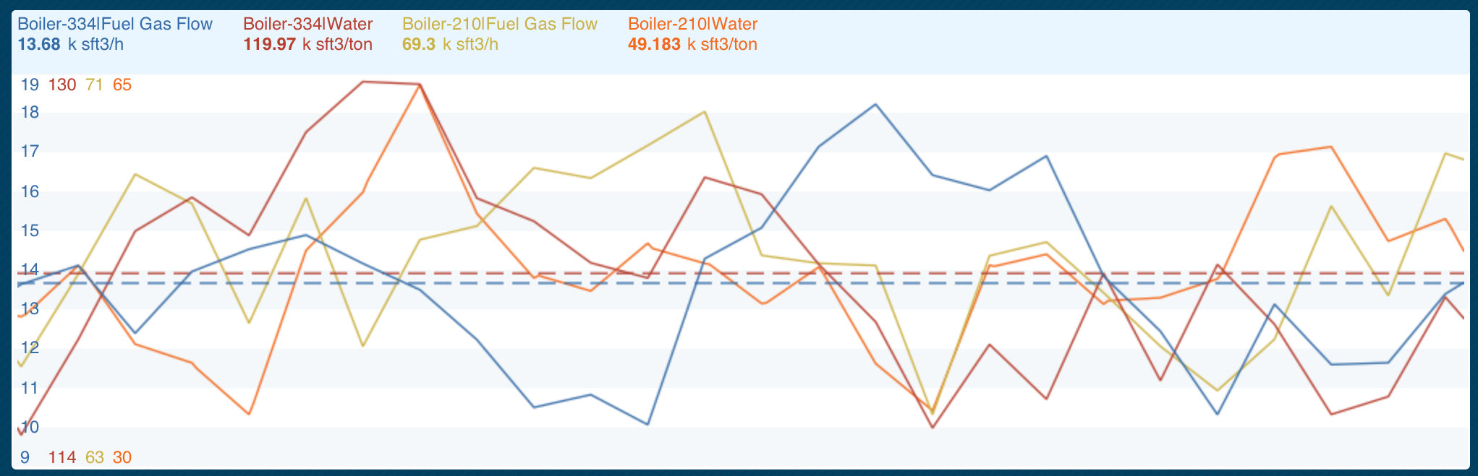
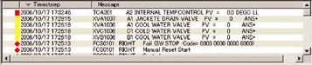
Trend & Event Data Contains Little Context
A mental model is required
Notes:
Temperature plot, xy – tag TI-940
Descriptor – bottoms temp
Operator – experience, DCS HMI, some training tells him
where the physical measurement point is, the type of unit and piping involved, past performance, remember when severe weather went through,…
Each operator may have a similar, but different mental model
Process and Automation Engineers
Understands chemistry involved with the fluid in the pipe, processing that goes on up and down stream from the measurement,
Manager
Knows production rate, product value, committee deliveries, raw materials used, cost data,…
Maintenance
Knows last time the transmitter was calibrated, replaced, serviced,... Maybe knows corrosion status of pipes in the area,…
No one can and need to know everything
But to make some critical decisions everyone needs to be in a meeting to discuss what to do and when
How can computer systems have this type of meeting?

Slide 4
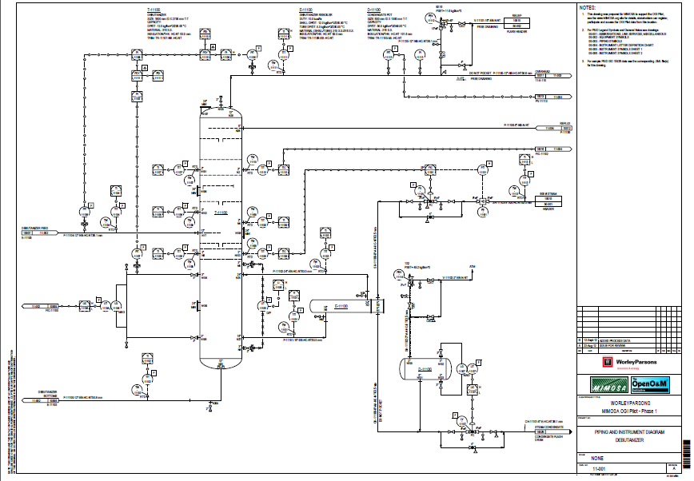
P&IDs Add Context
but are isolated documents
That are rarely maintained

Slide 5
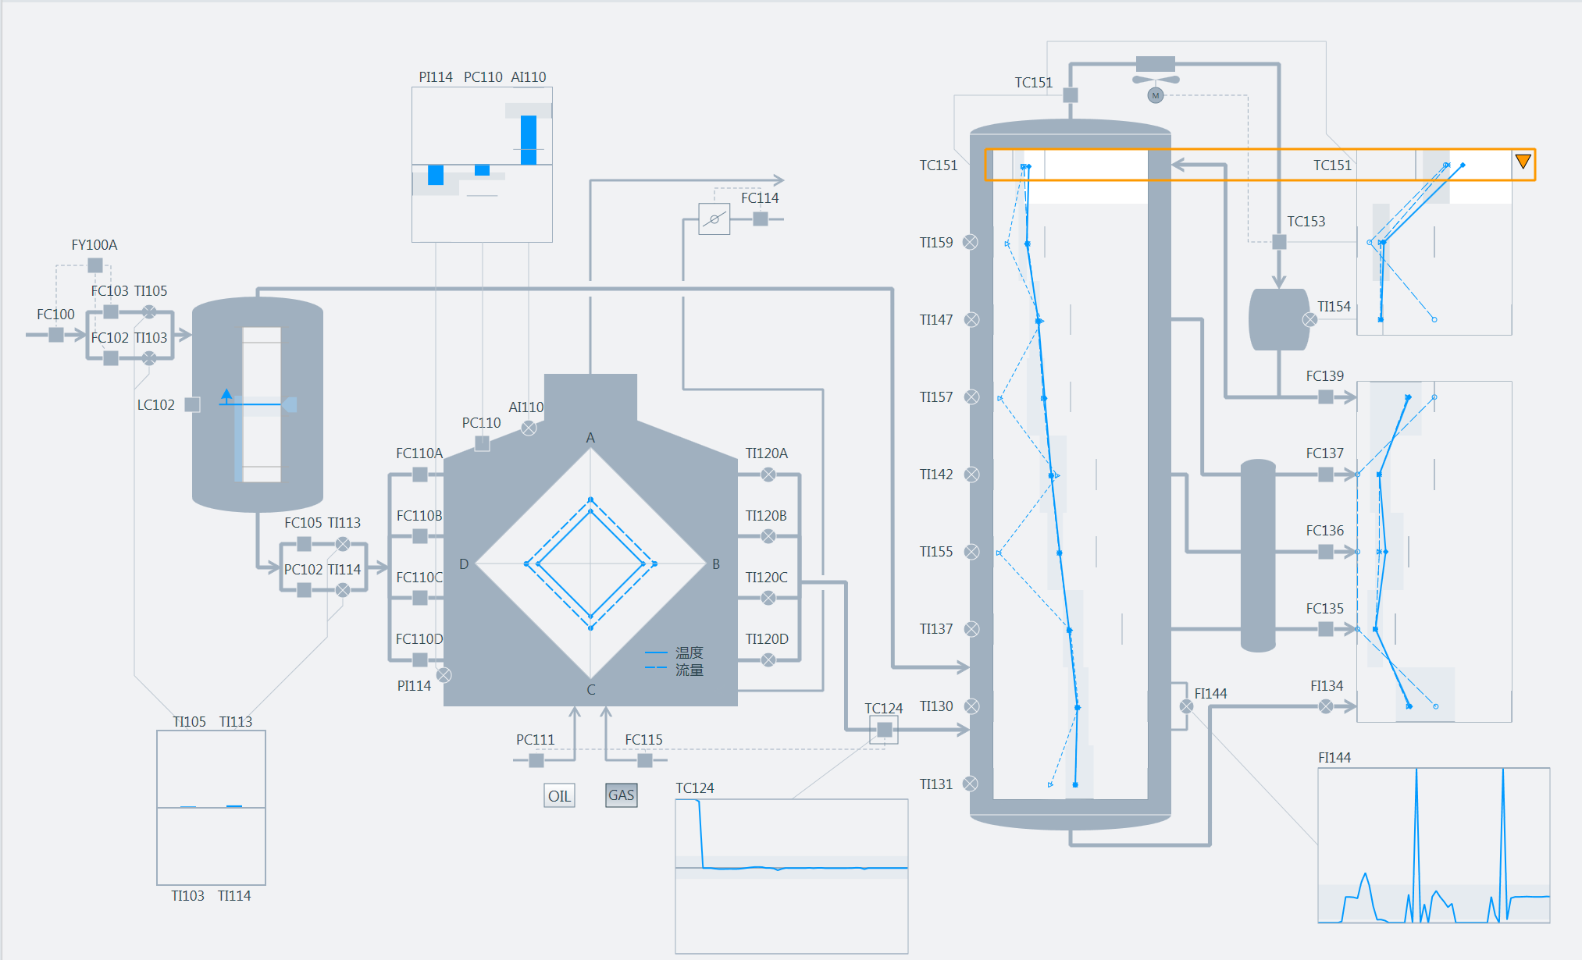
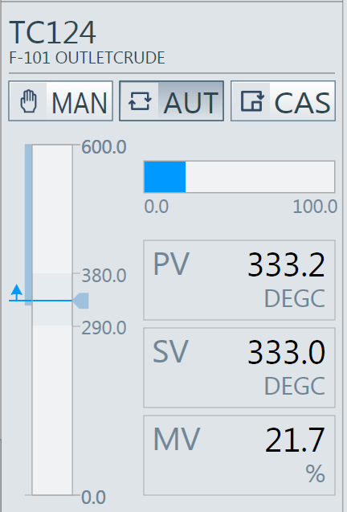
Operators are shown context
but must be manually designed and maintained

Slide 6
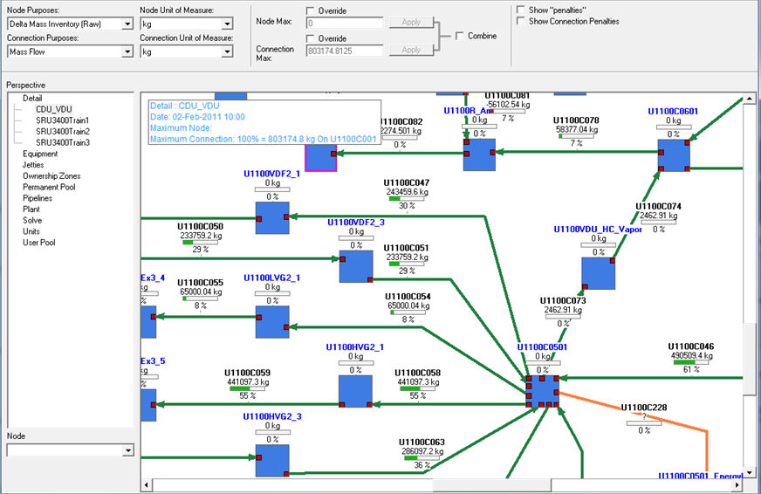
Process Models contain context
but must be manually designed and maintained
Notes:
Now imagine an employee leaves, retires or whatever, how does a new employee learn the context that left?
On the job training – mostly
Depending upon the individuals the new person could be better, eventually – or he may know different things

Slide 7
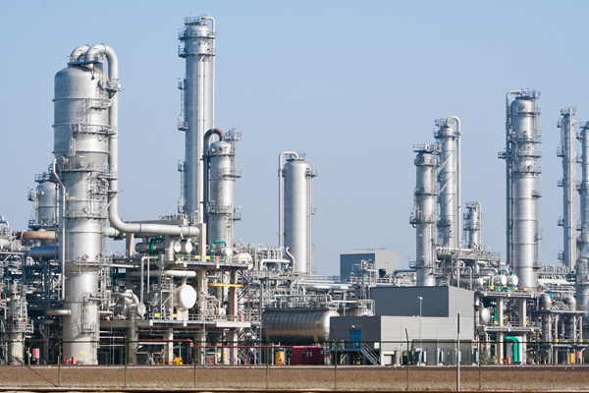
Plant Lifecycles Create & Lose Context
Planning
Design
Procure
Construct
Com-mission
Operate
Decom-mission
Each lifecycle phase creates context that is not available to downstream phases

Slide 8
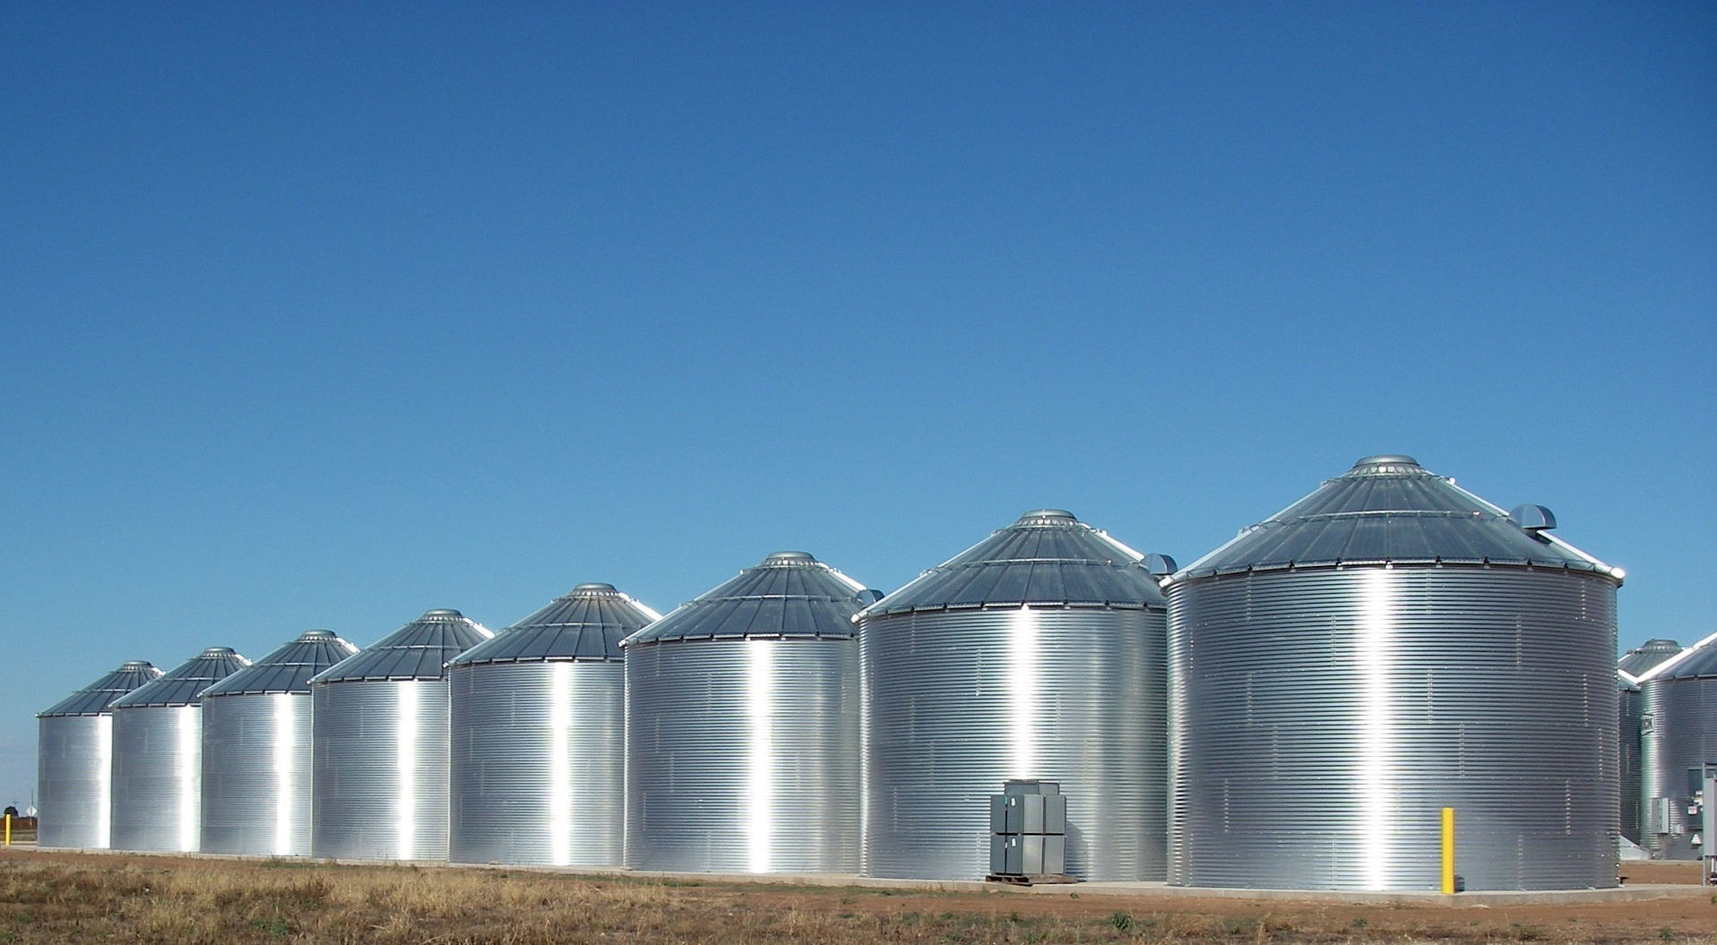
Silos Horde Context
Interoperability is required
vertical silos must interoperate

Slide 9

Context Dissipates
Computer files, documents, mental models
are forgotten, fade, become dated,…
Notes:
Context is complex & never ending
Preserving all context is a huge, overwhelming, task
Context is held in the heads of plant personnel
It is mental models
Some mental models are better than others
No one can know everything
PDFs are a great way to lose context
Computer actionable data formats are needed
To share and re-use context interoperable, actionable, data formats are needed
ETL = Extract, Transform, Load
Indicator that context is hard to maintain

Slide 10
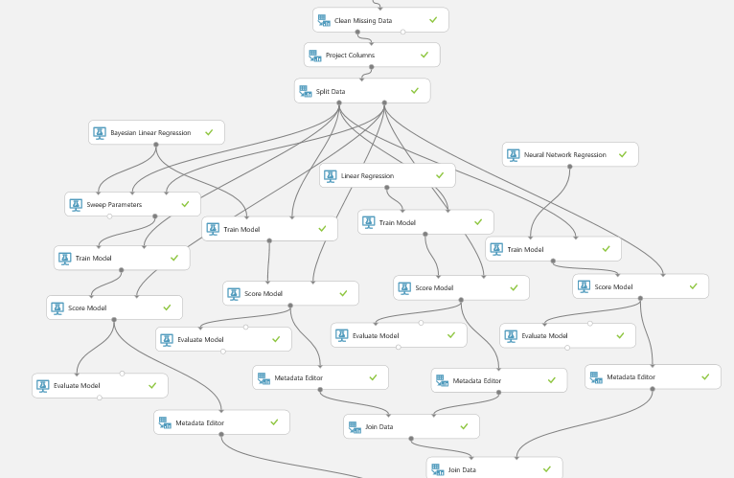
Context’s Value is Increasing
Big data, machine learning, AI
Will require context
How do we preserve it?

Slide 11
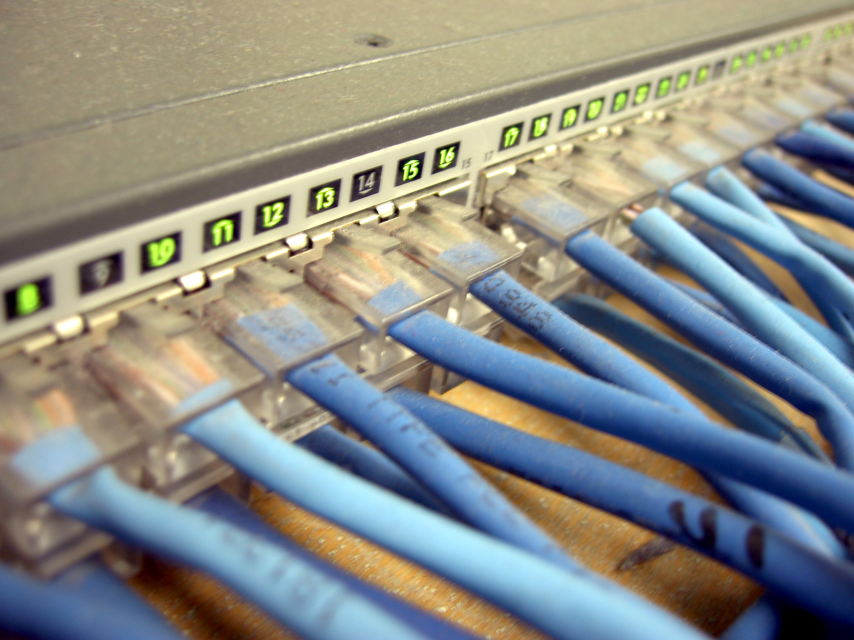

Preserving Context
Interoperable & computer actionable
data formats

Slide 12
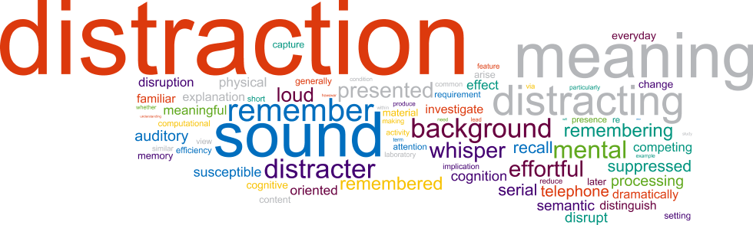
Preserving Context
Semantic processing

Slide 13
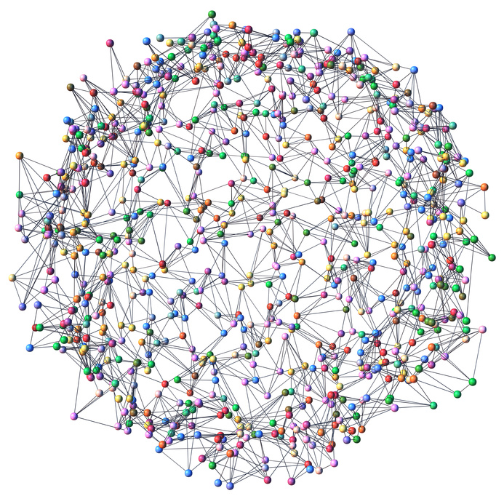
Preserving Context
Federated systems
discovering & sharing context

Slide 14
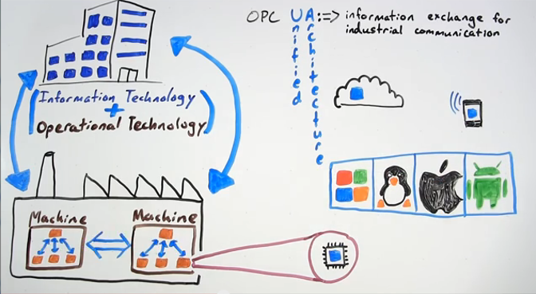

Preserving Context with OPC UA
What is OPC-UA? OPC-UA in a minute
https://www.youtube.com/watch?v=TFhqJQwLy7E
IEC 62541
Notes:
Ability to create multiple information models using common data
Ability for information models to discover and browse each other
Open, industrialized communications with built in security

Slide 15





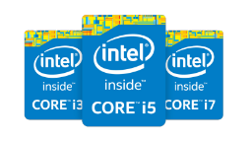


3 Key OPC UA Highlights
Open Data Connectivity
Connectivity Standards
Protocols

Slide 16


3 Key UA Highlights
Ground-Up Secure Design
Based on latest security standards
Accepted by IT and OT groups
Recognized for its security by key organizations:
  NIST
  Industrie 4.0
  Oil & Gas Majors (MDIS)
Data Security

Slide 17
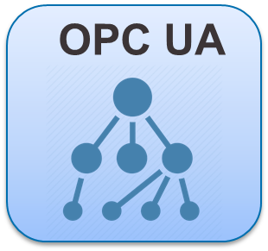
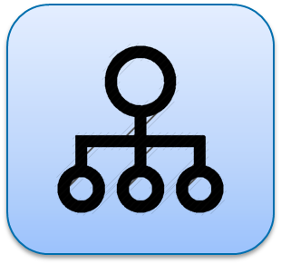
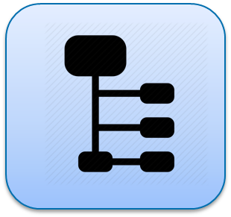



3 Key UA Highlights
Data Context Preservation
OPC UA
Notes:
Data modeling preserves source context
Products expose structured view
Extendable: new protocols welcome
(Companion Specifications)
BACNet
MDIS (Subsea standard)
Others…
UA Clients learn about data structure from devices

Slide 18
Services & Information Models
Client/Server
Pub-Sub
Services
Services
PubSub
Configuration
Connections
MessageWriters
Built-in Information Models
Protocols
Protocols
UA Secure Multicast
(AMQP, MQTT, DDS, REST…)
OPC UA Meta Model

Slide 19
Services & Information Models
Client/Server
Vendor Specific Extensions
Pub-Sub
Services
Companion
Information Models
Services
PubSub
Configuration
Connections
MessageWriters
Built-in Information Models
Protocols
Protocols
UA Secure Multicast
(AMQP, MQTT, DDS, REST…)
OPC UA Meta Model

Slide 20
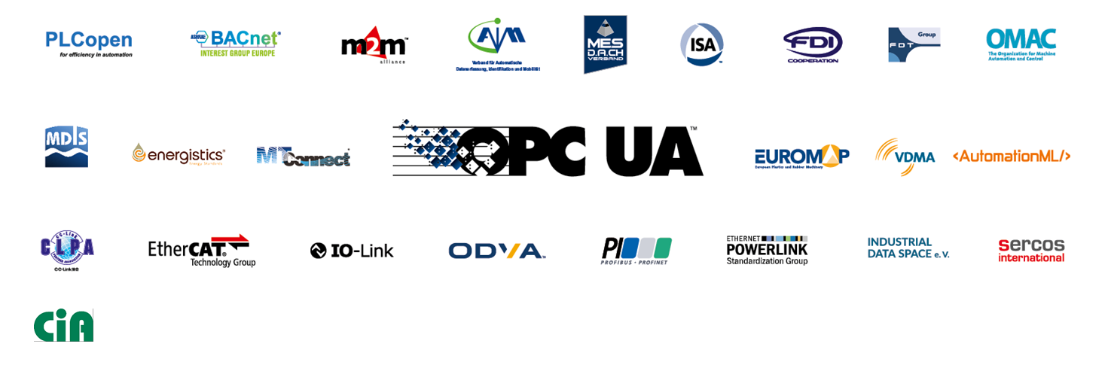



OPC Foundation Collaboration
OPC Foundation collaborates with organizations and domain experts
OPC UA
defines HOW
Domain experts
define WHAT
Client/Server
Vendor Specific Extensions
Pub-Sub
Services
Companion
Information Models
Services
PubSub
Configuration
Connections
MessageWriters
Built-in Information Models
Protocols
Protocols
UA Secure Multicast
(AMQP, MQTT, DDS, REST…)
OPC UA Meta Model
Notes:
Standards bodies, like the standards they create, can not be an island in todays every more tightly digitized and integrated world. Leading the charge, OPC Foundation started collaboration with various organizations over 10 years ago and is not being increasingly approached by other organizations to form new relationships… the family is growing!

Slide 21
Information Model Notation

Slide 22
Information Model Example

Slide 23
Sample Base Object Hierarchy

Slide 24
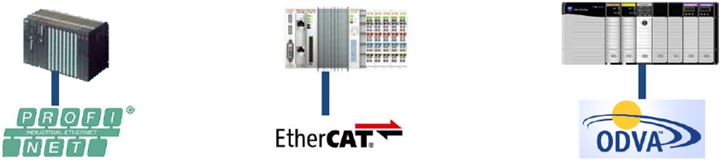
OPC UA for IEC 61131-3 (PLCopen)
PLCopen Collaboration
61131-3 Software Model mapped to OPC UA Information Model
PLC Data provided as UA Server
OPC UA Communication Function Blocks like Connect, Read, Call
PLC as OPC UA Client
HMI
MES
OPC UA
OPC UA
OPC UA
OPC UA

Slide 25

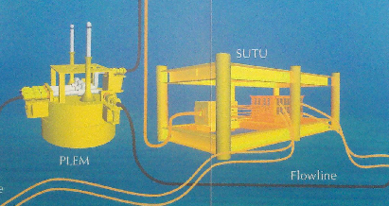
MDIS – Oil &Gas Industry
Industry Working Group
Joint Team of
Major oil companies
Major DCS vendors
Major Subsea vendors
Defined an industry standard information model
Communication between silos
OPC UA for
communication between
Subsea Production
and
DCS Systems

Slide 26
UA for ISA 95 Common Object Model
Common Object Model
Modeling Target
Object Models
Production Activity
Capacity Definition
Production Definition
Production Schedule
Production Performance
Logical View of Resources
Process Segment
Resources
Role Based Equipment
Physical Asset
Personnel
Material
Version 1.0 Released in October 2013
ISA 95 defines a model for Enterprise/Control System integration
OPC UA mapping for ISA 95 Resources Models
Role based equipment
Physical asset
Personnel
Material

Slide 27
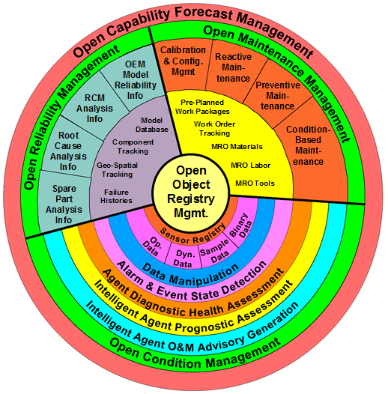

MIMOSA Companion Specification
OPC UA
Implementation of
MIMOSA’s Asset
Information Model
(CCOM)
Will bring asset management capabilities to
OPC UA compatible systems
Work starting 2016

Slide 28
Preserving Context with OPC UA
Communication
Data Modeling
Integrated security mechanisms
High speed UA TCP protocol
Web services for Internet
Platform independent
Built-in robustness and fault tolerance
Redundancy
Scalable from chips to clouds
Generic object-oriented modeling
Objects with variables, methods and events
Extensible type system
History for data and events
State machines, programs, alarms & condition
Complex data
Collaboration
New Applications and Use Cases
UA is IEC standard 62541
UA is base for industry & vendor information models
Collaboration is win-win
  Industry groups use open, proven base services
  OPC UA users can access more domains
Profiles for different use cases
Scalability
Integration into embedded systems
MES and ERP systems
Specialized versions for different industries

