Slide 1

On PWC for chemical plants
Krister Forsman
2016-09-29

Slide 2
Outline
Short facts about specialty chemicals industry and Perstorp
Plantwide control:
  Degrees of freedom
  Throughput manipulator selection
Specifying control objectives

Slide 3
Characteristics of chemical plants
(A view slightly biased by Perstorp experience)

Slide 4

Control: What differs between different industries?
For mature processes, with a large installed base, there are standard solutions; often quite advanced. Often packaged by control system suppliers.
  Oil refineries (~800 world wide)
  Paper machines (2000)
For specialized processes, that are fairly unique, local expertise has to design the controls.
  Only a handful of plants in the whole world
  Often confidential processes

Slide 5
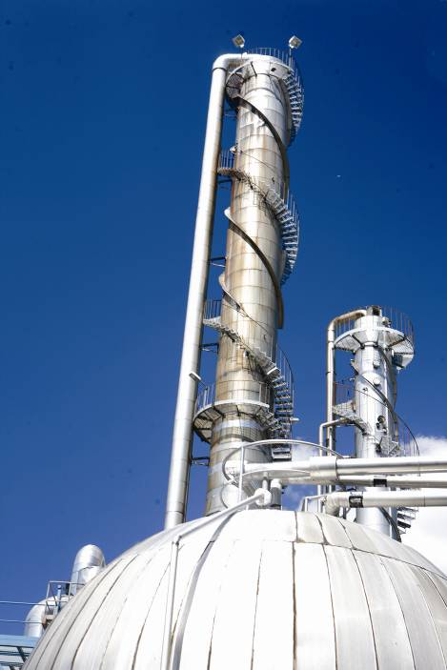
Characteristics of typical specialty chemicals plants
Synthesis (reaction) followed by a large number of separation steps.
Reaction is often batch-wise, and separation continuous.
Separation can be a number of sequential distillations, evaporations, crystallizations, filtrations, centrifuges, decanters, etc.
High value side streams (byproducts); many recycle loops
  The separation part of the plant is much more complex than the synthesis.
  Complex topologies
  Many internal buffers
Plants operate 24/7
Controlled by computerized control systems
Products are liquid, solid or gas

Slide 6
Topology for plant with multiple separations
(Loosely based on a true story)
Waste
Raw material 1
Raw material 2
Reaction
Separation
Separation
Product 1
Raw material 3
Waste
Bagging
Product 3
Separation
Separation
Product 2
Main product
Bagging

Slide 7
In reality, much more complicated
How many throughput manipulators?
What is the production rate?
What does ”shutdown” mean ?

Slide 8

The Perstorp group – short facts
Specialty chemicals company with focus on organic chemistry
  Turnover 2015: ~1200 MEUR
  Profit 2015: ~180 MEUR
  Main owner: PAI Partners, a French equity company
  1500 employees
Products: Mainly additives for other chemical industries
  Additives in paints and coatings, plastic-processing and automotive industries
  Thermoplastics, plasticizers, solvents, bleaching agents, etc
but also end products like feed additives and bio-diesel.
Global Technology has a group of 4-5 people working full time on
proces control and industrial IT.

Slide 9
Nine production sites
Bruchhausen
Castellanza
Gent
Stenungsund
Perstorp
Toledo
Warrington
Waspik
Zibo
Totally ca 40 plants ~50 000 variables ~5 000 control loops

Slide 10
Degrees of freedom

Slide 11
Catalytic incineration of VOC
5 manipulated variables
11 process variables
What to control? How?
TT
05
Atmosphere
Electric heater
TT
12
Heat exchanger
TT
13
TT
16
TT
11
Reactor
Variable speed fan
TT
01
Atm.
TT
03
PT
15
TT
02
FT
14
Waste gases from
reactor, distillation, evaporation, vacuum system etc
TT
04

Slide 12
DoF central concept in PWC
Control engineering point of veiw: Number of independent manipulated variables
  Typically: number of valves. Causality important.
Chemical engineering point of view: Number of independent variables in steady state
The number of controlled variables = number of DoF
Differ between dynamic and static DoF
  Inventories have to be controlled. Each one consumes a dynamic DoF.
  The remaining ones quantify the static behavior of the process.
Most expositions lack a rigorous mathematical definition.
  This should be possible using algebraic concepts, such as transcendence degree of extension fields.

Slide 13
Different competencies for different levels in the structure
Closing a loop does not reduce the #DoF. We have to choose setpoint.
Moving DOFs upwards in the hierarchy requires several competencies.
Example 1
Example 2
LC.SP
TC.SP
Buffert optimization
Process engineer
Crystallization theory
Process engineer
LC
TC
Cascade control
Control engineer
PI-controller
Control engineer
FC
Valve
PI-controller
Control engineer
Valve

Slide 14

Aspects of
Plant wide control
The throughput
manipulator

Slide 15
Throughput manipulator determines production rate
A plant always has a variable that determines the troughput rate:
  It is normally a flow, the “master flow”. The “gas pedal”
  Called TPM = throughput manipulator
  If you have very large buffers between process areas, where level is not controlled, you may in fact have several TPMs.
The operator gives the setpoint for the TPM.
All other flows are given indirectly by the master flow, typically through level controls.
You have to select a variable that is TPM: the choice is either deliberate or inadvertent.

Slide 16
Choice of TPM: Bottle neck or minimum variation
The two most common ways of selecting which variable is TPM:
  The flow closest to the bottle neck.
  The flow most important to keep constant.
Reason: The TPM flow will be the “most constant” one.
If no thought is given to the choice, then often the first flow in the plant becomes TPM.

Slide 17
Unconsidered choice of TPM gives suboptimal operation
Example: In a plant the feed of reactant 1 was chosen as TPM.
The filtration step is the bottle neck.
Which variable should be master flow in order to give maximum production with minimum number of SP changes?
Operator SP
Reactant 1
FC1
Reactor
Post
reaction
Filtration
Storage
FC3
FC4
FC5
Reactant 2
FC2

Slide 18
Solution: Filter feed = TPM
The setpoint for the filter feed flow is set by operator / plant manager.
Other flows are a consequence of level controls or similar.
Operator SP
Reactant 1
FC1
Reactor
Post
reaction
Filtration
Storage
FC3
FC4
FC5
Reactant 2
FC2

Slide 19
Inventory controls; real example
Four tanks in series. One thruput manipulator (TPM). Level controllers.
The ”radiating rule” gives the control topology below.
TPM
2
3
4
FC1
1
FC2
FC3
FC4
FC5

Slide 20
Radiating rule is not mandatory
The topology below will also work.
  Easy to realize that the entire process can be stabilized using only PI controllers.
Disadvantage: LC2 won’t work if LC1 is in manual.
However, it has an advantage too...
TPM
2
3
4
FC1
1
FC2
FC3
FC4
FC5

Slide 21
FC1 sometimes fixed
At times, the operator needs to run flow 1 with fixed SP.
Since tank 1 is much smaller than tank 2, it is easier to handle the process if level 1 is still controlled automatically, and FC1 is used to manually control level 2.
TPM
TPM
2
3
4
FC1
1
FC2
FC3
FC4
FC5
TPM
TPM
2
3
4
FC1
1
FC2
FC3
FC4
FC5

Slide 22
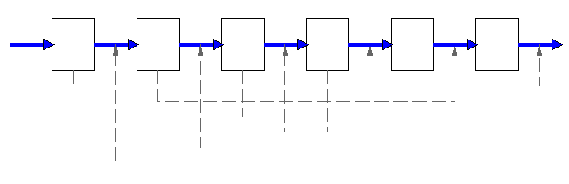
This can be made to work too...
...meaning all levels can be stabilized using only PI-controllers.
TPM

Slide 23
Even this ”works”
But not if both LCs are PI-ctrl. One has to be a PID.
Maybe this can be made into a general indicator?
  If you can’t stabilize the plant without resorting to using derivative action, the structure is not ”good”.
TPM
FC1
FC2
LC1
LC2

Slide 24
TPM selection and consistency
How many of the flows can be set independently?
Which combinations of flows?
FC
FC
FC
FC
FC
FC
FC

Slide 25
This works
TPM
q₀
LC
LC
FC
FC
FC
q₁
FC
FC
LC
FC
FC
q₂
LC

Slide 26
This is inconsistent
TPM
TPM
FC
FC
FC
FC
TPM
FC
FC
FC

Slide 27
This is also inconsistent
TPM
FC
FC
FC
FC
TPM
FC
TPM
FC
FC

Slide 28
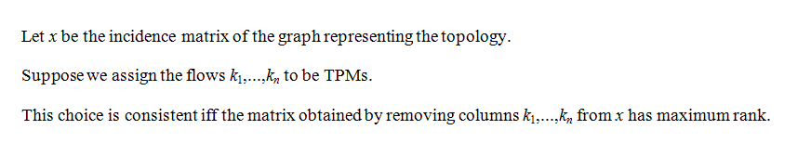
Algorithm for finding all consistent schemes
q₁
1
q₂
2
q₃
q₄
q₅
3
q₆
q₇
4

Slide 29
Most plants have several TPMs
This is possible because there are intermediate buffers inside the plant.
An indicator of this is that there is a large number of setpoint changes for some of the flows.
  Visible e.g. in operator action statistics.
Why not have a completely automated plant where buffer levels are controlled automatically (by P-controllers)?
  ”Bullwhip” effect
  Difficult to foresee all possible scenarios

Slide 30
An overlooked issue in TPM selection
The choice of TPM affects the precision in production planning:
  If the TPM is located far away from the point where production is measured, it becomes more difficult to adhere to the production plan.
  Plant management / operator has to guess what “speed” to choose in order to produce the right number of tons.
Tons produced
TPM setpoint

Slide 31
PWC issues should be included in control projects
The plant-wide control strategy is a very important tool for making a plant operate efficiently.
  Degrees-of-freedom analysis for enumerating all possible PWC schemes
  Thruput manipulator selection
Unfortunately PWC is often not taught in courses.
  Somehow falls between chemical engineering and control theory.
Process engineers rarely use a systematic approach to choose PWC strategy.
But ”PWC thinking” should be a part of all investment projects and control projects.

Slide 32
Control
specifications

Slide 33
Specifying control objectives
Examples of control specifications are
  Keep the PV as close as possible to the setpoint when there are disturbances, while not moving the MV too much.
  The controller should be possible to run in Auto during startups.
  Minimize outlet flow variations while keeping the level within some limits.
  Maximize reactor throughput while keeping temperature within limits.
It is often hard to obtain a scientific description of the control objectives.
  There may be implicit requirements.
Control engineers don’t always have a deep understanding of the process.
Process engineers are normally not used to specifying control objectives.
  What are constraints and what is target function?

Slide 34
Example: Split flow
Liquid (incompressible) flow. The total flow is controlled by FC1.
  Introduce a way to split the flow between stream 1 and stream 2.
  Of course, controlling both flow 2 and flow 3 is impossible.
FC1
FT
FT2
Stream 1
FT3
Stream 2

Slide 35
Simple solution: ratio control
Traditional ratio control (below) lets the operator specify flow 3 as a factor of flow 2. FV2 is fixed (but not closed).
  This solution was not accepted by operational staff.
  They sometimes have to set flow 2 as a factor of flow 3.
  Total pressure drop should be as small as possible
Which structure can we use now?
FC1
FV2
FT
FT2
x
Ratio entered
by operator
FC3
FT3
FV3

Slide 36
This solves the split control problem
FC1
FV2
FT
FT2
PV
+
x
FC4
OP
SP
Desired
split
0-1
FT3
FV3
Desired split FT2/Total is entered by the operator

Slide 37
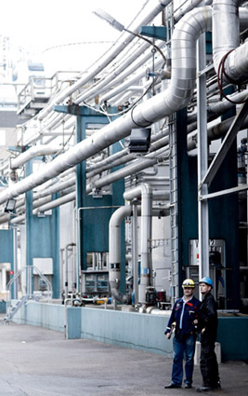
Some things should be left to the operators
Complex control solutions make it hard for the operator to know which situations are handled automatically.
Sometimes the control solution does not cover all the scenarios that the operator has to handle.
  Some requirements were forgotten in the specifications.
More automation may increase the cognitive load on the operator.
Compare: Adaptive cruise control

Slide 38
Thank you!

