Slide 1

Dark data: The use of sensor data in process monitoring and control
LCCC Process Control Workshop
September 28-30, 2016
Margret Bauer
School of Electrical and Information Engineering
University of the Witwatersrand
South Africa

Slide 2
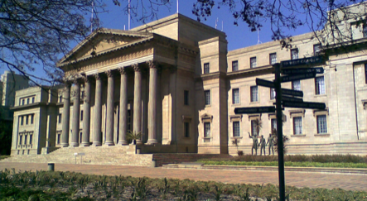
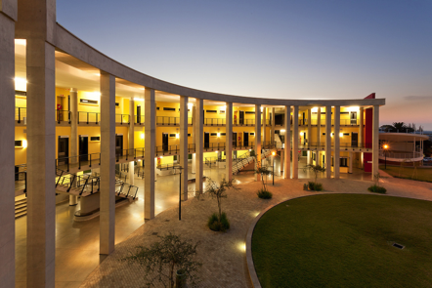
Wits
One of the oldest Universities in South Africa, founded in 1896
Rooted in the mining industry
Most famous student: Nelson Mandela
Famous control engineers: David Limebeer (Oxford), David Mayne (Imperial College), Anthony Bloch (University of Michigan)

Slide 3

What is Dark Data?
Dark Matter
Unidentified type of matter that has not been observed yet, and does not give of or reflect light.
100101010100001011110101010101010101010010101
010101101110101010010101010100101010111110101
100000111110101101011110101011010111010011101
101010101010101010101011101010101010101100010
Dark Data
Information assets organizations collect, process and store during regular business activities, but generally fail to use for other purposes.
http://www.gartner.com/it-glossary/dark-data/

Slide 4

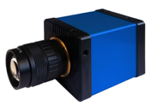
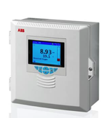
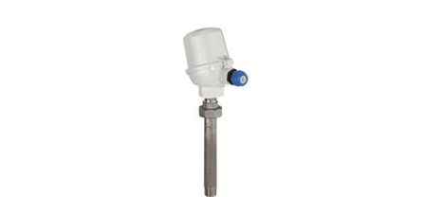
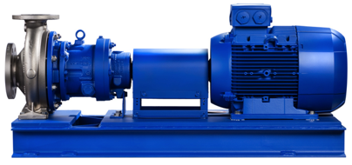


Some sources that generate data in an industrial process
Video
cameras
PLC and DCS status: Overload, hard disk, speed
FC
Control data: Output, setpoint
MPC trajectory
Analyzers
(e.g. pH)
Process
measurements
Temperature
Flow
Pressure
Level
Alarm limits (L, LL, H, HH)
Switches
Condition
monitor
Electrical measurements
Valve position

Slide 5

What happens to the process measurement data?
Field device
Display only
Connected to DCS
50%
50%

Slide 6
What happens to the process measurement data?
Field device
Display only
Connected to DCS
50%
50%

Slide 7
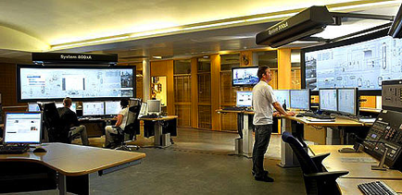
What happens to the process measurement data?
Field device
Display only
Connected to DCS
50%
50%

Slide 8

What happens to the process measurement data?
Data base
i.e. process historian/
Operational historian
Field device
Display only
Connected to DCS
50%
50%

Slide 9

What happens to the process measurement data?
Data base
i.e. process historian/
Operational historian
Field device
Display only
Connected to DCS
50%
50%

Slide 10




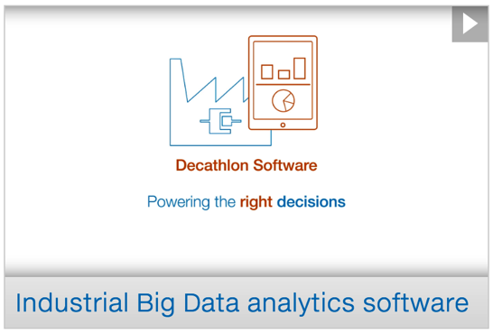

Is this Big Data?
Wikipedia: Big data is a term for data sets that are so large or complex that traditional data processing applications are inadequate. Volume, Variety, Velocity, Veracity (Uncertainty)
“Before the term Big Data was being used as part of the Internet of Things, plant historians were handling large volumes of time-synchronized data.”
B. Lydon, ISA InTech Magazine Jan/Feb 2015 https://www.isa.org/intech/20150201/

Slide 11
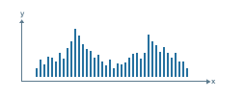
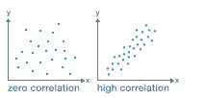
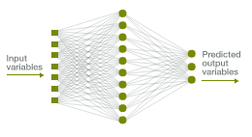
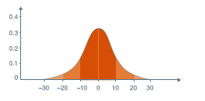
How to get value out of dark data:
Big data analytics
Correlation analysis
Data visualization
Artificial neural networks
Significance testing
http://www.mckinsey.com/business-functions/operations/our-insights/how-big-data-can-improve-manufacturing

Slide 12

How to get value out of dark data:
Big data analytics
Correlation analysis
Data visualization
Artificial neural networks
Significance testing
http://www.mckinsey.com/business-functions/operations/our-insights/how-big-data-can-improve-manufacturing

Slide 13
How to get value out of dark data
Providing context for the
DATA
Providing context for the
PROBLEM
Notes:
Following from this, it is clear that we first of all need to look at the question. I will refer to this as the context for the problem. There is a second aspect which assists in getting value out of dark data and this is to provide context for the data. In the following slides I will elaborate on both propositions.

Slide 14

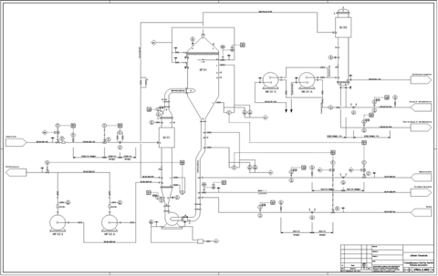
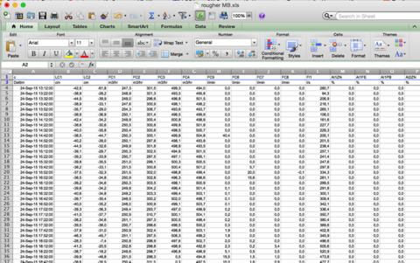
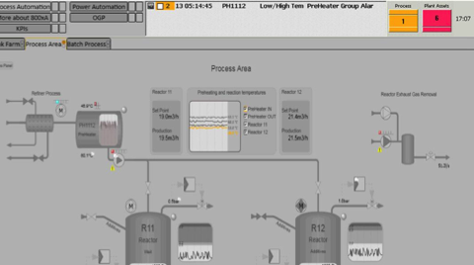
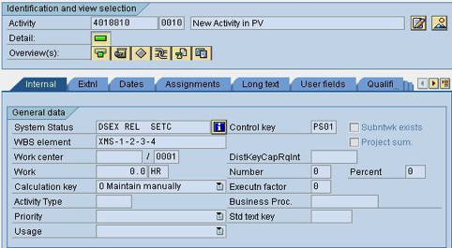
Providing context for DATA
P&ID
Maintenance information

Slide 15



Providing context for DATA
Expert knowledge
P&ID
Maintenance information
95
5.1

Slide 16



Context of PROBLEM: Objectives of plant operation
Safety
Safety
Safety
Efficiency
Efficiency
Efficiency

Slide 17


Some problems we can solve with ‘Dark Data’ today
Root cause analysis
Alarm management
Control performance monitoring (CPM)
Controller tuning
Sensor validation
FC
Process modeling
Batch process monitoring
Plant asset management
Energy management

Slide 18

Control loop performance monitoring: What can we find in the dark data?
Process variable
Controller output
Saturation
Oscillation
Manual control
Sluggish
Nonlinear
Quantization
Bauer, M., Horch, A., Xie, L., Jelali, M. and Thornhill, N., 2016. The current state of control loop performance monitoring–A survey of application in industry. Journal of Process Control, 38, pp.1-10.

Slide 19

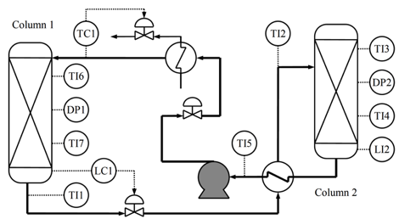


Plant-wide root cause analysis
Bauer, M., Cox, J.W., Caveness, M.H., Downs, J.J. and Thornhill, N.F., 2007. Finding the direction of disturbance propagation in a chemical process using transfer entropy. IEEE transactions on control systems technology, 15(1), pp.12-21.

Slide 20


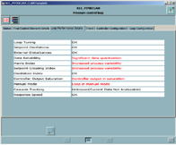


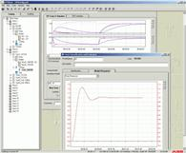




Control loop performance monitoring at ABB
Alf Isaksson
ABB
Nina Thornhill, Secondment at ABB
ABB/RAE Research Chair since 2007
Margret Bauer
PhD, ABB
CPM on DCS 800xA
Alexander Horch
PhD, ABB
2015
2000
2005
2010
2015
Service Port
OptimizeIT
Loop Performance Manager
Nunzio
Bonavita
Kevin
Starr
Patric Boo
Horch, A., Cox, J. W., & Bonavita, N. (2007). Peak performance- root cause analysis of plant-wide disturbances. ABB Review, (1), 24-29.
Starr, K. (2012). Expert access – anytime, anywhere. ABB Review (2), 12-17.
Boo, P. (2015). A service tool grows up. ABB Review (1), 27-31.

Slide 21
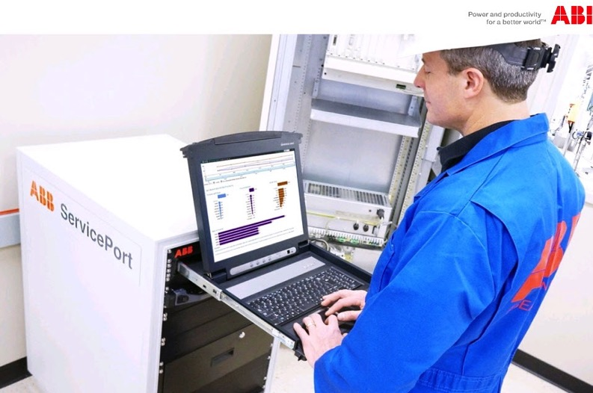
ABB’s Service Port – what’s new
It’s not the algorithm…
On site PC and off-site notifications
Considers workflow, i.e.
  Initialization
  Training
  Target setting
  View, Scan, Track
KPI representation
➔ 5,000+ installations
Starr, K. D., Petersen, H., & Bauer, M. (2016). Control loop performance monitoring–ABB’s experience over two decades. IFAC-PapersOnLine, 49(7), 526-532.

Slide 22
Industrie 4.0: Changing requirements for control engineering
Industrie 2.0
1870: Mass production, electricity
Industrie 3.0
1969: Computer & automation
Industrie 4.0
2010: Internet of Things, Cyber Phyiscal Systems
IT
Mechanical
Mechanical
IT
Mechanical
Mechatronics
Electrical
Electrical
Electrical
Pneumatic control
Digital control
?
Graphic based on Kunschert & Glaser, VHS4Business Thementag Industrie 4.0, 2015

Slide 23
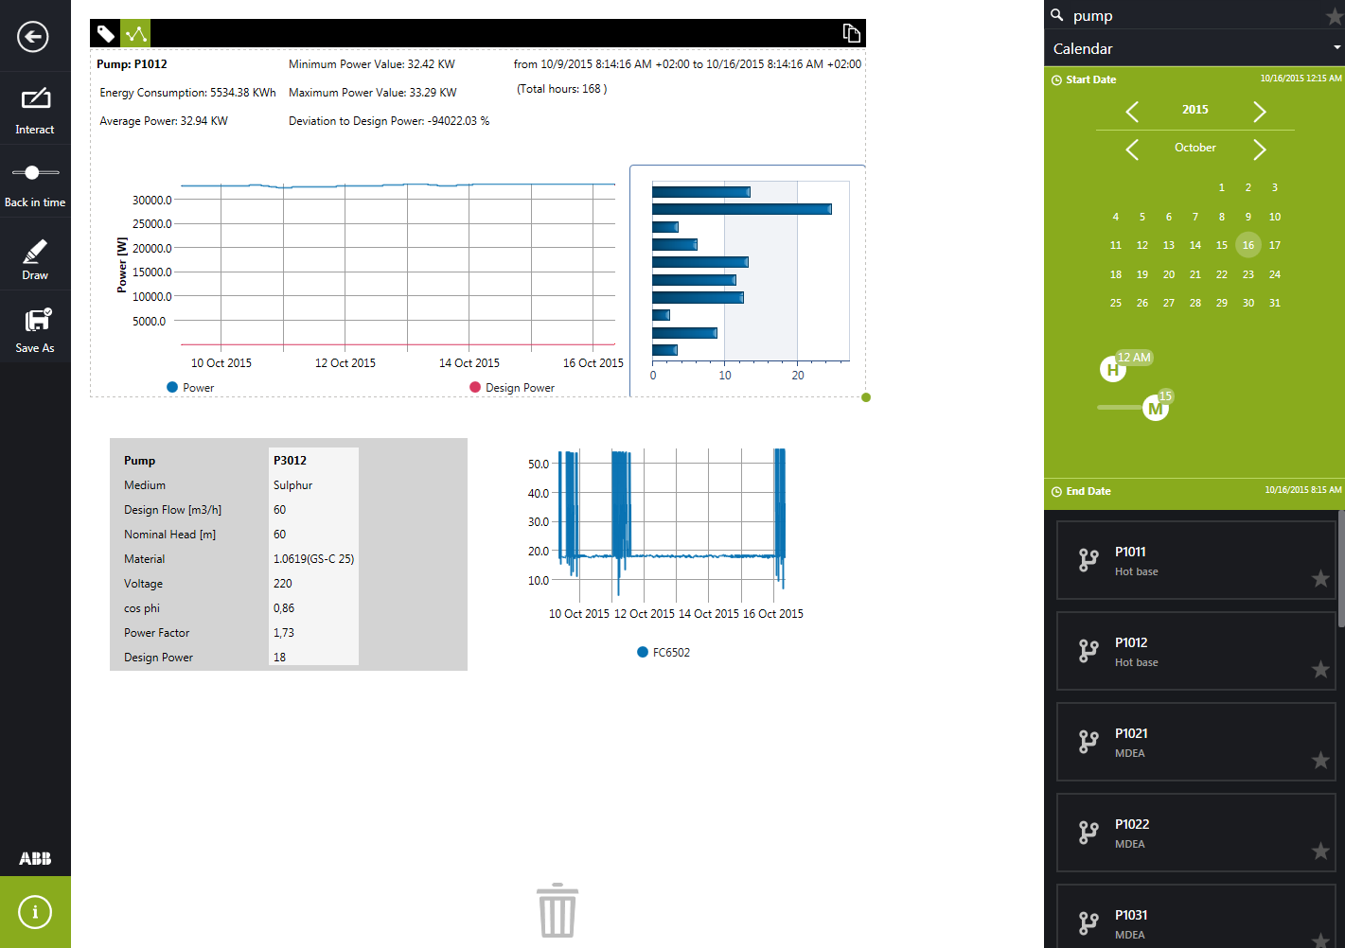
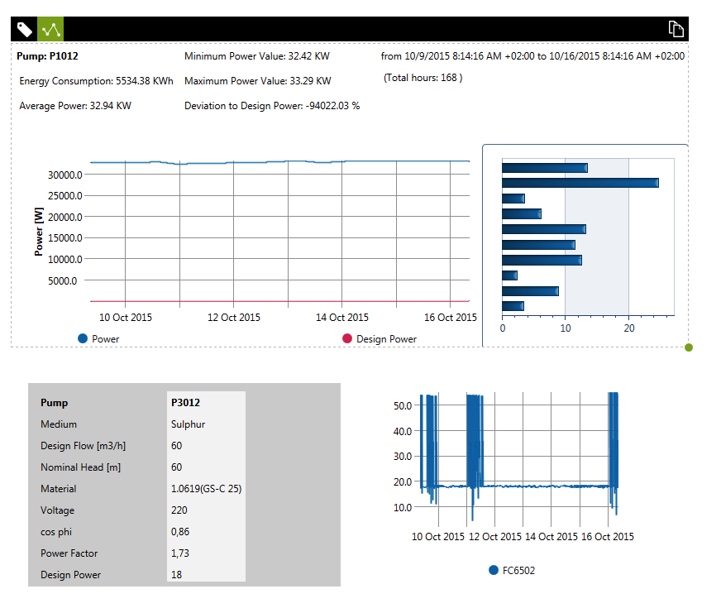
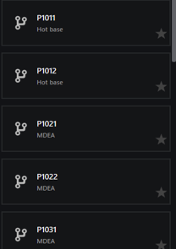
ABB’s DECATHLON SERVICES
Contact: Christian Johansson, christian.johansson@se.abb.com (ABB Malmö)
Bauer, M., Schmidt, W., Schlake, J., Larsen, P. and Johansson, C., 2016. Integrating IT and OT. Leveraging operational technology integration with Decathlon Services. ABB Review (2), 60-67.

Slide 24

No (big, dark) data analysis without
Context for DATA and
Context of the PROBLEM
Consider the workflow when developing solutions
Control engineering is moving towards IT
Thanks to: Kevin Brooks, Alexander Horch, Christian Johansson

